Slide 1

Saints: Inspiring People of Faith
Diocese of Kerry Resource

Slide 2
Learning Outcomes for Junior Cycle
1.5
1.8
2.8
3.4

Slide 3
Success Criteria
Be
You will be able to:
Explain
Explain why some people are declared saints
Present
Present the story of the life of one saint
Describe
Describe how a saint has had a positive impact on the lives of people because of their commitment to living out their beliefs

Slide 4

Lesson 1

Slide 5
Keywords
Saint
Canonisation
Martyr
Missionaries

Slide 6
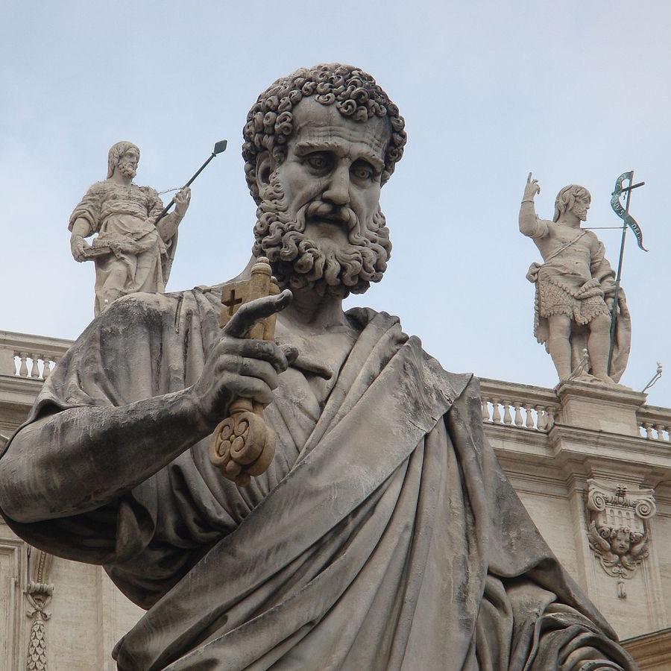
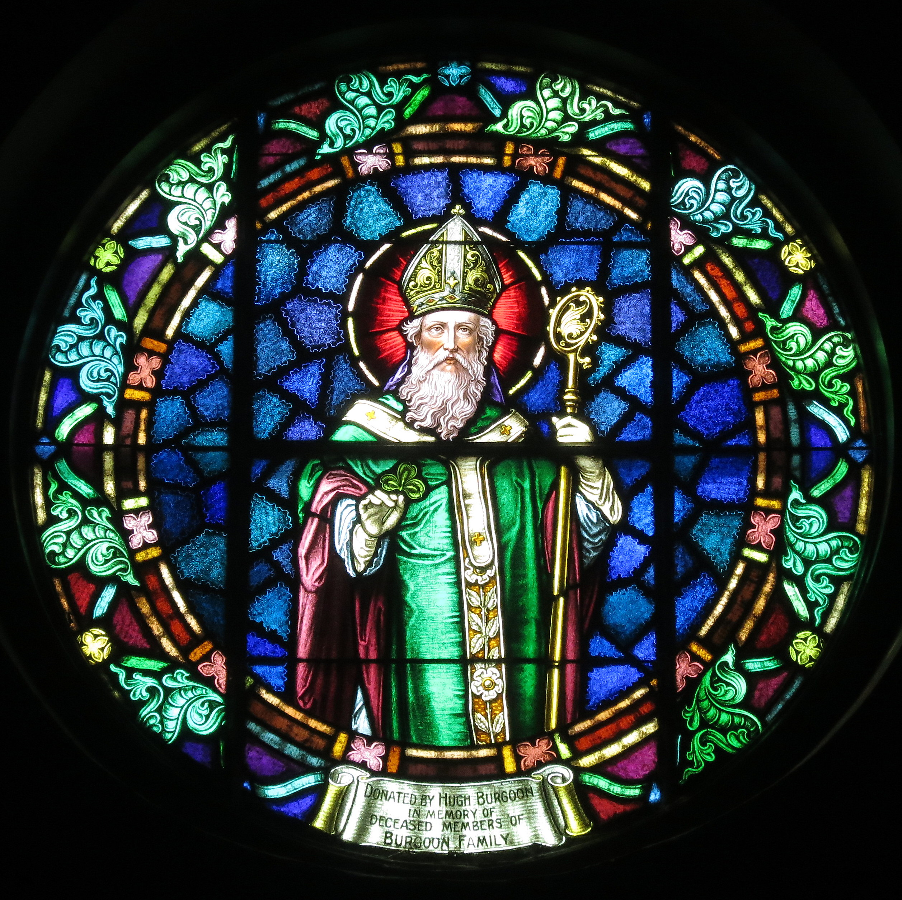
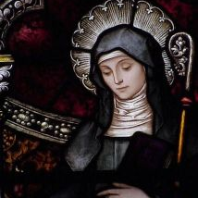
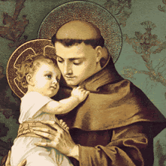
Saint
Someone believed to be a good example to others because of what they did when alive and who is now in heaven with God
This Photo by Unknown author is licensed under CC BY-SA.
This Photo by Unknown author is licensed under CC BY-SA.

Slide 7
Canonisation
To be declared a saint
https://youtu.be/kQuqxe5uPhQ

Slide 8
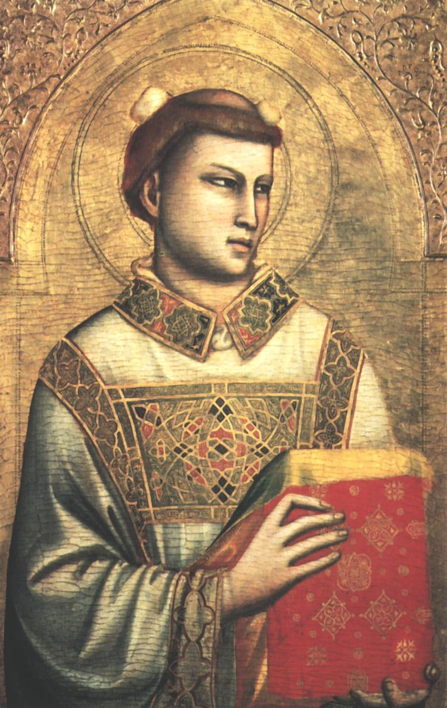
Martyr
Someone who died for their faith

Slide 9
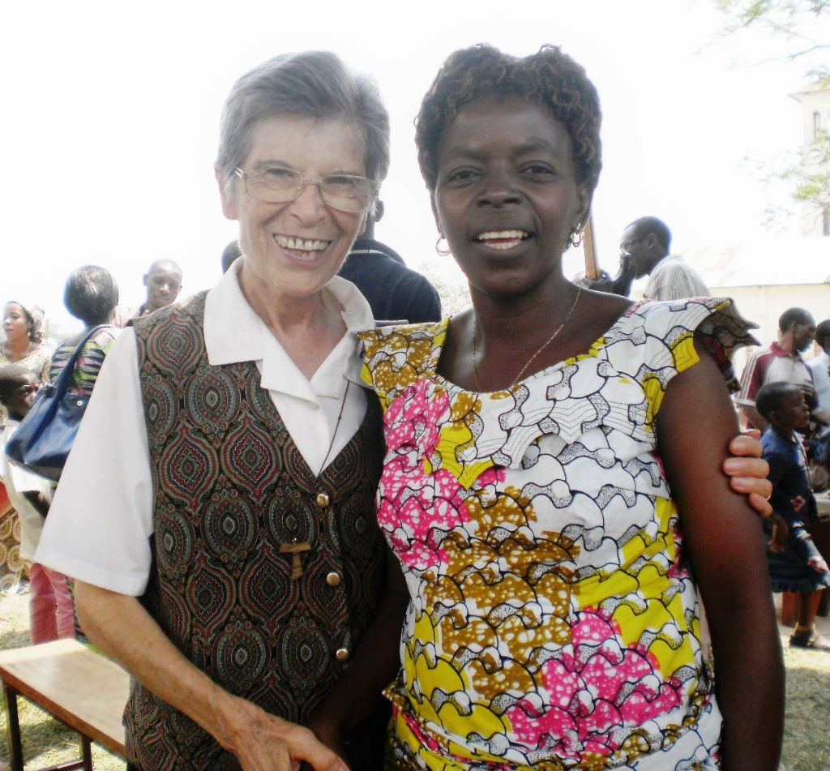
Missionaries
Members of a religion who are sent into an area to share their faith and be of service
This Photo by Unknown author is licensed under CC BY-NC-ND.

Slide 10
Groupwork -
Choose one of the following people
Suzanne Jackson
Chrstiano Ronaldo
Selena Gomez
Kylie Jenner
Beyonce
Lionel Messi

Slide 11
Discuss and share your thoughts
What are they famous for other than Instagram posts?
1
Why would someone choose to follow them on Instagram?
2
How might they try to influence their followers?
3
Do you think they have a positive or negative influence on their followers?
4

Slide 12

Think, Pair Share
Who else can influence us in our lives?

Slide 13

The Pathway to Sainthood

Slide 14
Christian Saints
In Christianity, a saint is someone believed to be a good example to others.
A person can only become a saint after they have died.
Christians are declared an official saint because they lived out their Christian faith on earth in a way that had a positive impact on the world.
The faith of Saints through good and bad times can inspire people. Saints often showed or spoke out about the importance of prayer in their lives.
There were thousands of Saints and they lived all over the world.
Some Christian Saints are shared among all the different Christian denominations will stop
Today in the Catholic Church new saints are regularly canonized by the Pope.

Slide 15
Becoming a saint.
https://youtu.be/d97Vn7q2n3I
Watch the You Tube clip and find the answer to the question you were assigned.
Each person will be given a number. Find the answer to the question number you were given while listening to this clip.

Slide 16
Questions – Take down your question and get ready to answer it!
1. How many steps are there in the process of becoming a saint. Name each step.
2 How many miracles are normally required after the person has died?
3 What requirements are needed for the miracle to be accepted?

Slide 17
Lesson 2

Slide 18
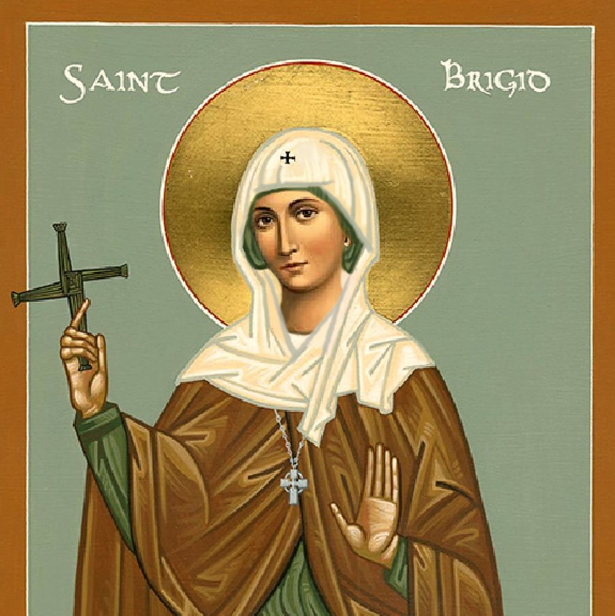
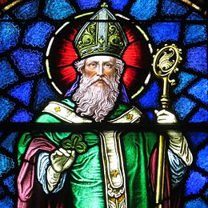
Patron Saints
This Photo by Unknown author is licensed under CC BY-SA.

Slide 19
Patron Saints
For example Saint Patrick is the patron Saint of Ireland because he brought Christianity to Ireland.
When someone is recognized as an official saint their remains are called relics and are usually kept in churches.
Someones personal belongings may also be used as relics.
An official saint also has a feast day to remember them for example 17th of March is the feast day of Saint Patrick and the 1st of February is the feast day of Saint Bridget.

Slide 20
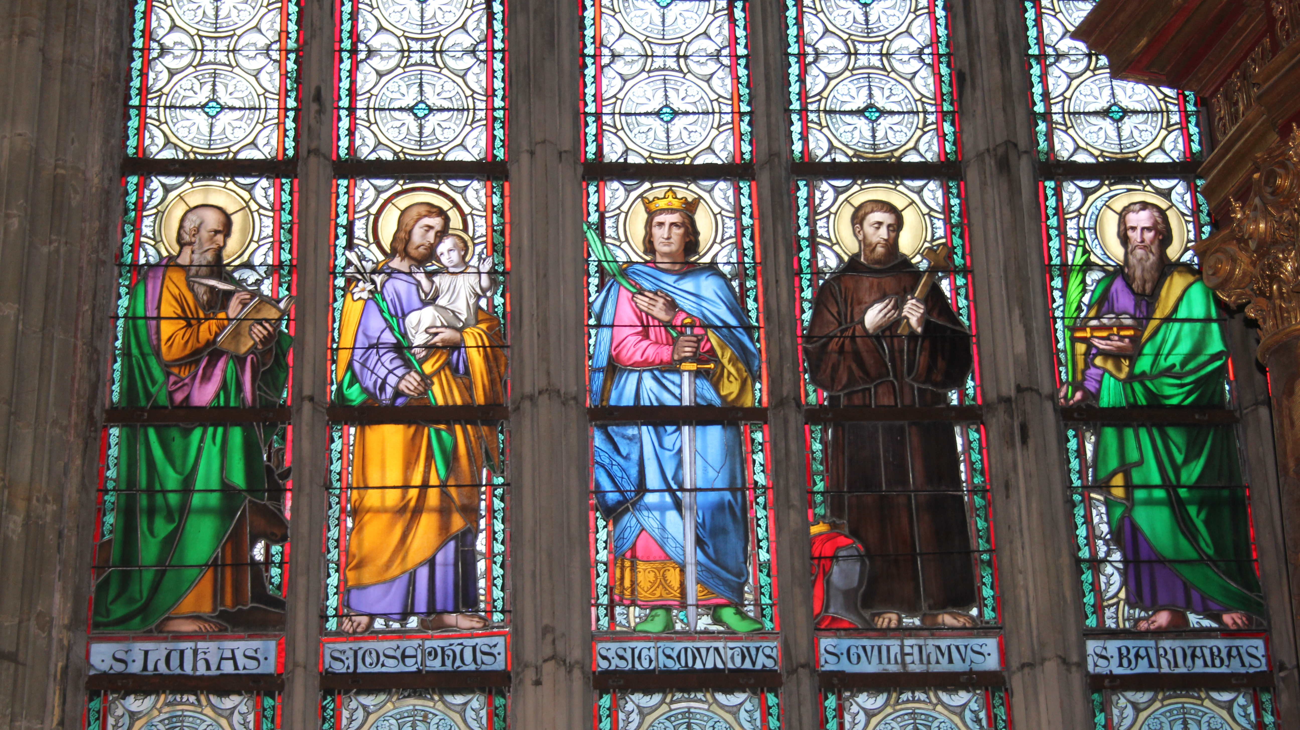
Christian Saints
This Photo by Unknown author is licensed under CC BY-SA.

Slide 21
The Influence of Christian Saints
The influence of Christian Saints around the world is often evident in place names.
In Spanish place names begin with San for males or Santa for females for example San Francisco means Saint Francis.
The influence of saints can be seen in different ways at different times. Some are known around the world but others might be well known only in the country or part of the world where they lived.
Some saints were friends of Jesus while some lived more recently. Some were married some were single and some were popes, bishops, priests or nuns. Some were very rich and others were very poor.Many Saints are famous for their work with the poor or for providing education.
What they all have in common is that they tried their best to have a relationship with God by following the teaching of Jesus to love others.

Slide 22

Inspiring Christian Saints
NOT SUPERHEROES!!!!
When we examine the lives of Christian Saints we realized that they were not superheroes used special powers to stand up for truth and justice. They were ordinary people who made mistakes and some even questioned their faith in God.
However they managed to make an extraordinary difference during their lives. Perhaps this is the reason why they inspire people: they were not perfect they struggled to live out their beliefs but their commitment to faith had a positive impact on others.

Slide 23
Classwork/Homework
1 Why are some Christians declared official Saints? MUST
2 What is a relic? MUST
3 What do all saints have in common? MUST
4. Name three Christian Saints. MUST
5. What is a martyr? MUST
6. Why are Christian saints so inspiring? SHOULD
7. Choose one of the saints we looked at in class today and explain briefly why they are inspiring for people today. SHOULD
8. Name one Christian martyr and say what they are remembered for. COULD

Slide 24
Lesson 3

Slide 25
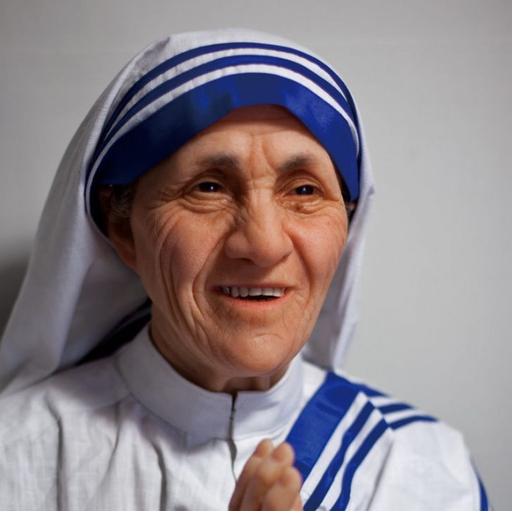
Mother Teresa
Profile of a saint: St. Teresa of Calcutta
https://youtu.be/mEZGjL1akt0
This Photo by Unknown author is licensed under CC BY.

Slide 26
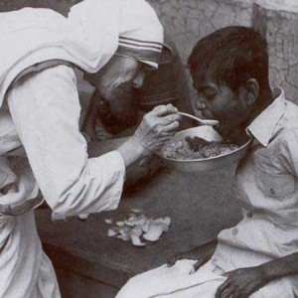
Mother Teresa
Born – August 26th 1910 in Skopje, Northern Macedonia
Died – September 5th 1997 in Kolkata (Calcutta), India
Best known for – devoting her life to working with the poor, the sick and the dying.

Slide 27
Early Life
Saint Teresa of Calcutta is best known as Mother Teresa but her birth name was Agnes. Her father died when she was eight and she was raised by her mother. She decided to devote her life to God at an early age.
When she turned 18, Agnes joined the Loretto sisters. She wanted to become a missionary in India before she could go there she had to learn English. She spent a year in Ireland learning to speak English at Loretto Abbey in Rathfarnham, Dublin before going to India. She never saw her mother or sister again after leaving home to become a missionary.
In 1931 agnostic reposes Anon and chose the name Teresa after a saint she loved - Saint Teresa of Lisieux. She taught for many years in India and eventually became the principal of a school in Calcutta.

Slide 28
Commitment to living out her beliefs
In 1950 she founded a new religious order called the missionaries of charity. She described the Missionaries of Charity as an organization that would take care of:
'the hungry naked at the homeless the crippled the blind the lepers of all those people can feel unwanted unloved uncared for throughout society people that have become a burden to the society and are shunned by everyone'

Slide 29
Classwork/Homework
1. What was Mother Teresa's name before she became a nun? MUST
2. (a) When and where was she born? MUST
(b) Where and when did she die? MUST
3. What religious order did she first join? MUST
4. Why did Mother Teresa come to Ireland? MUST
5. What order did Mother Teresa found? MUST
6. What was the goal of the order that she founded? SHOULD
7. What, do you think, inspired Mother Teresa to want to achieve the goal mentioned in Question 6? COULD

Slide 30
Lesson 4

Slide 31
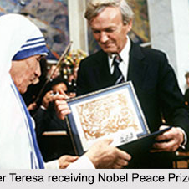
Living out her beliefs
When she started the Missionaries of Charity there were only twelve members. Today the group has thousands of members all over the world including in Ireland.
Mother Teresa received numerous awards for her charity work including the Nobel Peace Prize in 1979. Rather than have the traditional Nobel honor banquet she asked that the money for the banquet be donated to the poor of India.
https://youtu.be/I36Nistc9wE

Slide 32
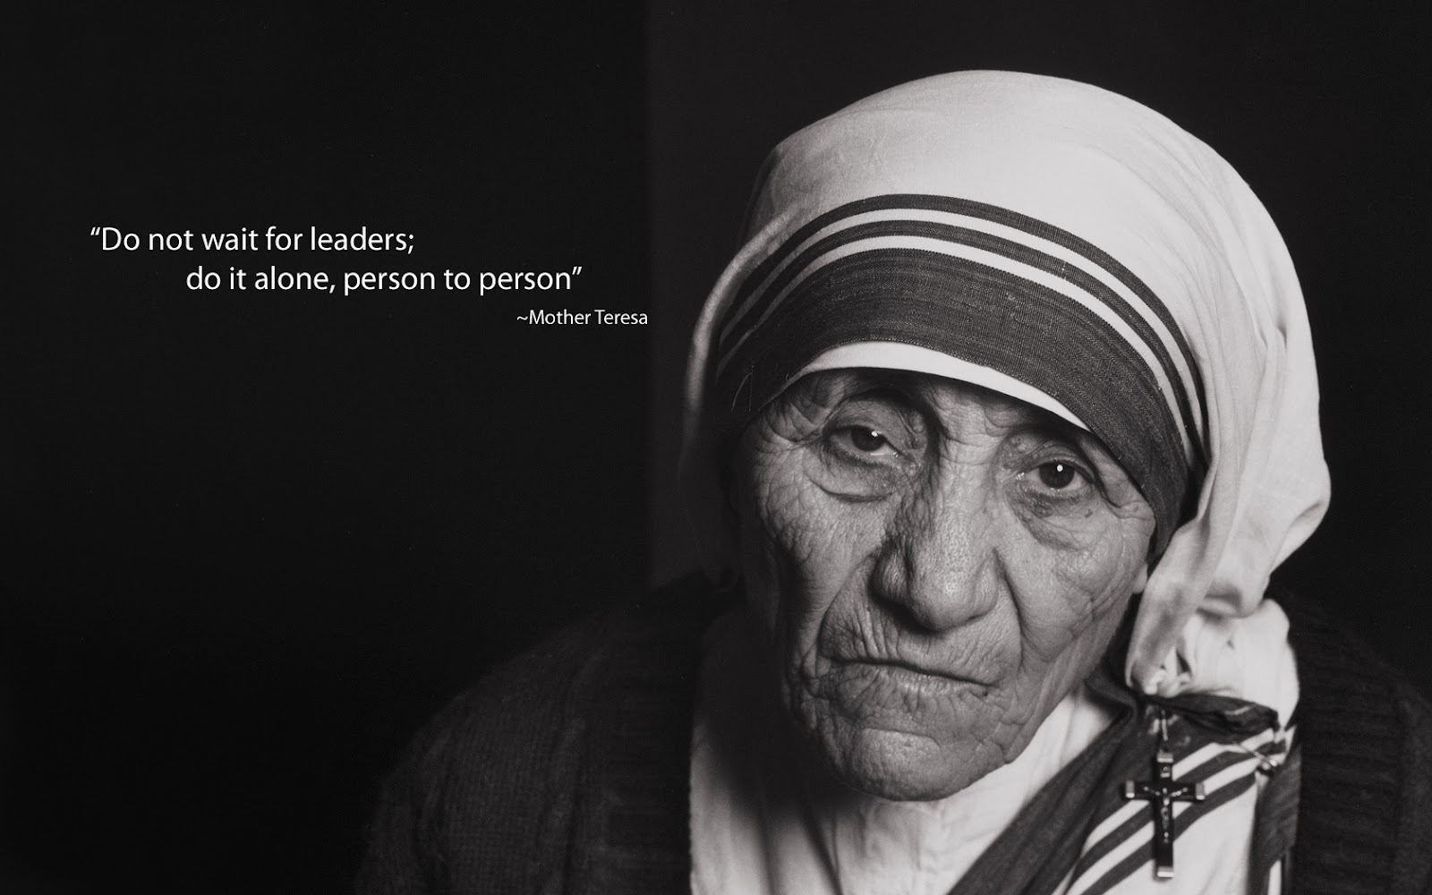
Challenges to her faith
Mother Teresa of Calcutta is a good example of how Saints have the same struggles in their journey of faith as everyone else. Even though she was doing her best to live a holy life from a young age she also experienced darkness doubts and loneliness when she felt abandoned by God. In spite of this she never stopped following her Christian calling and focused her life on her work for others.

Slide 33
Criticism and Controversy
Similar to other saints, Saint Teresa has faced criticism and controversy.
Some organisations have criticized the quality of medical care received by the poor and dying in the homes that she set up have also come under scrutiny.

Slide 34
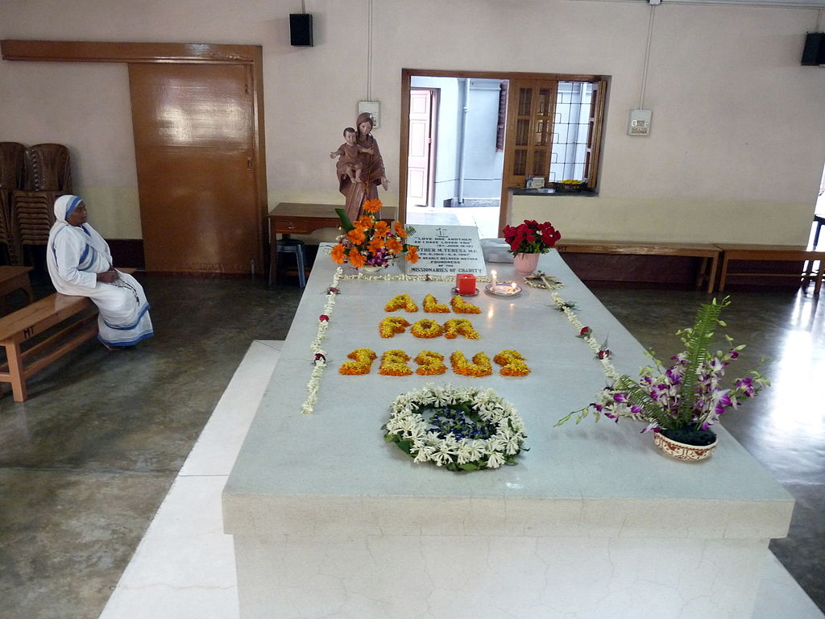
Positive Impact on the World
It is clear that Mother Teresa was not perfect but her commitments to live out her Christian beliefs had a positive impact on the lives of many people.
She worked tirelessly to care for the sick and dying who had been abandoned on the streets of Calcutta and worked almost up until her death on September the 5th 1997.
People now pray to her for guidance and strength and women continue to join the Missionaries of Charity order she set up. This order remains active throughout the world ministering to the sick hungry and forgotten.
Mother Teresa of Calcutta was canonized in 2016.

Slide 35
Inspiring Quotes of Mother Teresa
What can you do to promote world peace? Go home and love your family.
Not all of us can do great things. But we can do small things with great love.
Kind words can be short and easy to speak, but their echoes are truly endless.
Peace begins with a smile.
If you judge people, you have no time to love them.

Slide 36
Classwork/Homework
What prize did Mother Teresa win in 1979? MUST
What did she ask to be done with the money that came with the prize? MUST
When was Mother Teresa canonised? MUST
What struggles did Mother Teresa face? SHOULD
What criticism and controversy did she face? SHOULD
Describe the positive impact Mother Teresa has had on the world. SHOULD
Which quote of Mother Teresa's did you find inspiring and why? COULD
Mother Teresa once said The most terrible poverty is loneliness, and the feeling of being unloved – what do you think she meant by this statement? COULD

Slide 37
Lessons 5 & 6

Slide 38
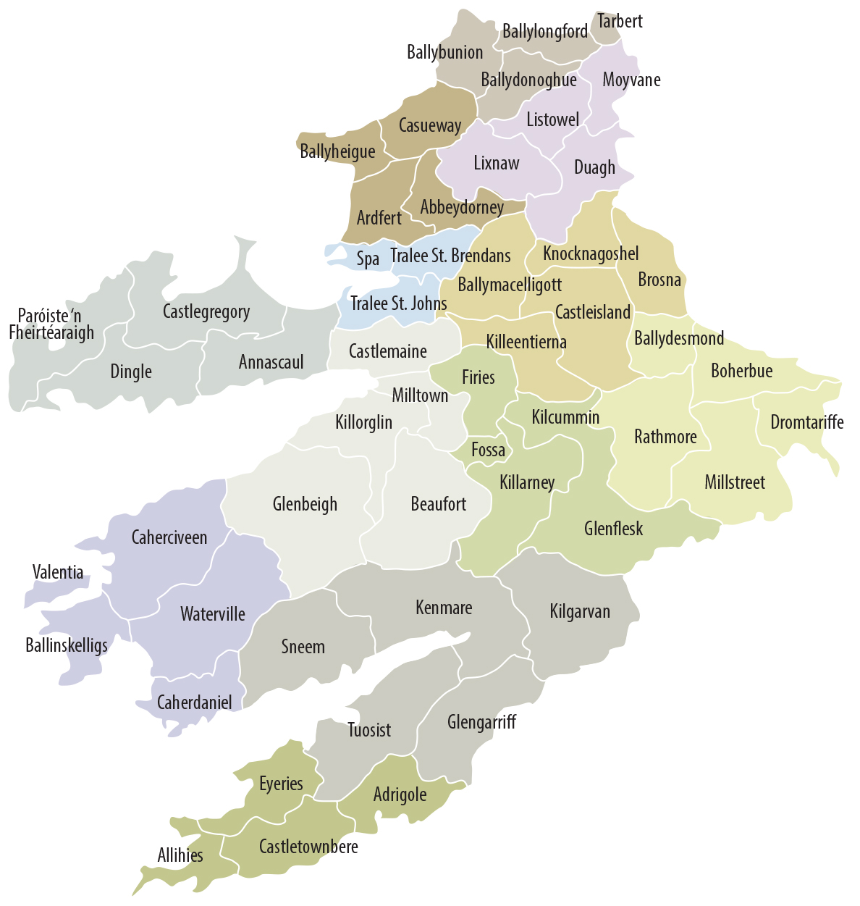
Saints of Our Diocese

Slide 39
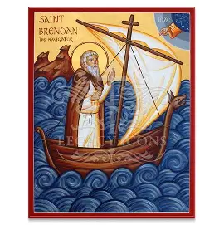
Saint Brendan
The Navigator
Patron Saint of boatmen; divers; mariners; sailors; travellers.
Feast Day: 16th May

Slide 40
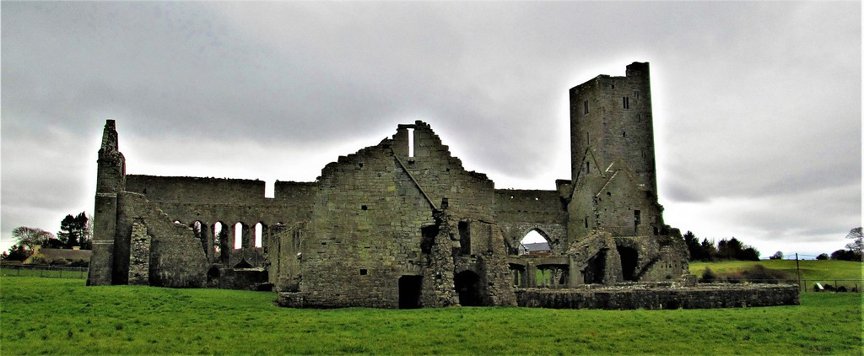
Who was Saint Brendan?
St. Brendan the Navigator (also known as Brendan of Clonfert) was born around 484 AD near Tralee, in County Kerry, Ireland.
: The area traditionally associated with his birth is Fenit, near Tralee Bay, County Kerry.Sometimes this area is referred to as Ardfert, where he later founded a monastery.

Slide 41
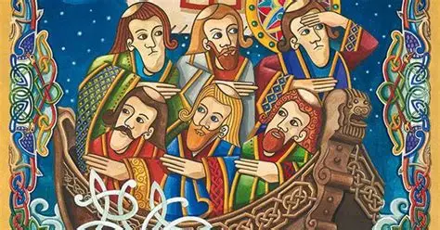
St Brendan’s Voyage

Slide 42
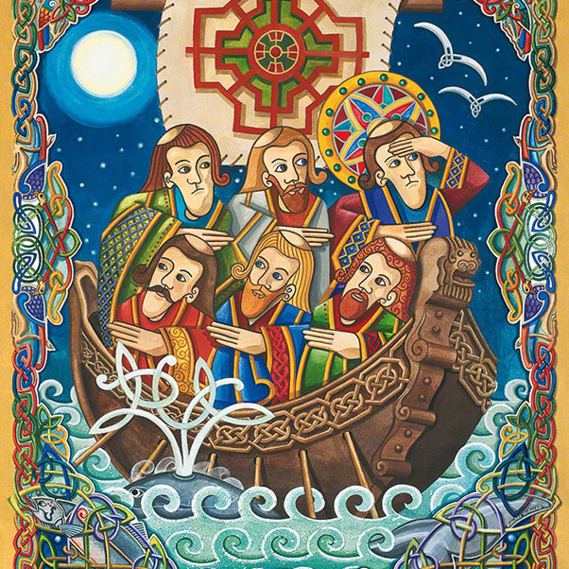
The Call to Adventure
Brendan was inspired by tales of a mystical land beyond the horizon, described as a paradise where the faithful would dwell. One day he heard a voice telling him to make a journeyGuided by visions and fueled by unwavering faith, he built a currach and assembled a small crew of about 14 men.
They sailed to Inismore, one of the Aran Islands to seek the blessing of St. Enda
Returning to Kerry they fasted an prayed for 40 days before loading the boat with enough food for six weeks and then set sail.

Slide 43
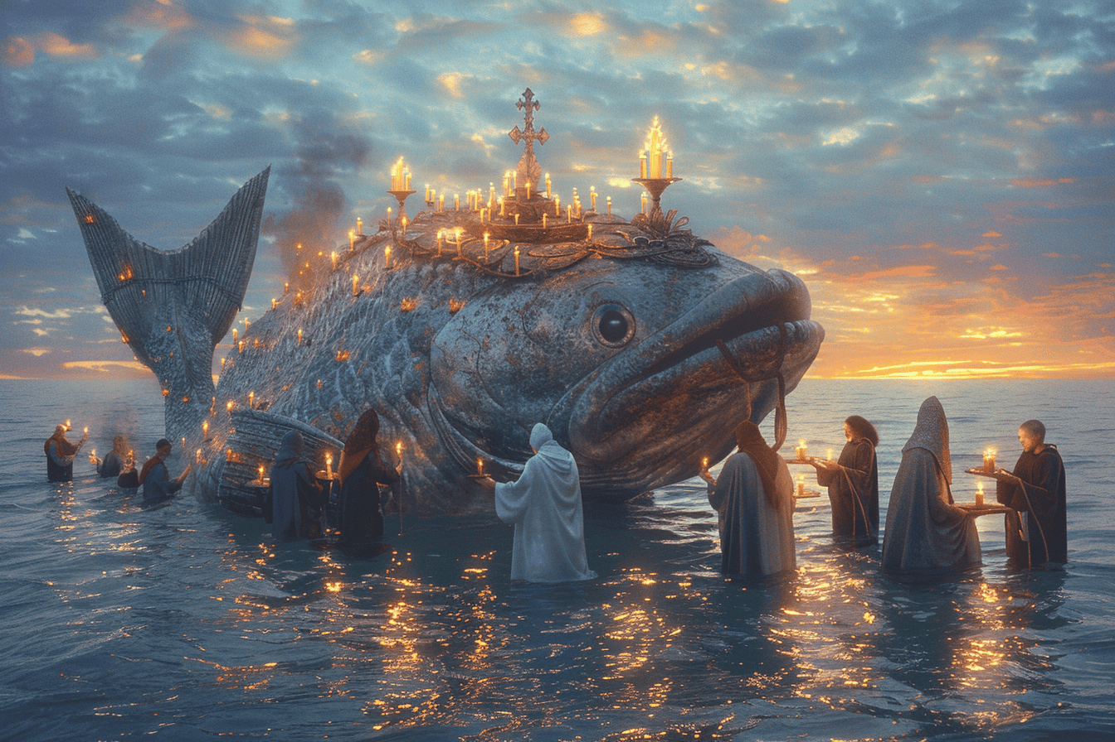
The Journey
The voyage was fraught with challenges and marvels:
Mermaids and Sea Creatures: The crew reportedly encountered strange aquatic beings, including a mermaid, now symbolic of the dangers and allure of the unknown.
Floating Islands: Some scholars suggest these could have been descriptions of icebergs or volcanic islands.
The Promised Land: After years of hardship, Brendan and his crew are said to have reached a lush, fertile land—speculated by some to be North America.

Slide 44
Over to you…..
Using your research skills investigate one of the following associated with St. Brendan’s Journey
Mythical Sea Creatures
Floating Islands
The Promised Land

Slide 45
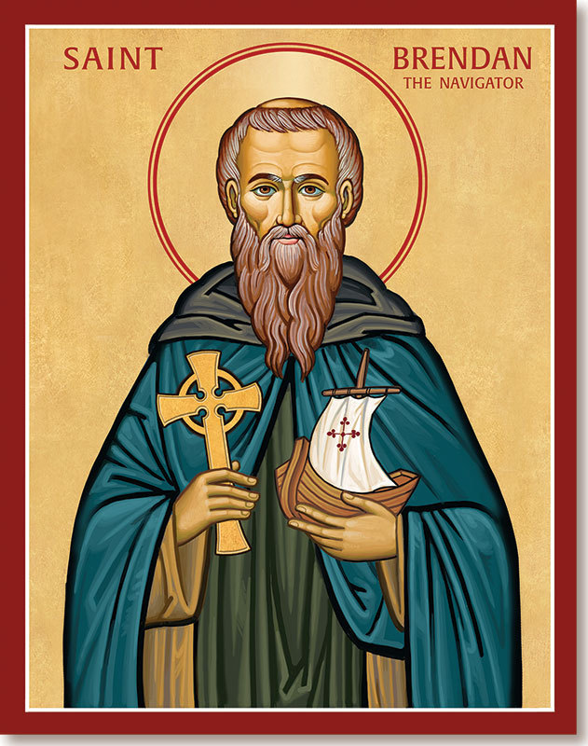
The Return
Brendan returned to Ireland, sharing his experiences and inspiring countless others with tales of his journey. His story became a cornerstone of medieval Irish literature and remains a source of wonder today.
St Brendan lived out his final days at a monastery he founded in Clonfert on the River Shannon.

Slide 46
The Re-creation of the Brendan Voyage.
In pairs see what you can find out about Tim Severin’s re-creation of the Brendan Voyage. These clips may help you.
https://youtu.be/qADZan1eojI?list=PLkAeSrJAngckQ51Tn5ht5wi5TvheUbsft
https://youtu.be/wB2EsZhzVtE
https://youtu.be/5wsaKiGw0Vw

Slide 47
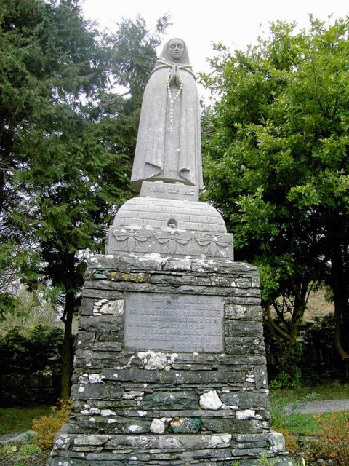
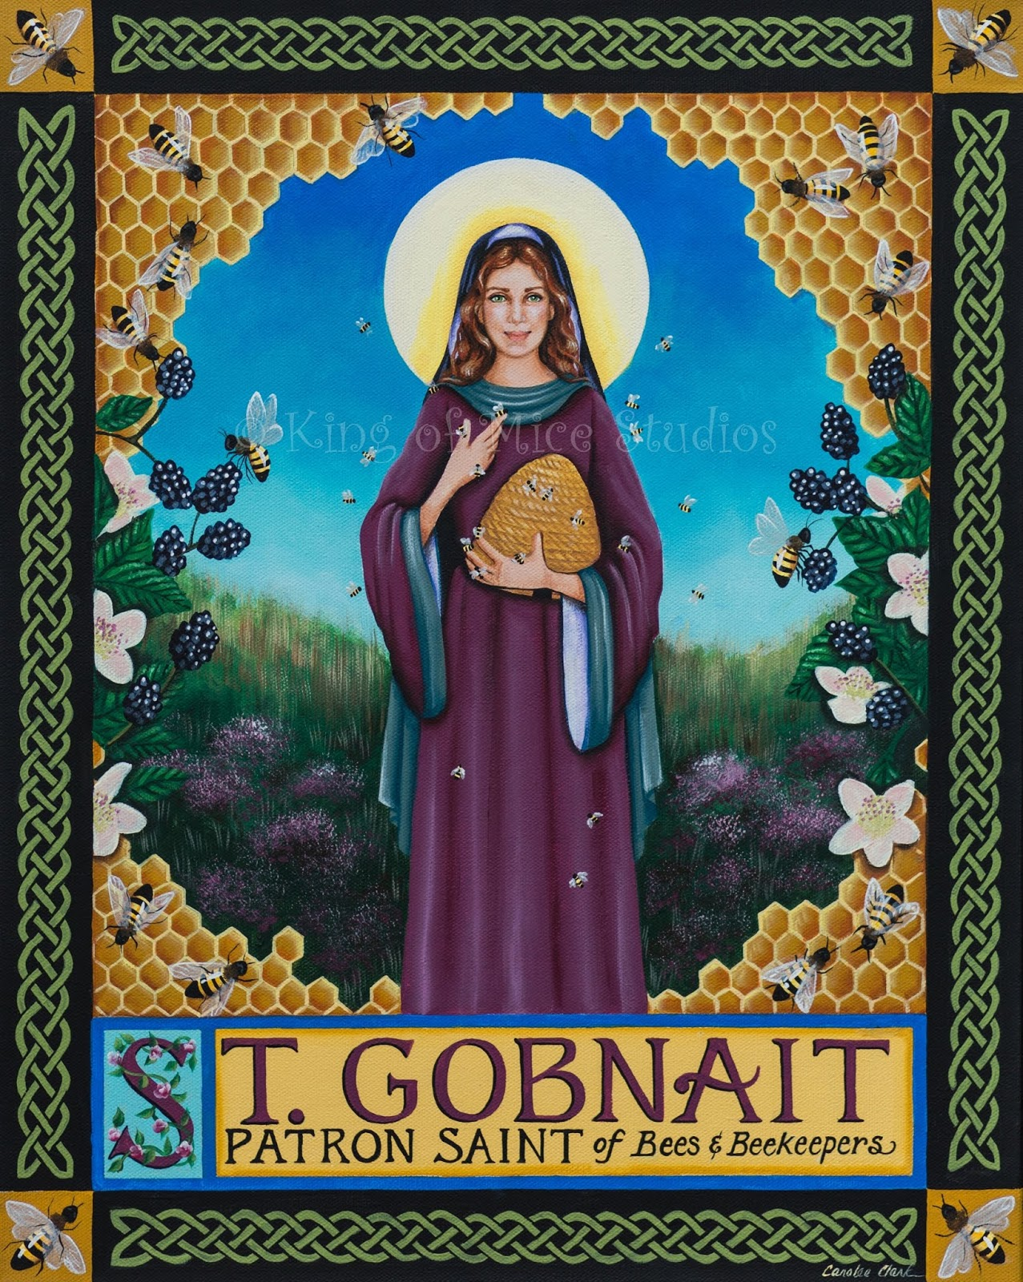
Homework
Find out 5 facts about the Diocese of Kerry’s other patron saint – St. Gobnait.
This Photo by Unknown Author is licensed under CC BY-SA

Slide 48
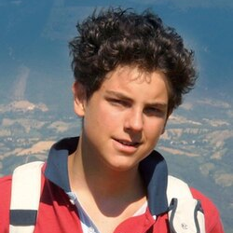
Project Work
Complete a project on Carlo Acutis.
You should include the following elements:
Biography
Road to Sainthood
Becoming a saint
Why Carlo Acutis an inspiration to young people today.
This Photo by Unknown Author is licensed under CC BY-SA

