Slide 1
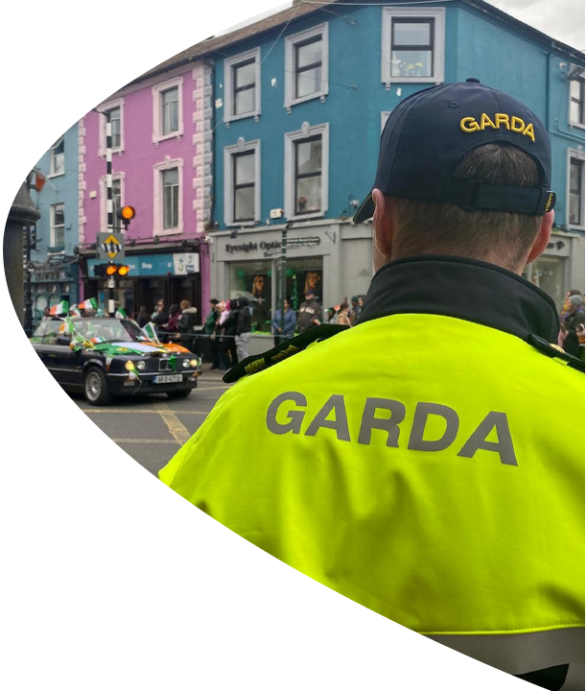


New Garda Vetting Compliance Training for Validators.
Jacklyn McCarthy
Vetting Liaison Person
Date: September 2025
Notes:
I have renamed it as the required training piece and included using their language as per GV Form i.e Validator and Affiliate

Slide 2
Garda Vetting Information Briefing
Legal framework and new vetting procedures
The Liaison Person is the designated gatekeeper under Section 9 of the National Vetting Bureau Act 2012 to 2016.
They ensure that the vetting process is accountable, auditable, and legally compliant.
Section 13 outlines consent requirements: Name, DOB, address, and declaration tick box must be completed.
Section 7 allows the Bureau to make enquiries to confirm identity.
What’s new?
New vetting application forms
European criminal record checks
Notification of completed vetting
Notes:
Highlighted our legal responsibilities

Slide 3
Garda Vetting Information Briefing
New Garda Vetting Application Form
Vetting application form is a legal document.
In Diocesan Office we can no longer amend / write on forms.
Requirement to complete forms fully and ensure information is correct before sending.
Forms with missing / incorrect information will have to be sent back to the parish.
Changes to what ID documents will be accepted.
New Validator page.
Do not bulk print forms.
Notes:
Highlighted our legal responsibilities

Slide 4
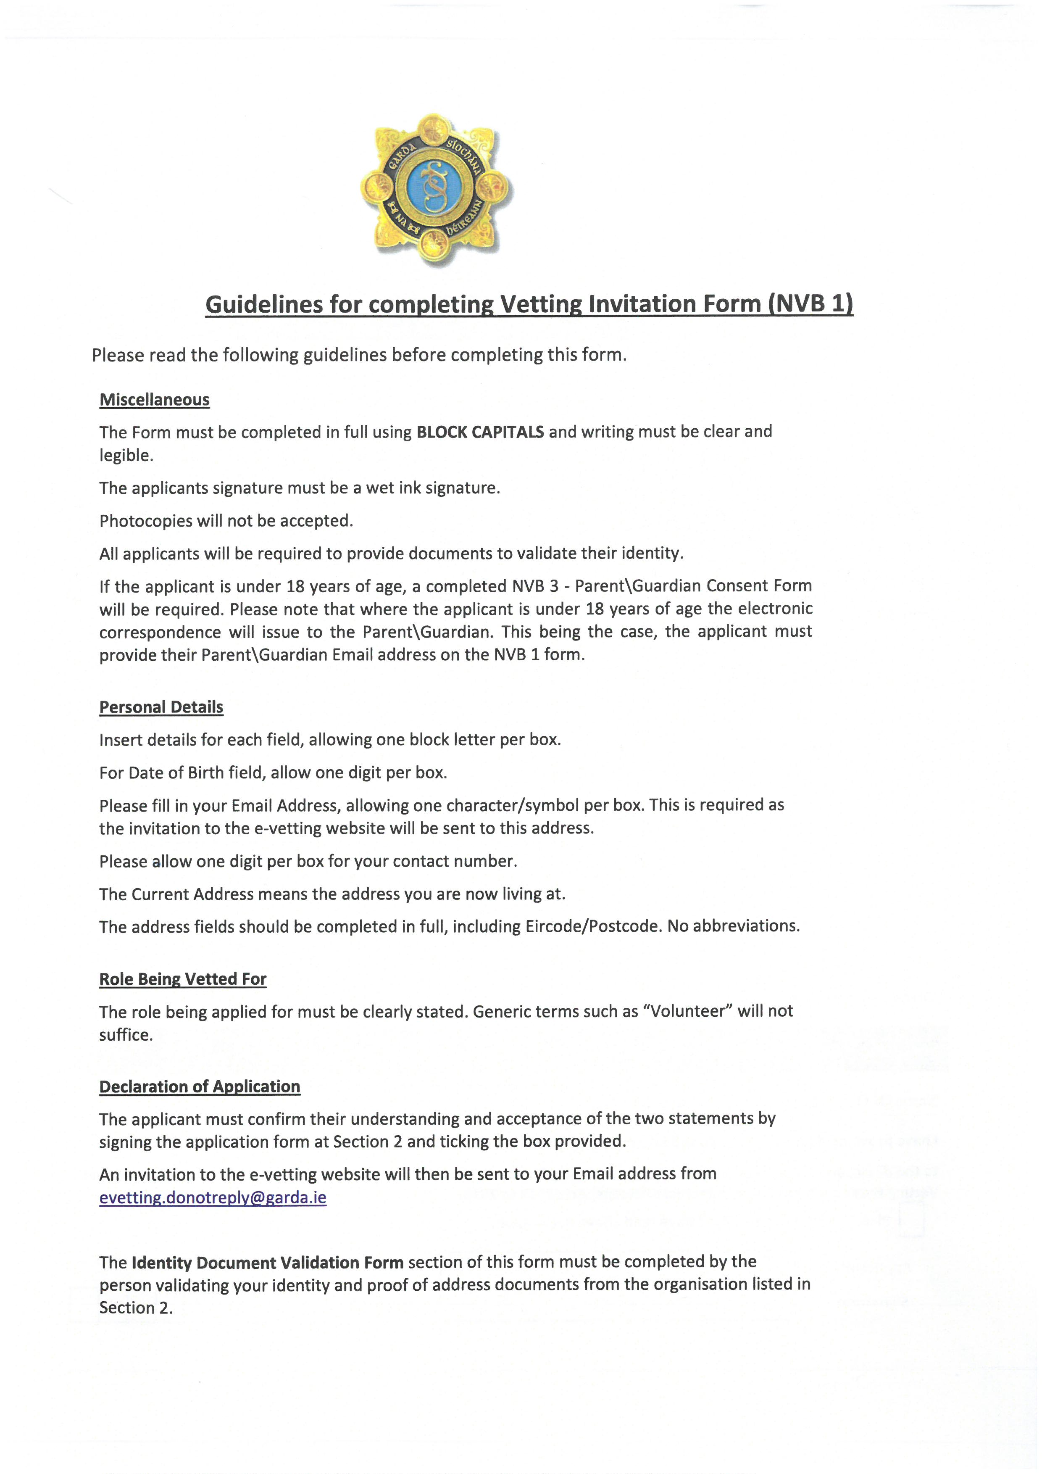
Page 1: NVB instructions
Notes:
Highlighted our legal responsibilities

Slide 5
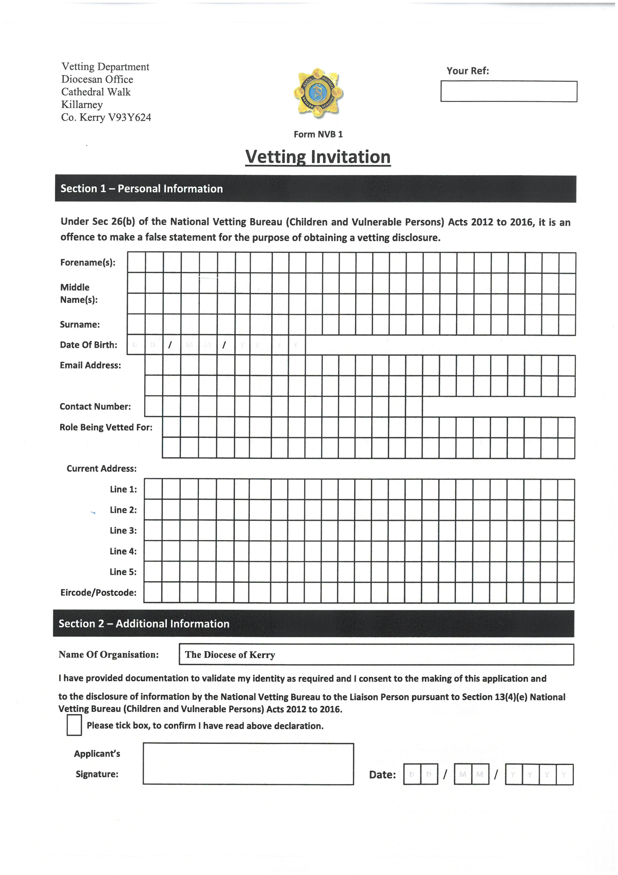
Notes:
Highlighted our legal responsibilities

Slide 6
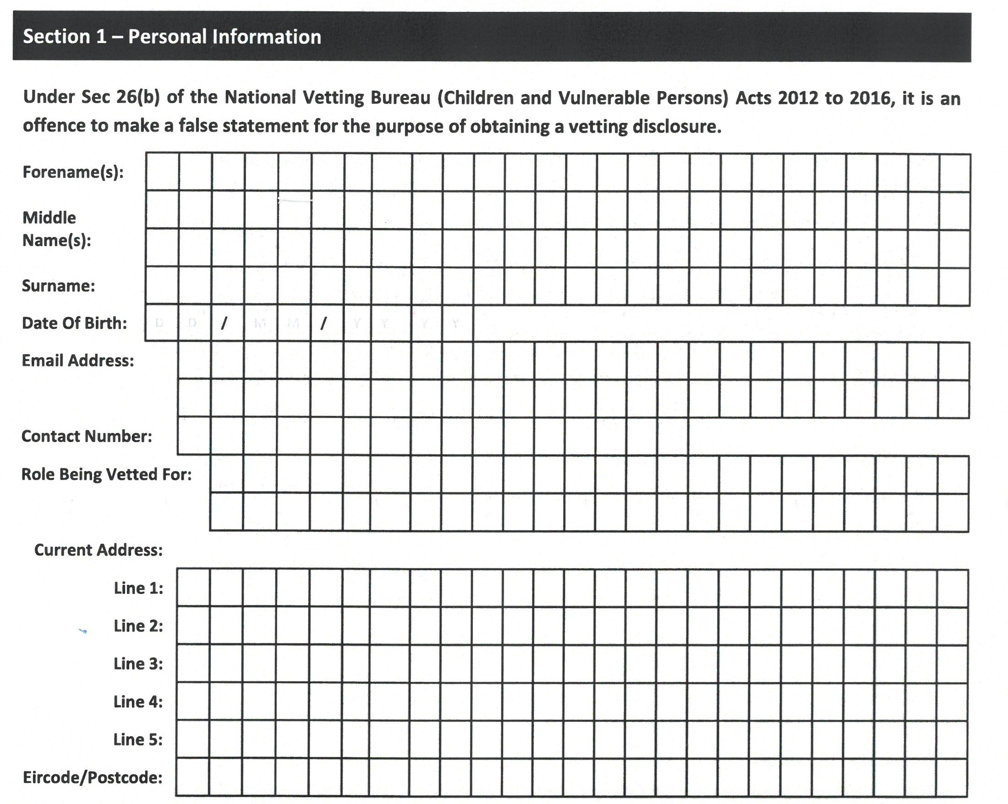
Page 2: Applicants details
Valid readable email
Role must be filled in
Current address must match the address on proof of address document
Tick consent box
Signature and date of applicant
Notes:
Highlighted our legal responsibilities

Slide 7
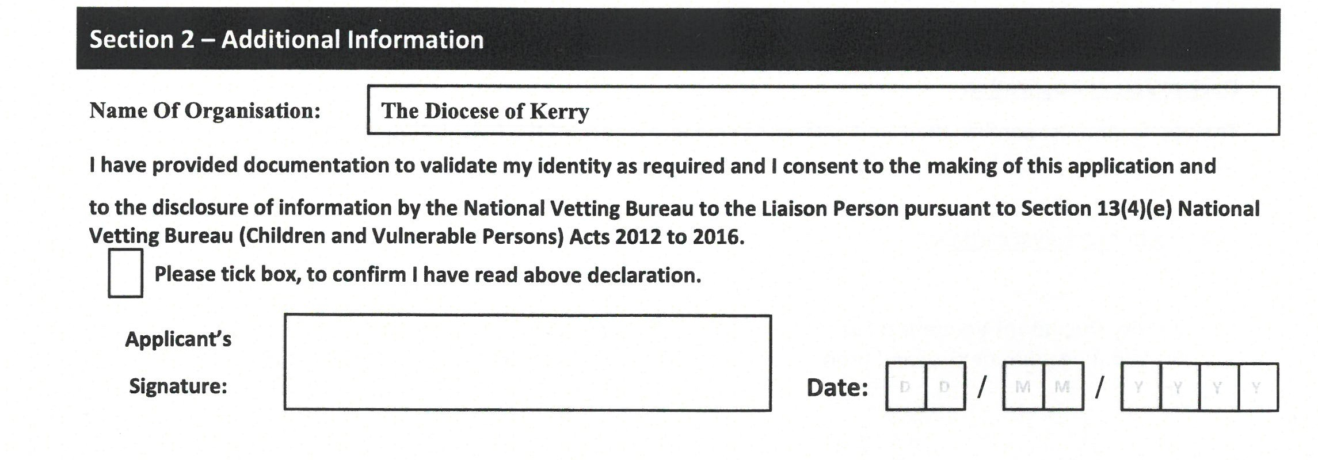
Page 2: Applicants details
Tick consent box
Signature and date of applicant
Notes:
Highlighted our legal responsibilities

Slide 8
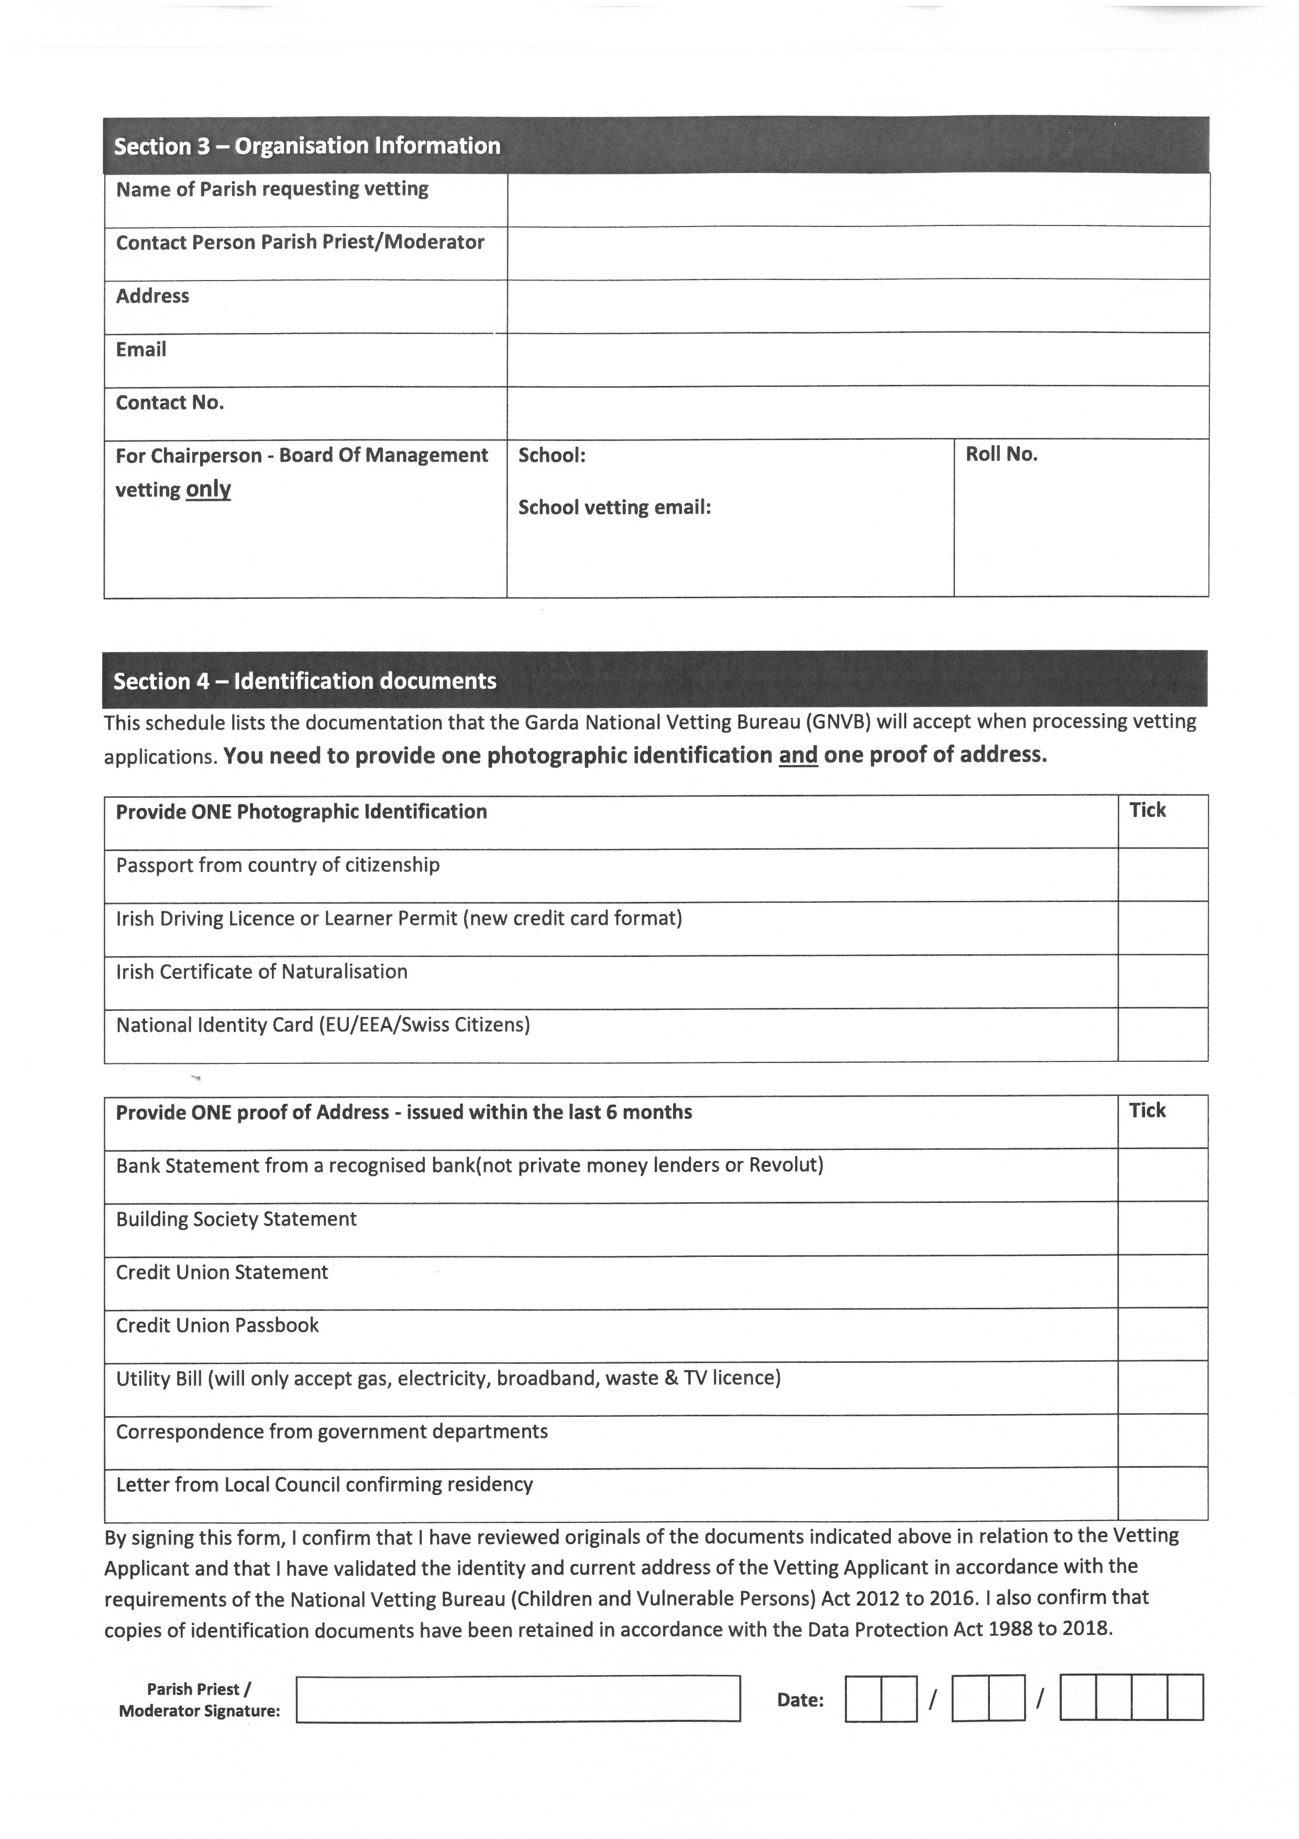
Notes:
Highlighted our legal responsibilities

Slide 9
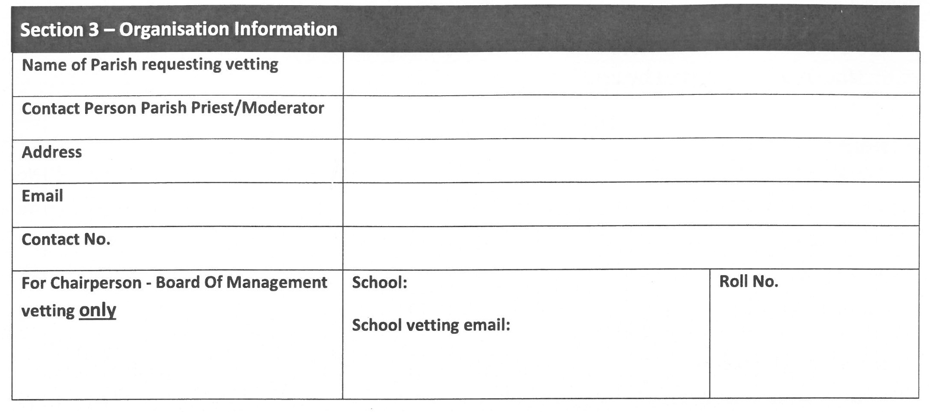
Notes:
Highlighted our legal responsibilities

Slide 10
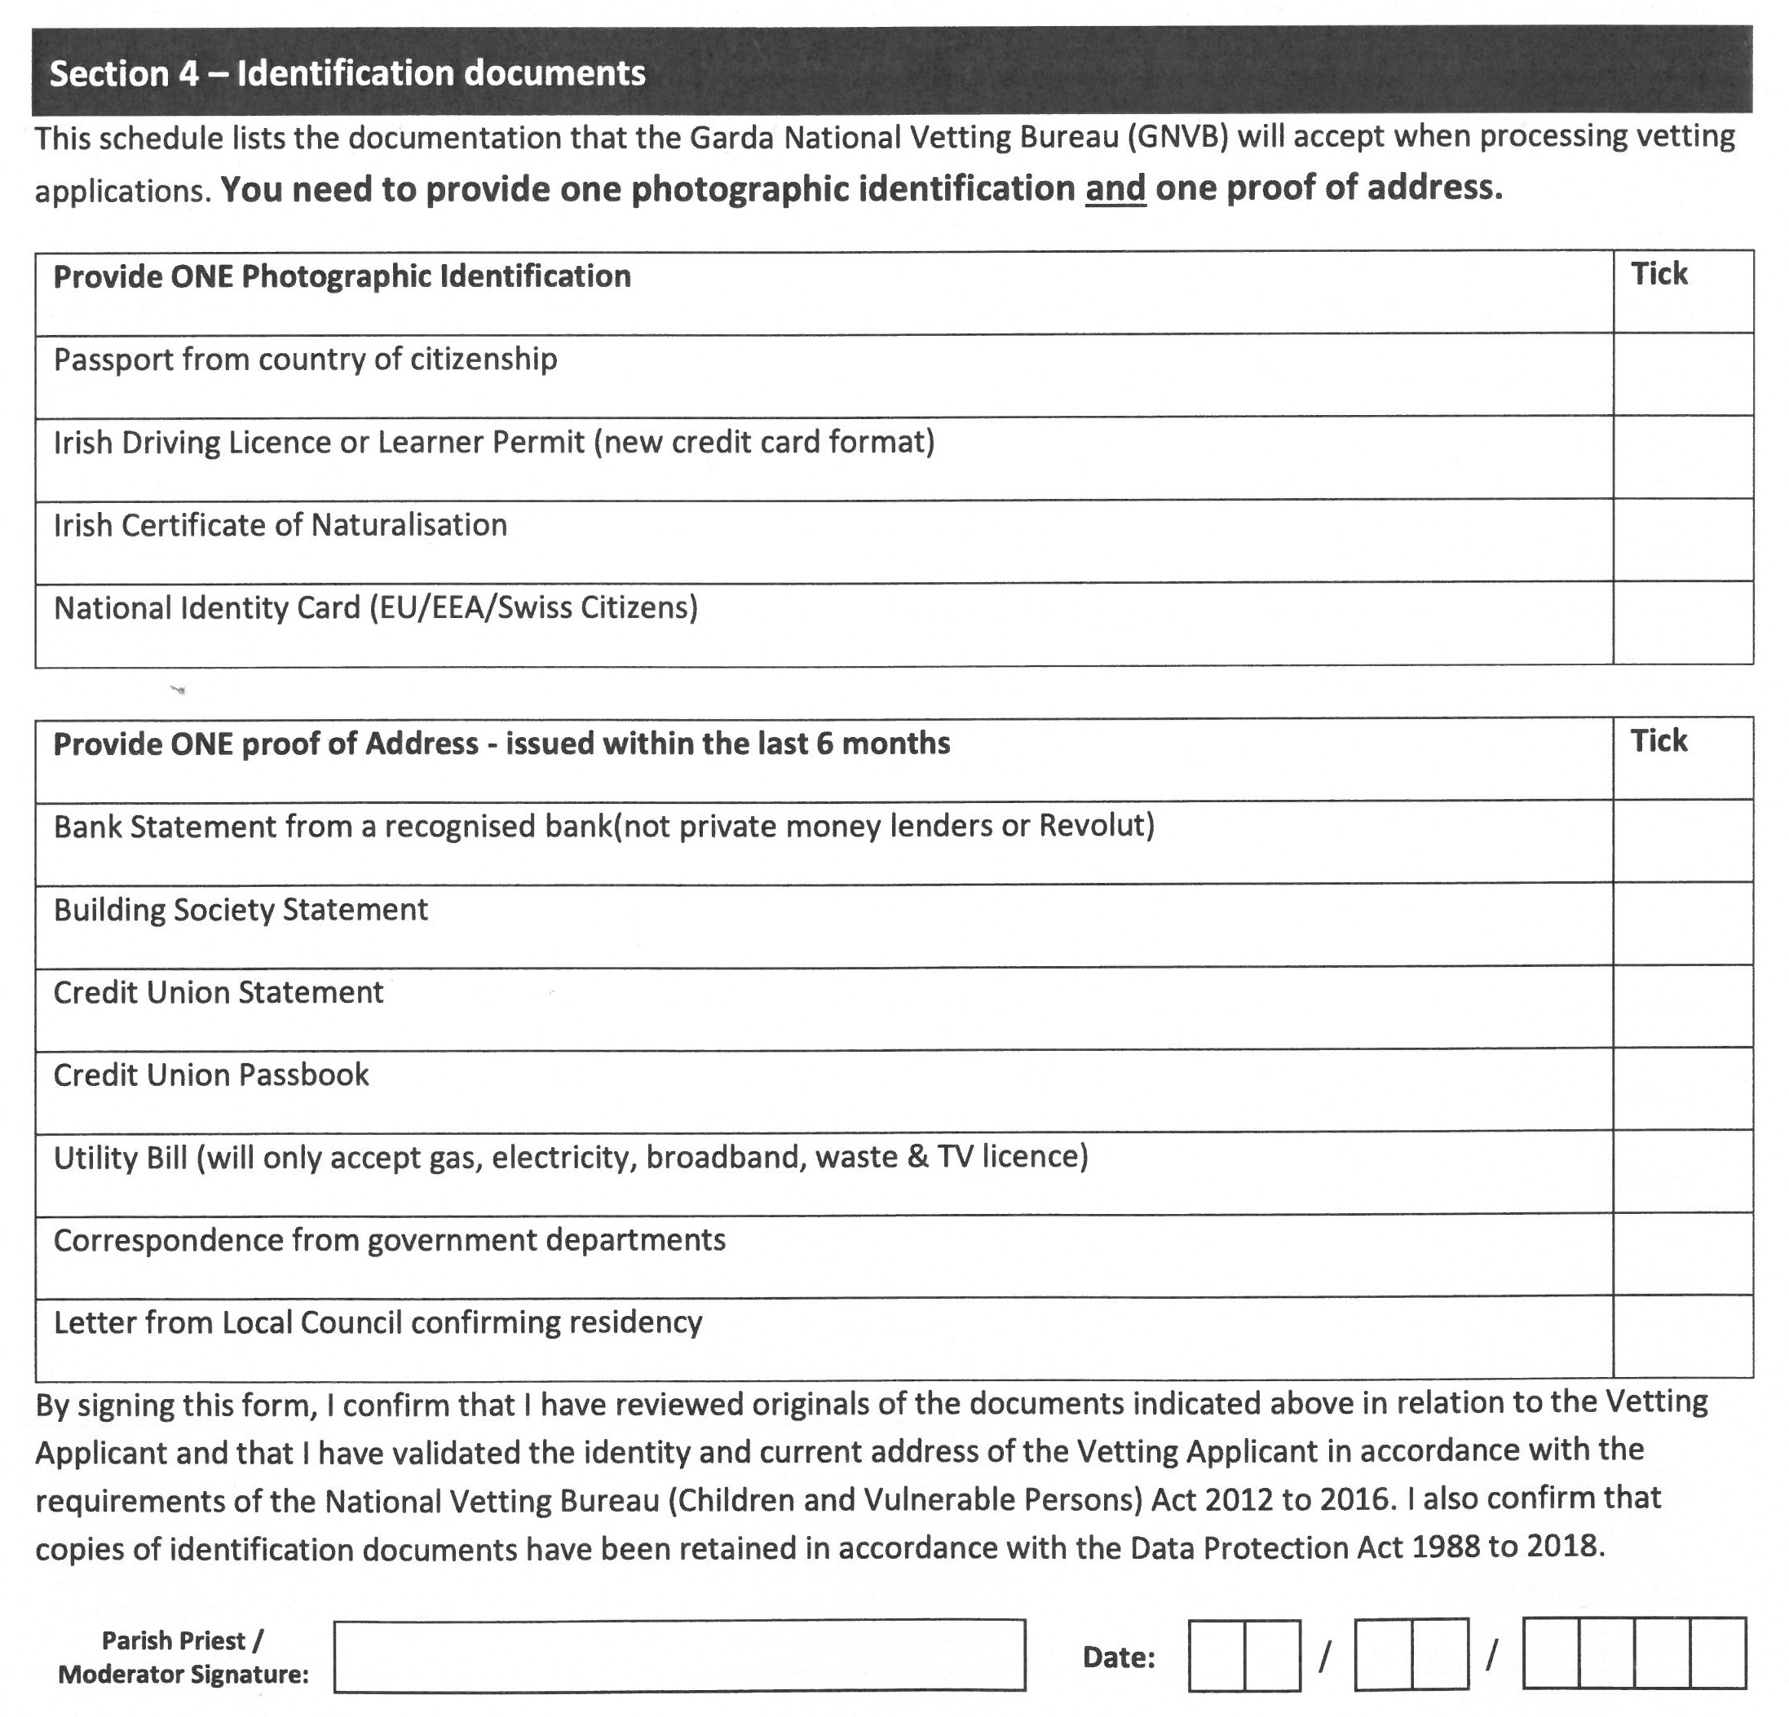
Page 3: Parish details & ID documents
Only the documents listed will be accepted
Name and address on application must match what is provided on the ID doc
6 months in date
Work backwards
Chairpersons for schools only
PP/Moderator signature & date
No public service cards
No mobile phone bills
Notes:
Highlighted our legal responsibilities

Slide 11
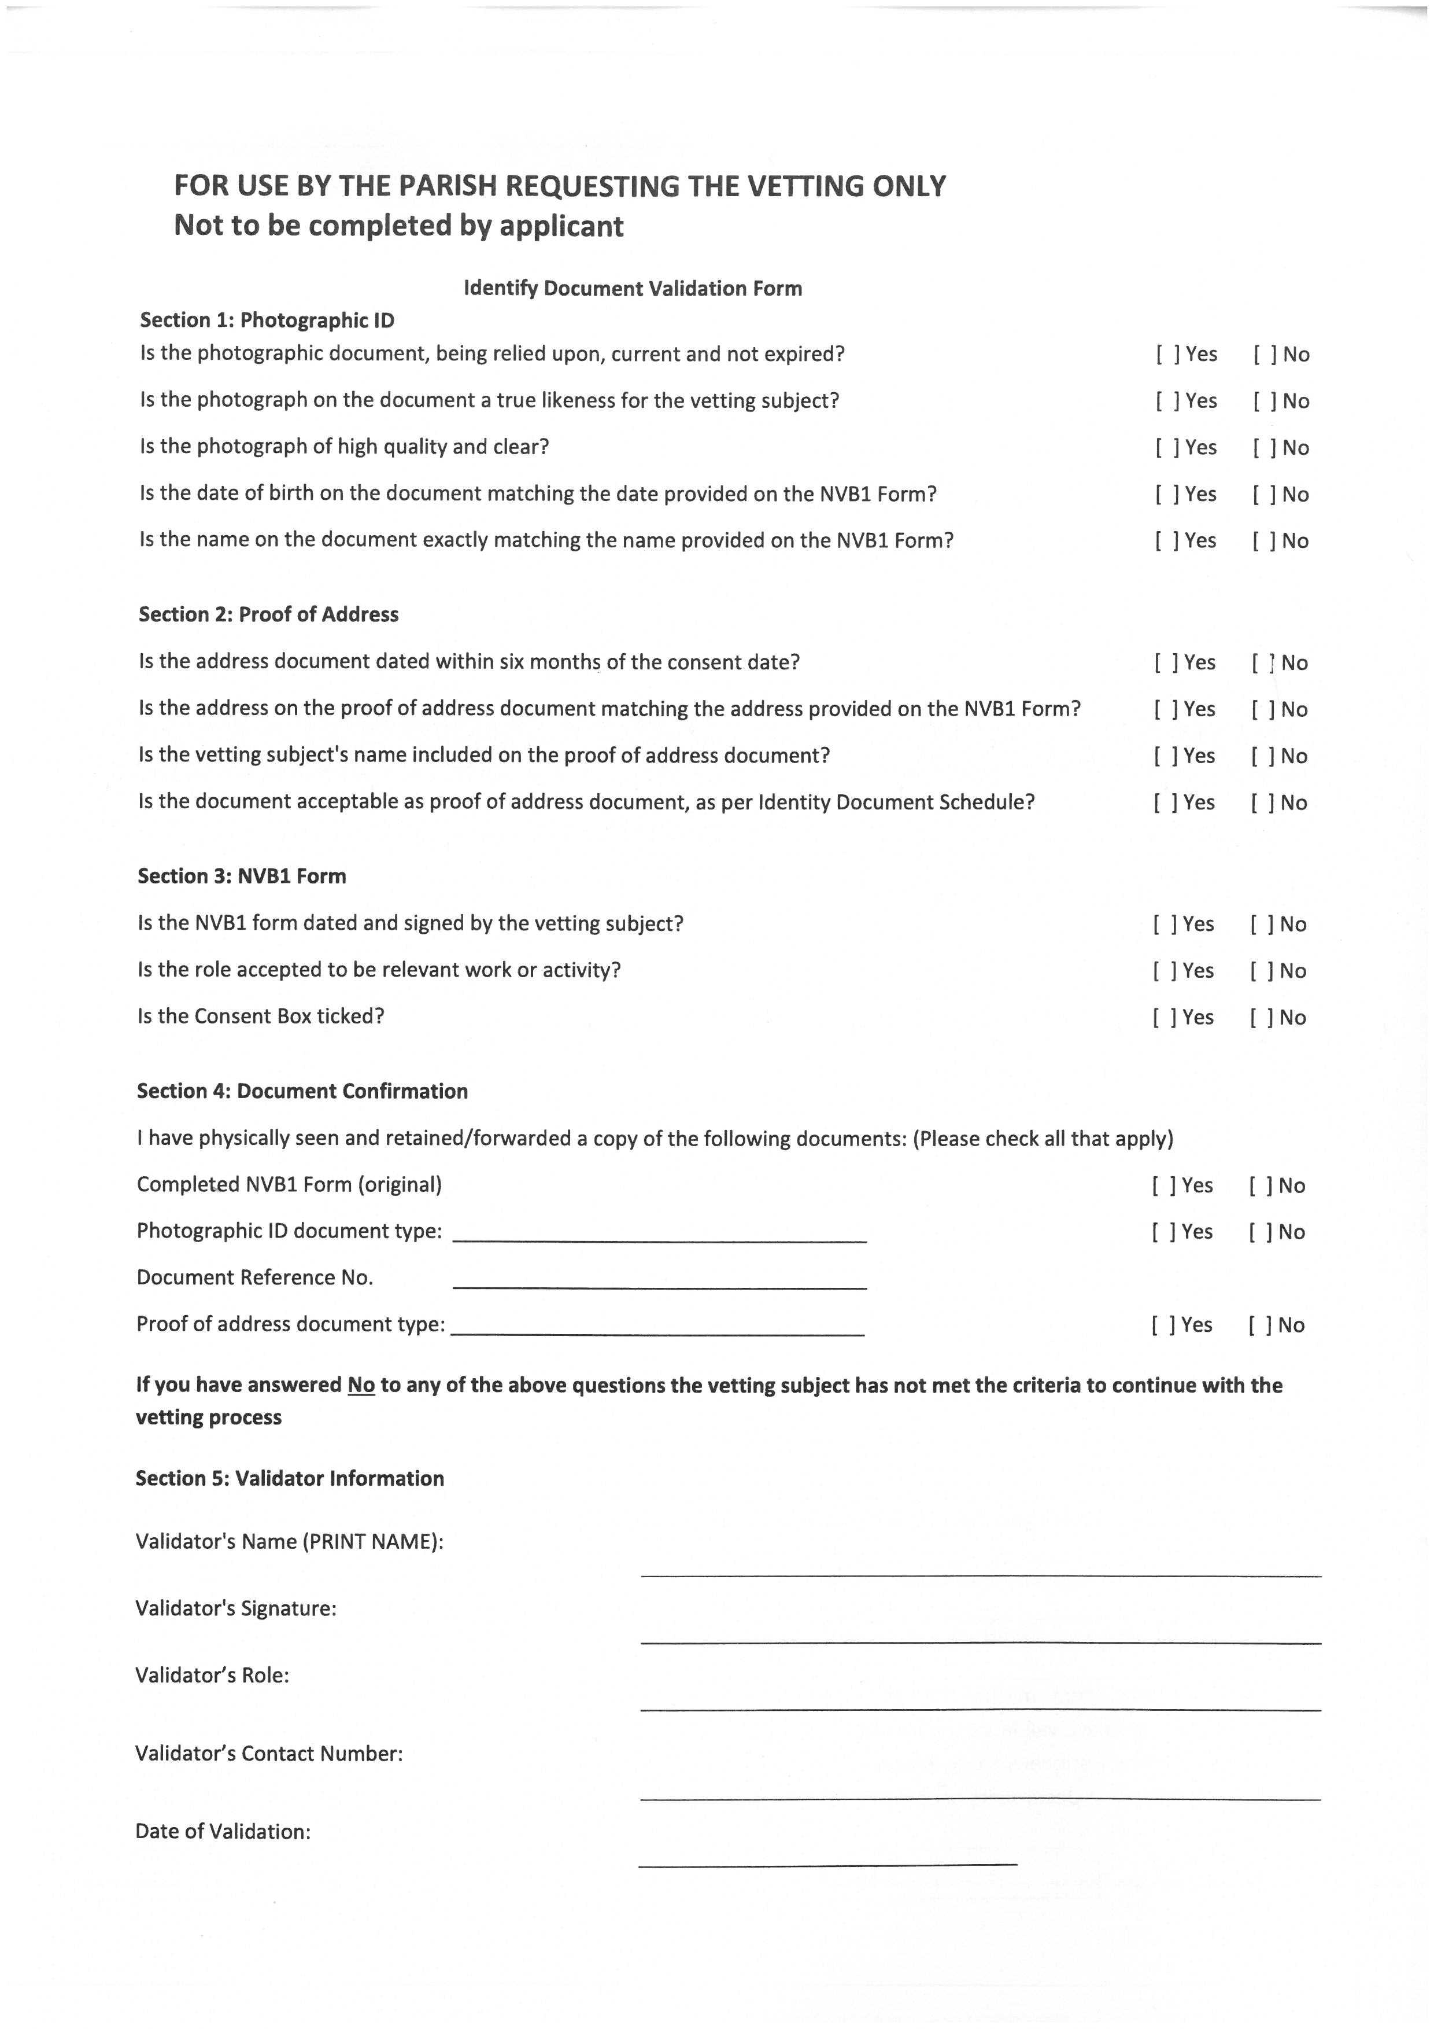
Page 4:Validator
Notes:
Highlighted our legal responsibilities

Slide 12
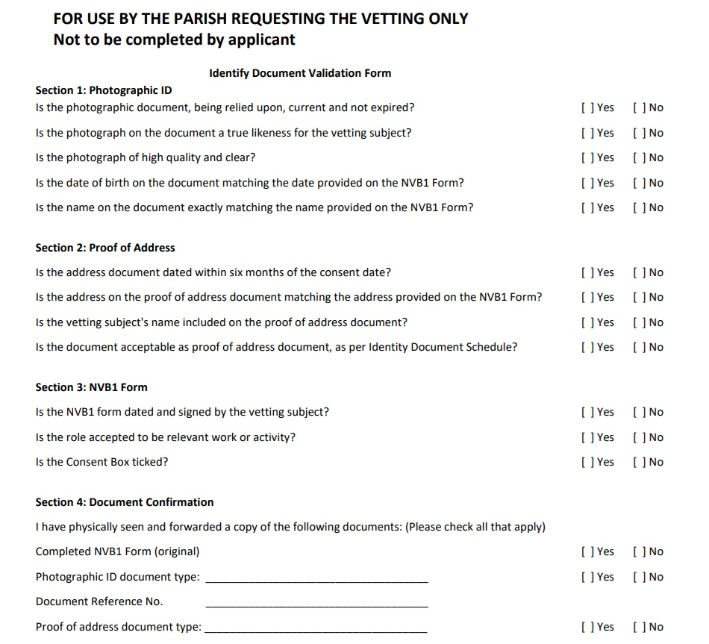
Notes:
Highlighted our legal responsibilities

Slide 13
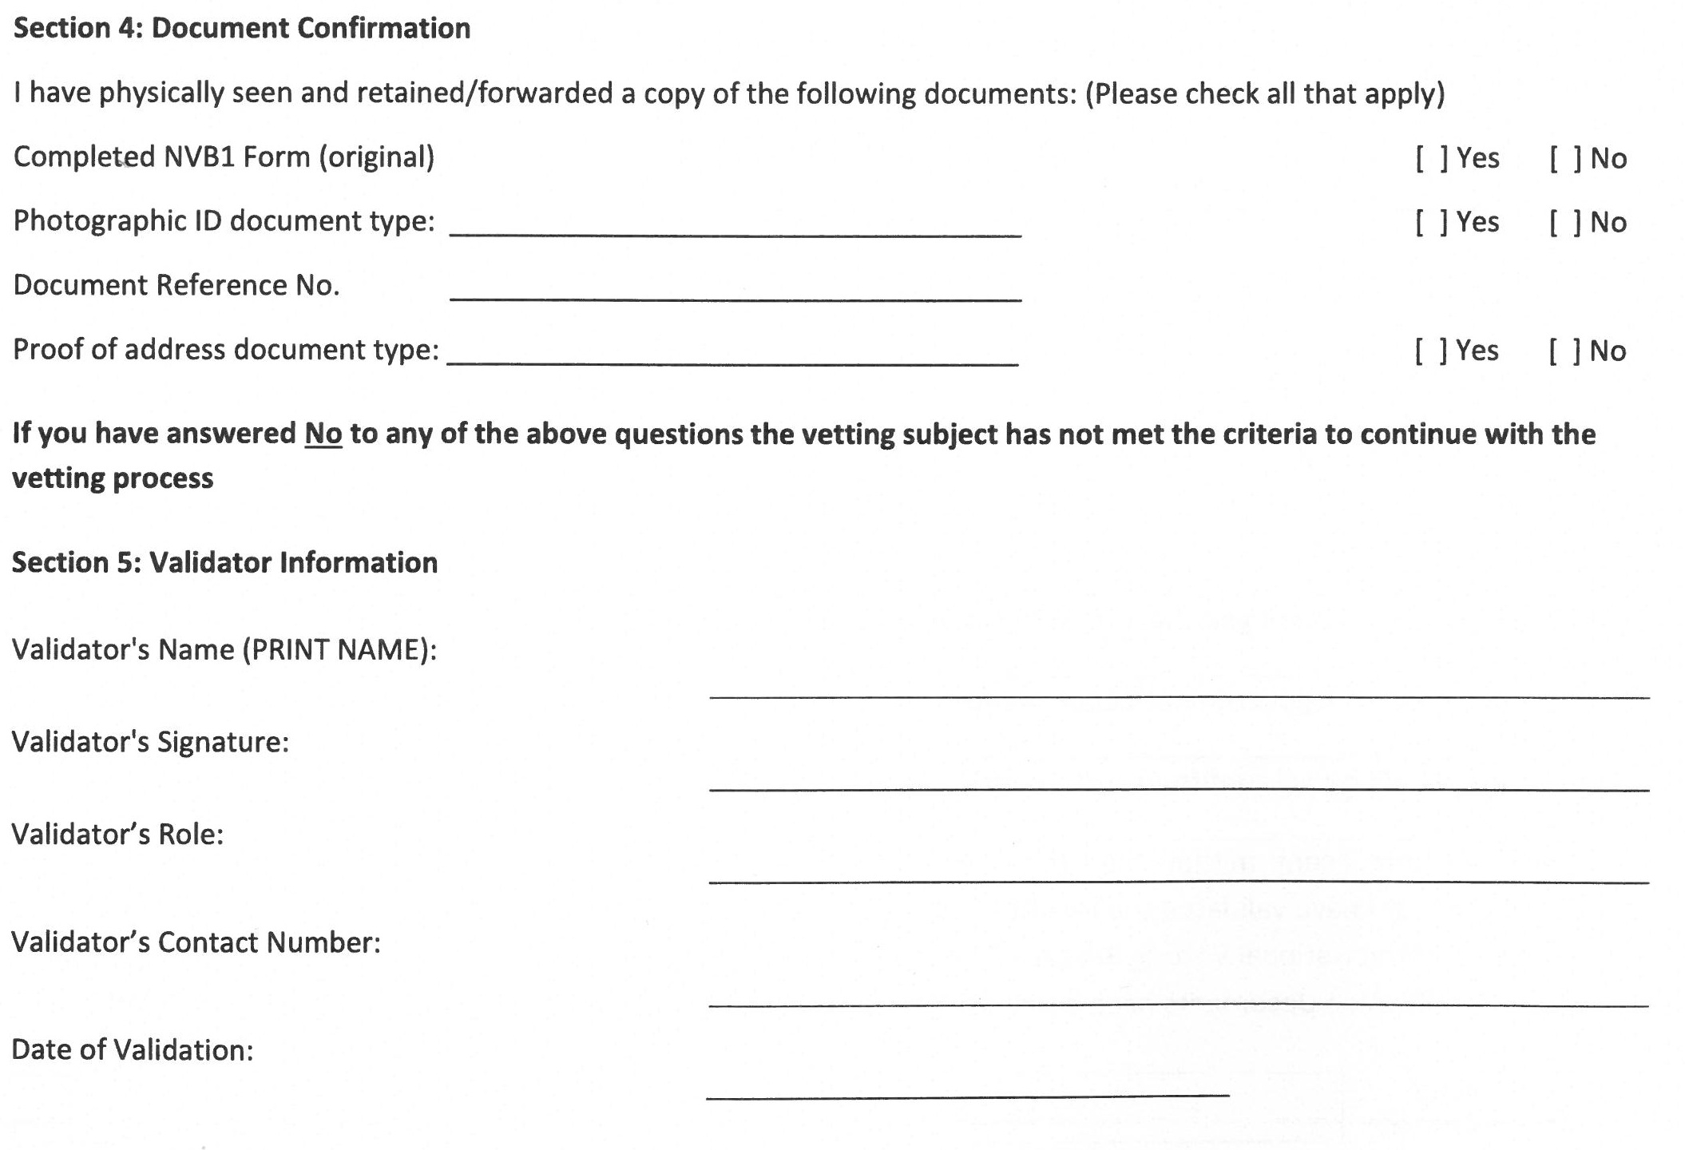
Page 4:Validator
Complete by PP/Moderator/Parish personnel
Doc ref no for driver’s licence is 4d 9-digit number
Notes:
Highlighted our legal responsibilities

Slide 14
Garda Vetting Information Briefing
Validator checklist for NVB1 Form
Completed NVB1 Forms must have all of the following:
Name, address, and date of birth must be correctly entered.
Phone contact details and email.
Specified relevant role (directly working with children or vulnerable person).
Name of the organisation (Diocese / School for Chairperson BOM).
Consent box TICKED.
Sign and date the form - A handwritten signature (wet ink) is required.
NVB1 Form must be submitted within a six-month period.
Any documentation in relation to your current address must also be submitted within the required six-month period.
All four pages and photocopies of ID docs posted to Diocesan Office. Scanned copies not accepted
Notes:
Email request was omitted from this slide which I have not inserted

Slide 15
Garda Vetting Information Briefing
Validation of documents identity & address
The validator must physically see the original documents before submitting copies of same.
The validator has legal responsibilities to:
Record in the designated section of the NVB1form (Page 4)
Document type and reference number
The date of validation
The validator’s name, position, and organisation

Slide 16
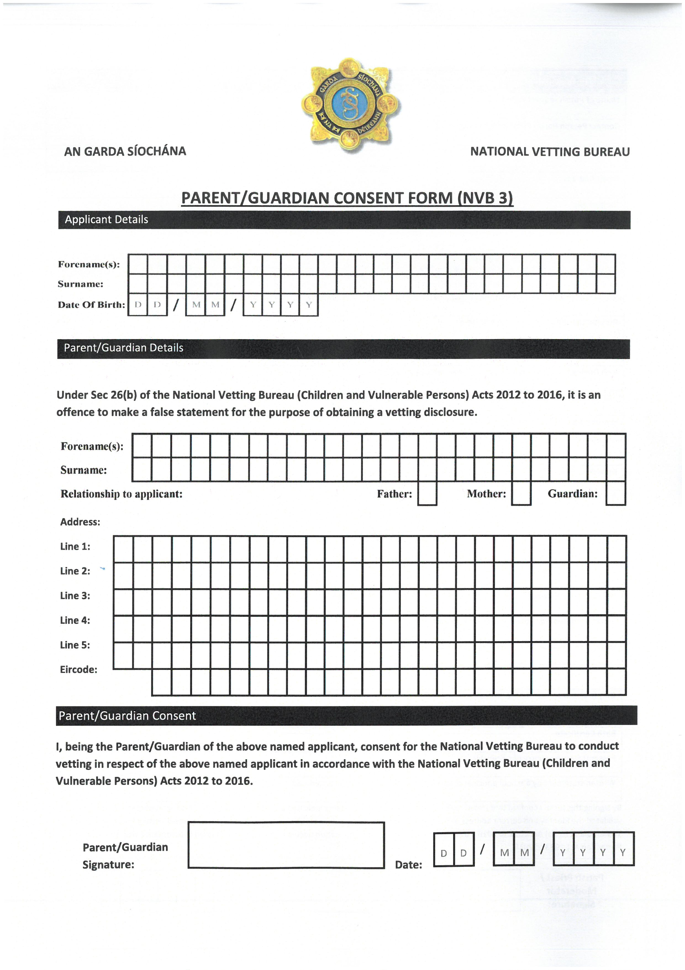
Vetting for 16 &17 year olds
Parental consent page
Notes:
Highlighted our legal responsibilities

Slide 17
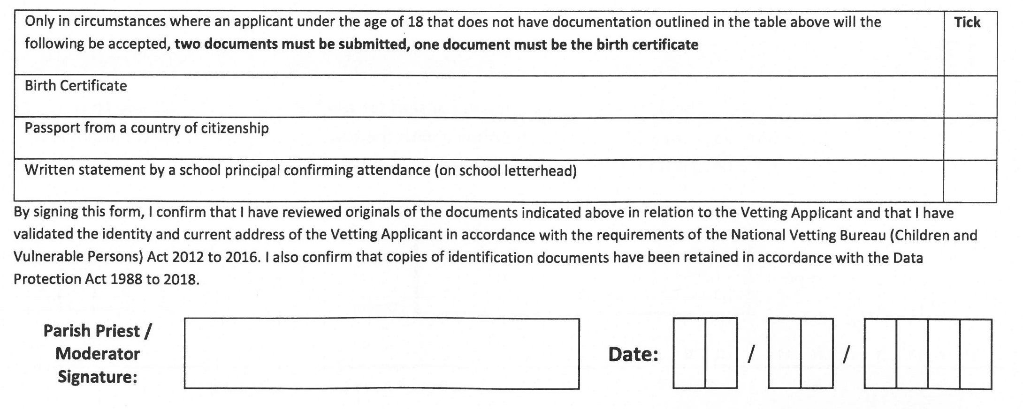
Vetting for 16 &17 year olds
Two documents including birth certificate
Notes:
Highlighted our legal responsibilities

Slide 18
Garda Vetting Information Briefing
New EU Directive and eVetting process
Online application part:
New questions are included in the vetting form for those who lived in another EU country or the UK.
Applicants must confirm if they held ID in another country and if their current role involves work with children.
The process includes parental details and checks for sexual offenses in 26 EU states and the UK.
These applications may take 10–20+ days.
Notes:
Highlighted the key information

Slide 19
Retention, Training and Compliance
The Diocese will keep the original NVB forms and they will be retained for 6 months; then digitized.
ID and address documents will be retained securely by Diocese and no copies to be kept in Parish.
Parish will not keep any NVB forms or documentation, however they must keep a record of who has been vetted and date of renewal.
No person may begin relevant work without a vetting approval
Notes:
Important to explain wet signature

Slide 20
Garda Vetting Information Briefing
Communicating vetting approval with parish
No longer send out vetting certificates.
Approval email will be sent to parish.
Applicant will also be included in the email.
Notes:
Highlighted the key information

Slide 21
Points to note
If vetting subject has no ID that is listed on identity sheet, they must be directed to a Solicitor to obtain a Sworn affidavit of identity.
If their Photographic ID has expired then they will have to renew it, to continue with the vetting process.

Slide 22
Points to note
Garda Vetting cannot be completed on mobile phones.
This new process does not mean ever person has to be re-vetted. Only need to be vetted if vetting is out of date.

Slide 23
Garda Vetting Information Briefing
Questions
Contact details for Parish Vetting Liaison Persons:
Jacklyn McCarthy | jacklynmccarthy@dioceseofkerry.org
Helen Moynihan | admin@dioceseofkerry.org
0646631168

