Slide 1
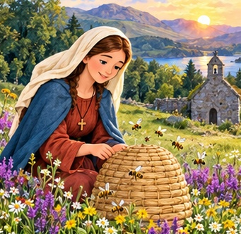
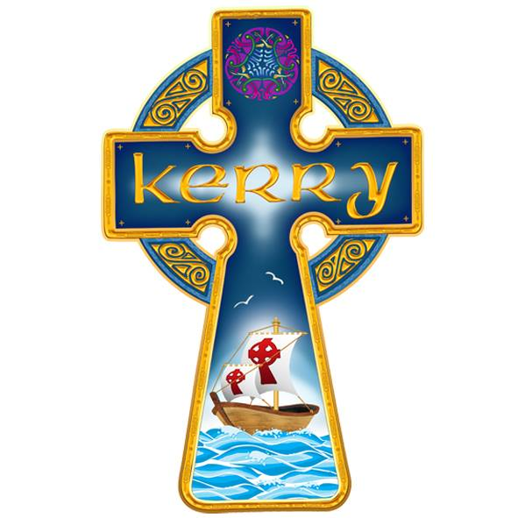
St Gobnait
Faith and care for others
A saint cherished
in the Diocese of Kerry
Diocese of Kerry
Notes:
For ages 8–12. Suggested time 25–30 minutes. Opening question: Who helps other people in your community? St Gobnait is an important local saint in Kerry. Do not call her patron of the whole diocese. Sources: https://www.dioceseofkerry.ie/parish/baile-an-fheirtearaigh/ and https://www.dioceseofkerry.ie/parish/castlemaine/
User-supplied Kerry logo. All story images are imaginative AI-generated illustrations, not historical portraits.

Slide 2
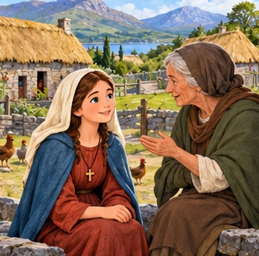
A saint from long ago
Gobnait lived in early
Christian Ireland.
Tradition links her early life
with County Clare.
Many details reach us
through old stories.
Stories can help us think
about faith and kindness.
Notes:
Her exact dates and many biographical details are uncertain. Avoid presenting a precise birth or death year. The following slides retell traditions rather than a fully documented biography. Source: https://irishheritagenews.ie/st-gobnait-patron-saint-of-ironworkers-beekeepers-and-ballyvourney/
Illustration: AI-generated storybook image. It is not a historical likeness.

Slide 3
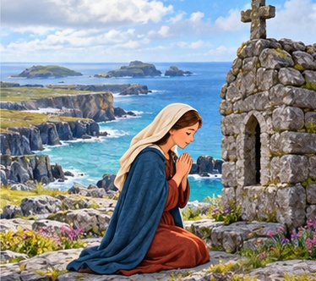
A quiet island
In the traditional story,
Gobnait finds shelter on
Inis Oírr, an Aran island.
She spends time in prayer
and listens for God’s guidance.
Where can you find
a quiet moment?
Notes:
Tradition says she leaves Clare to find safety on Inis Oírr. A church site on the island bears her name. The details about refuge belong to the traditional account. Source: https://omniumsanctorumhiberniae.com/2013/02/11/saint-gobnait-of-ballyvourney-february-11-2/
Illustration: AI-generated storybook image. It is not a historical likeness.

Slide 4
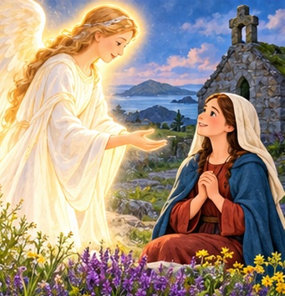
An angel’s message
The story tells of an angel
who asks Gobnait to travel
until she finds nine white deer.
That will be the place
where she is to settle.
What might she have felt
about a new journey?
Notes:
Introduce this as a legend or faith story. Do not present the angel’s appearance as an independently documented event. Let children suggest hopeful, curious or nervous feelings. Source: https://omniumsanctorumhiberniae.com/2013/02/11/saint-gobnait-of-ballyvourney-february-11-2/
Illustration: AI-generated storybook image. It is not a historical likeness.

Slide 5
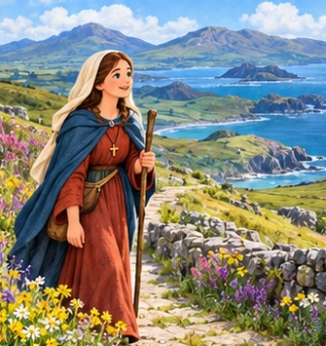
The journey continues
Tradition tells of Gobnait
travelling through Munster,
including places in Kerry.
She keeps searching
and trusts in God.
Who helps you keep going
when something is difficult?
Notes:
Places dedicated to Gobnait preserve memories of her traditional journey. Do not show an exact travel route because we cannot verify one. Sources: https://omniumsanctorumhiberniae.com/2013/02/11/saint-gobnait-of-ballyvourney-february-11-2/ and https://irishheritagenews.ie/st-gobnait-patron-saint-of-ironworkers-beekeepers-and-ballyvourney/
Illustration: AI-generated storybook image. It is not a historical likeness.

Slide 6
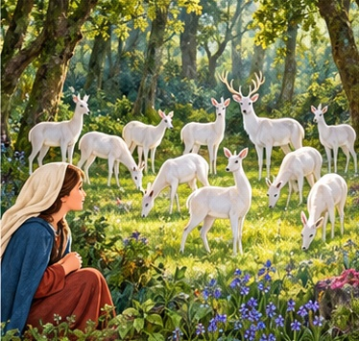
Nine white deer
At Ballyvourney in Cork,
the story says Gobnait
finds the nine white deer.
She has reached the place
where she will make her home.
What makes a place
feel like home?
Notes:
Ballyvourney is Baile Bhuirne in Irish. White deer belong to the traditional account of her journey and calling. Source: https://irishheritagenews.ie/st-gobnait-patron-saint-of-ironworkers-beekeepers-and-ballyvourney/
Illustration: AI-generated storybook image. It is not a historical likeness.

Slide 7
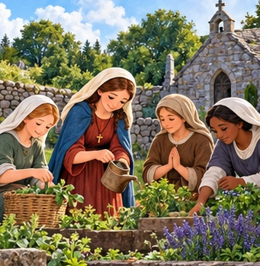
A community of faith
Gobnait is remembered
as the leader of a community
of religious women
at Ballyvourney.
They devoted their lives
to God.
How can we help our class
be a caring community?
Notes:
Explain abbess as the woman who leads a community of nuns. Traditions associate Gobnait and St Abbán with the foundation. Avoid asserting a precise founding year. Source: https://www.duchas.ie/en/cbes/4811665/4810576/5167368 and https://irishheritagenews.ie/st-gobnait-patron-saint-of-ironworkers-beekeepers-and-ballyvourney/
Illustration: AI-generated storybook image. It is not a historical likeness.

Slide 8
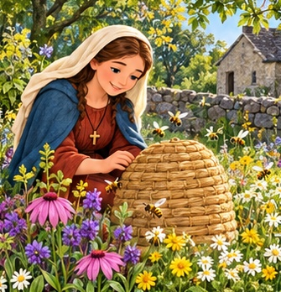
Gobnait and the bees
Gobnait is closely linked
with bees and beekeeping.
In the stories, she keeps hives
and cares for her community.
Her story can inspire us
to care for living things.
Notes:
She is honoured as a patron of beekeepers. The beehive is a familiar symbol in her stories and art. This is a reflection on the story rather than a quotation from Gobnait. Source: https://irishheritagenews.ie/st-gobnait-patron-saint-of-ironworkers-beekeepers-and-ballyvourney/
Illustration: AI-generated storybook image. It is not a historical likeness.

Slide 9
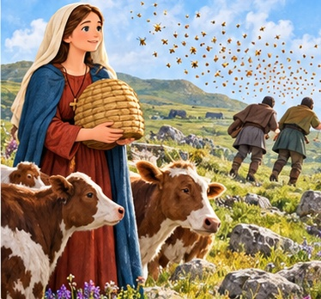
The bees protect the cattle
One legend tells of people
trying to take cattle.
Gobnait releases bees,
and the people flee.
The cattle remain safe.
The tale remembers her
as a protector of others.
Notes:
A version collected in County Kerry describes a widow seeking Gobnait’s help when men come for her cattle. Retell gently without graphic stings. Label it as a legend. Ask what safe ways children can seek help when someone needs protection. Source: https://www.duchas.ie/en/cbes/4742074/4732959/4759727
Illustration: AI-generated storybook image. It is not a historical likeness.

Slide 10
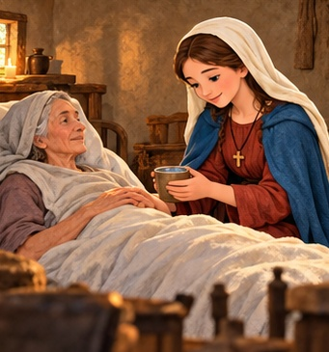
Care for people in need
People remember Gobnait
as someone who brought
comfort and help.
Traditional stories link her
with caring for the sick.
How could you comfort
someone who feels lonely?
Notes:
Stories describe consolation, advice and care for sick members of her religious community. Do not claim honey was a verified cure, or tell children prayer replaces care from a doctor. Sources: https://www.duchas.ie/en/cbes/4742074/4732959/4759727 and https://www.duchas.ie/en/cbes/4811665/4810576/5167368
Illustration: AI-generated storybook image. It is not a historical likeness.

Slide 11
Gobnait and our diocese
Churches in the Diocese of Kerry
bear St Gobnait’s name.
We find them in Dún Chaoin
and in Keel, Castlemaine.
Her memory belongs to the faith
and heritage of our communities.
Notes:
Dún Chaoin is Dunquin in English. The diocesan parish pages identify Naomh Gobnait, Dún Chaoin, and St Gobnait’s, Keel, Castlemaine. This supports her local importance without claiming she is patron of the entire Diocese of Kerry. Sources: https://www.dioceseofkerry.ie/parish/baile-an-fheirtearaigh/ and https://www.dioceseofkerry.ie/parish/castlemaine/

Slide 12
A day to remember Gobnait
11 February
This is St Gobnait’s feast day.
People honour her through prayer
and remember her care for others.
Who could we remember in our prayers?
Notes:
The National Proper for Ireland lists St Gobnait on 11 February. Her collect asks her intercession for protection and the work of our hands. The invitation on this slide is an original classroom reflection. Source: https://www.catholicbishops.ie/wp-content/uploads/2024/09/National-Proper-for-Ireland-web.pdf

Slide 13
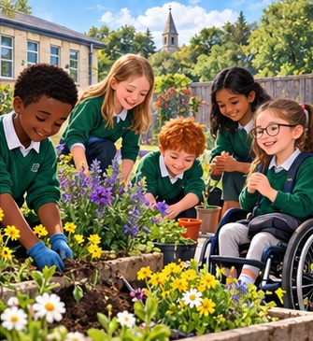
Kindness in our own lives
We can follow her example
by noticing who needs help.
We can listen kindly,
include someone, or care
for our shared surroundings.
What small act of care
could you choose today?
Notes:
Modern applications of the story. Ask for one specific action within children’s abilities. Examples include welcoming someone, asking an adult to help, looking after shared materials or planting flowers.
Illustration: AI-generated storybook image. It is not a historical likeness.

Slide 14
A caring response
A classmate sits alone at break time.
They look sad and do not join in.
What could you say?
Which trusted adult could help?
Talk with a partner and choose a kind response.
Notes:
Give two minutes for partner discussion. Suggest a gentle invitation to join a game, offering company, or seeking a trusted adult’s support. Do not encourage children to solve serious distress alone. This is an application, not an episode in the saint’s biography.

Slide 15
Our garden of kindness
Draw a flower on a page.
On a petal, write one kind action
you will try this week.
Add your flowers to a class display.
Together, our small actions help others.
“God, help me to care for …”
Notes:
Five-minute activity. Younger pupils may draw or dictate their action. Older pupils can say why they chose it. Optional: add a drawn bee as a reminder of Gobnait. Make connections with caring for neighbours and creation. No real beehive activity is required.

Slide 16
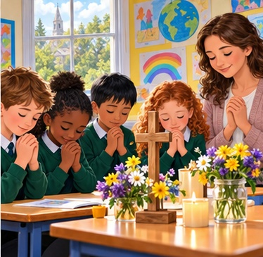
A prayer with St Gobnait
Loving God,
help us to notice those in need.
Give us kind words
and willing hands.
Help us to care for one another
and for your beautiful world.
St Gobnait, pray for us.
Amen.
Notes:
Original classroom prayer. Invite children to pray or listen quietly and respectfully. Allow a brief silence for people who are sick or lonely.
Illustration: AI-generated storybook image. It is not a historical likeness.

Slide 17
Teacher notes and sources
Ages 8–12 Suggested time: 25–30 minutes
Use the speaker notes for storytelling and discussion.
The angel, white deer and bee episode are traditional stories.
Exact dates are uncertain. Illustrations are imaginative.
Sources
Diocese of Kerry: Dún Chaoin and Castlemaine parish pages
Dúchas, National Folklore Collection: Gobnait traditions
Irish Heritage News: St Gobnait and Ballyvourney
Irish Catholic Bishops’ Conference: National Proper for Ireland
Notes:
Teacher reference slide. Finish the pupil-facing display with the prayer. Full references:
https://www.dioceseofkerry.ie/parish/baile-an-fheirtearaigh/
https://www.dioceseofkerry.ie/parish/castlemaine/
https://www.duchas.ie/en/cbes/4742074/4732959/4759727
https://www.duchas.ie/en/cbes/4811665/4810576/5167368
https://irishheritagenews.ie/st-gobnait-patron-saint-of-ironworkers-beekeepers-and-ballyvourney/
https://omniumsanctorumhiberniae.com/2013/02/11/saint-gobnait-of-ballyvourney-february-11-2/
https://www.catholicbishops.ie/wp-content/uploads/2024/09/National-Proper-for-Ireland-web.pdf
Gobnait’s early life and journeys are traditional accounts. Do not describe the generated art as authentic likenesses or photographs. Kerry logo supplied by the user.

