Slide 1
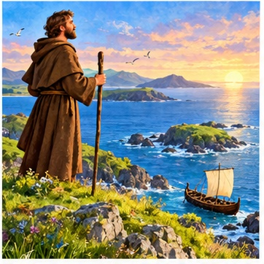
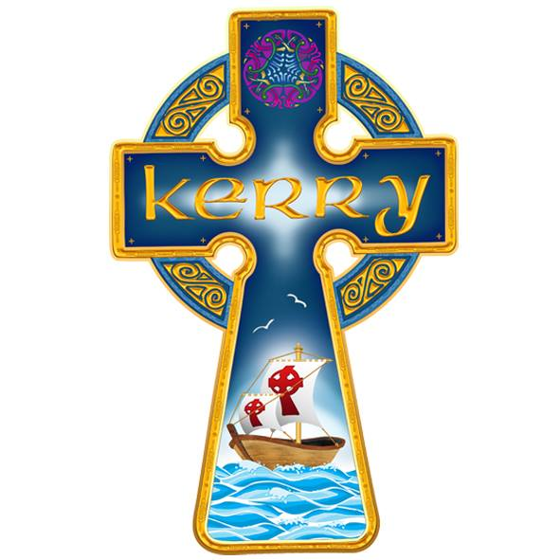
St Brendan
The Navigator
A saint from Kerry
A story of faith and courage
Diocese of Kerry
Notes:
For children aged 8–12. Allow about 25–30 minutes, including discussion and activity. Opening: What helps you when you try something new? Source: https://www.dioceseofkerry.ie/media/uploads/Feast%20of%20St%20Brendan.pdf
Images are imaginative illustrations, not historical portraits. Logo supplied by the Diocese of Kerry.

Slide 2
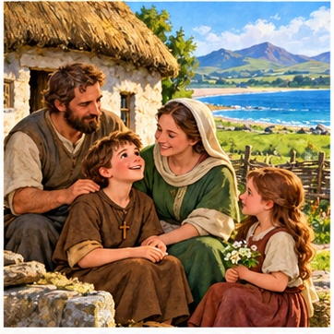
A child from Kerry
Brendan was born near Tralee
over 1,500 years ago.
Like you, he began life
as a child with much to learn.
What do you love about
the place where you live?
Notes:
Explain that Brendan lived in the late fifth and sixth centuries. Sources differ on his exact birth year and location. Say “near Tralee in Kerry” rather than asserting a precise village. Source: https://www.newadvent.org/cathen/02758c.htm
Illustration: AI-generated storybook image. It is not a historical likeness.

Slide 3
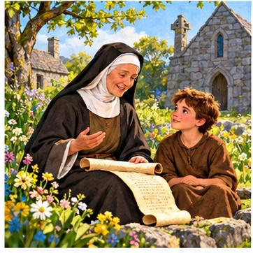
People who helped him
Tradition tells us that St Ita
and St Erc helped Brendan
learn about God.
He learned to pray and grew
in his Christian faith.
Who helps you learn
and grow?
Notes:
Introduce Ita as a holy woman and teacher, and Erc as a bishop. Details of Brendan’s childhood come through the traditional accounts of his life. Source: https://www.newadvent.org/cathen/02758c.htm
Illustration: AI-generated storybook image. It is not a historical likeness.

Slide 4
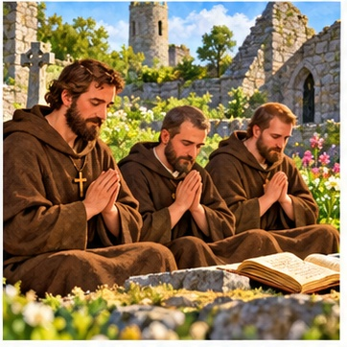
A life with God
Brendan became a priest
and a monk.
Monks lived in communities,
praying and working together.
We can make time for God
in our day too.
Notes:
A monk is a person who dedicates his life to God within a religious community. Ask children what a quiet moment of prayer might look like at home or school. Source for Brendan as priest and monastic founder: https://www.newadvent.org/cathen/02758c.htm
Illustration: AI-generated storybook image. It is not a historical likeness.

Slide 5
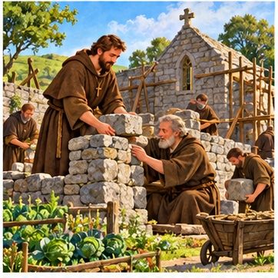
Building communities
Brendan founded monasteries,
including one at Clonfert
in County Galway.
These were places of prayer
and learning.
How can we make our class
a welcoming place?
Notes:
Explain that a monastery is a home for a community of monks. Clonfert became an important monastic foundation. Avoid a precise foundation year because accounts differ. Source: https://www.newadvent.org/cathen/02758c.htm
Illustration: AI-generated storybook image. It is not a historical likeness.

Slide 6
A real saint and a famous story
Brendan’s life
The voyage legend
He lived in early Christian Ireland
and founded monasteries.
People remember him as
a traveller and teacher of faith.
Later storytellers described
a wonderful ocean adventure.
We cannot prove every event
in that story happened.
Notes:
Keep this distinction clear before the voyage slides. The Navigatio, or Voyage of St Brendan, is a medieval religious story. It may reflect traditions of sea travel, but its marvels and destination are not established historical facts. Do not teach that Brendan discovered America as a proven fact. Source: https://www.newadvent.org/cathen/02758c.htm

Slide 7
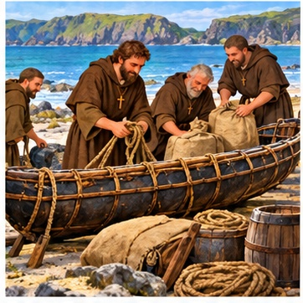
Getting ready to sail
In the voyage story, Brendan
and his companions prepare
a currach for their journey.
It has a wooden frame
covered with animal hides.
Why is preparation
important?
Notes:
Read as a retelling of the legend. They gather supplies and share the work before setting out. Ask what the class would need for a journey. Source: https://www.dioceseofkerry.ie/media/uploads/Feast%20of%20St%20Brendan.pdf
The illustrated boat is an imaginative reconstruction.
Illustration: AI-generated storybook image. It is not a historical likeness.

Slide 8
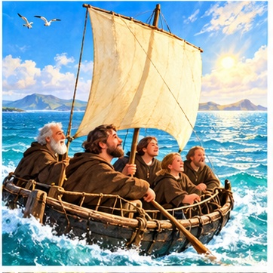
A journey into the unknown
The story says they sail west,
seeking the “Promised Land
of the Saints”.
They travel together and
place their trust in God.
What might the travellers
have felt?
Notes:
Invite words such as excited, worried, curious or hopeful. Courage can include feeling afraid, preparing carefully and accepting help. This scene belongs to the voyage legend. Source: https://www.dioceseofkerry.ie/media/uploads/Feast%20of%20St%20Brendan.pdf
Illustration: AI-generated storybook image. It is not a historical likeness.

Slide 9
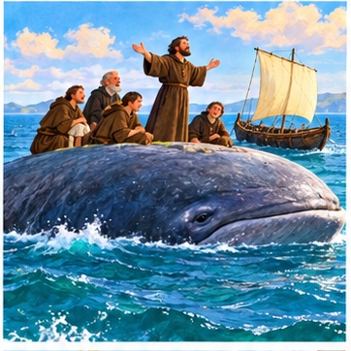
The island that moved
In one famous tale, the monks
land on a tiny “island”.
Suddenly it moves!
They hurry back to their boat.
The “island” is a whale!
This is part of the legend.
Notes:
Tell the whale episode with a sense of wonder. Ask children to predict the ending before revealing it. The giant creature is a story motif, not a historical event. Source: https://www.dioceseofkerry.ie/media/uploads/Feast%20of%20St%20Brendan.pdf
Illustration: AI-generated storybook image. It is not a historical likeness.

Slide 10
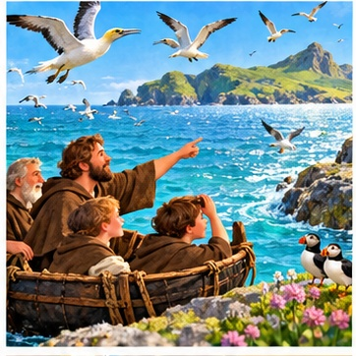
Wonder along the way
The voyage story is full of
surprising sights at sea.
Brendan’s journey invites us
to notice the beauty
of God’s creation.
What fills you
with wonder?
Notes:
Invite children to name birds, waves, trees or stars. The connection with wonder and care for creation is a classroom reflection, not a quotation from Brendan. Source for marvellous sea sights in the tale: https://www.dioceseofkerry.ie/media/uploads/Feast%20of%20St%20Brendan.pdf
Illustration: AI-generated storybook image. It is not a historical likeness.

Slide 11
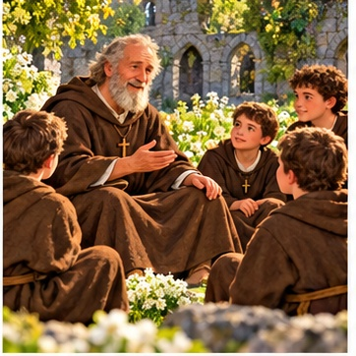
A life remembered
Brendan spent his life
sharing his faith.
He died around AD 577
and is buried at Clonfert.
His feast day is 16 May.
People still tell his story
today.
Notes:
Dates are approximate for this early medieval life. The feast is celebrated on 16 May. Source: https://www.newadvent.org/cathen/02758c.htm
Illustration: AI-generated storybook image. It is not a historical likeness.

Slide 12
Our patron saint in Kerry
St Brendan is the patron saint
of the Diocese of Kerry.
A patron saint is a special example
and a saint whose prayers we ask for.
His story reminds us to trust God
and share love wherever we go.
Notes:
Use “our Diocese of Kerry” with Kerry pupils. A diocese is a family of parishes guided by a bishop. A patron saint inspires us and intercedes for us. Point to the boat in the supplied Kerry logo and connect it with Brendan the Navigator. Source for patronage: https://www.dioceseofkerry.ie/media/uploads/Feast%20of%20St%20Brendan.pdf

Slide 13
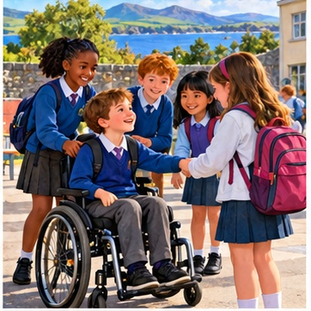
Courage in our own lives
We can be brave when we
welcome someone new,
ask for help, or try again
with a difficult task.
Small acts can make
a big difference.
What brave, kind thing
could you do today?
Notes:
These are applications of the story to children’s lives. Give thinking time before inviting optional answers. Do not ask children to disclose personal fears publicly. Emphasise safe choices, support and kindness.
Illustration: AI-generated storybook image. It is not a historical likeness.

Slide 14
A good crew helps everyone
Imagine a new pupil joins your class.
They seem nervous and do not know anyone.
What could you say?
What could you do at break time?
Turn to a partner and plan one kind action.
Notes:
Two-minute partner discussion. Ask pairs to suggest a concrete welcome: introducing themselves, inviting the pupil to a game, explaining a routine or finding a trusted adult. Link good teamwork to the companions in the voyage story.

Slide 15
My next brave step
Draw a small boat on a page.
On the sail, write one brave or kind action
you will try this week.
Beside the boat, write who can help you.
Add a short prayer for your journey.
“God, help me to …”
Notes:
Five-minute activity. Younger pupils may draw and dictate their words. Older pupils can explain why they chose their action. Examples: include someone, keep practising, ask for help or apologise. The boat is a classroom symbol, not a historical map. Children may keep their prayer private.

Slide 16
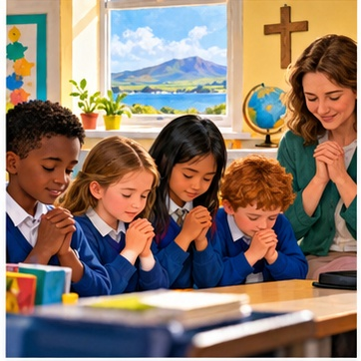
A prayer for our journey
Loving God,
help us to be brave and kind.
Stay close when we feel worried.
Help us to support one another
and share your love each day.
St Brendan, pray for us.
Amen.
Notes:
Original prayer written for this display. Invite children to join in, or to listen quietly and respectfully. Allow a short silence before the final Amen.
Illustration: AI-generated storybook image. It is not a historical likeness.

Slide 17
Teacher notes and sources
Ages 8–12 Suggested time: 25–30 minutes
Use the speaker notes for storytelling and discussion prompts.
Slides 7–10 retell the voyage legend. Dates are approximate.
The illustrations are imaginative, rather than historical portraits.
Sources
Diocese of Kerry · Feast of St Brendan
dioceseofkerry.ie/media/uploads/Feast%20of%20St%20Brendan.pdf
The Catholic Encyclopedia · St Brendan
newadvent.org/cathen/02758c.htm
Notes:
Teacher reference slide. End the pupil-facing display after the prayer. Sources: https://www.dioceseofkerry.ie/media/uploads/Feast%20of%20St%20Brendan.pdf
https://www.newadvent.org/cathen/02758c.htm
The older diocesan worksheet includes outdated bishop information and presents the western voyage more literally. This presentation does not repeat those details. Source disagreements about exact years are handled with approximate dates. Logo supplied by the user. Illustrations generated for this presentation.

