Slide 1
“Men don’t talk face to face: they talk shoulder to shoulder”
Registered Charity: CHY 19928
SUPPORTING A NEW SHED
Maurice O’Driscoll – Kerry Representative
– Irish Men’s Sheds Association

Slide 2
Irish Men’s Shed Association
IMSA’s Purpose
To support the development and sustainability of Irish Men’s Sheds and that everything we do is transparent and accountable to the Shedders and to the public.
IMSA’s Mission
Our mission is to support the development of the expanding men’s sheds movement in Ireland. As a grassroots organisation, we believe strongly in the autonomy of each individual shed, as we strive for a future in which all men have the opportunity to maintain and improve their well-being on their own terms and within their own communities.
IMSA Vision:
“A future where all men in Ireland have the opportunity to improve and maintain their health and wellbeing by taking part in a community Men’s Shed.”

Slide 3
What is a men's shed ?
A men's shed is a dedicated friendly and welcoming place where men come together and undertake a variety of mutually agreed activities.

Slide 4
Men’s Sheds
Men’s sheds are open to all men regardless of age, background or ability. It is a place where you can share your skills and knowledge with others, learn new skills and develop your old skills.

Slide 5
Men’s Shed
New members are always welcome and can be assured that there is something of interest for everyone as the men have ownership of the projects and decide there own programme of events

Slide 6
MENS’S SHEDS ACTIVITIES

Slide 7
What a Men’s Shed is not!
It is not a formal training programme but you may gain new knowledge and skills
It is not a service for men but activities organised by men
It is not a sports club but you could play sports
It is not a health programme but your health and wellbeing might improve
It is not an information service but you can ask for info you need

Slide 8
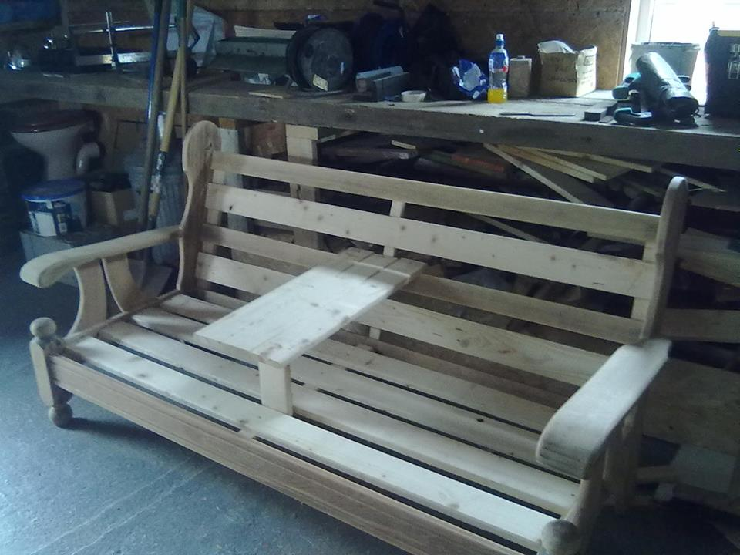
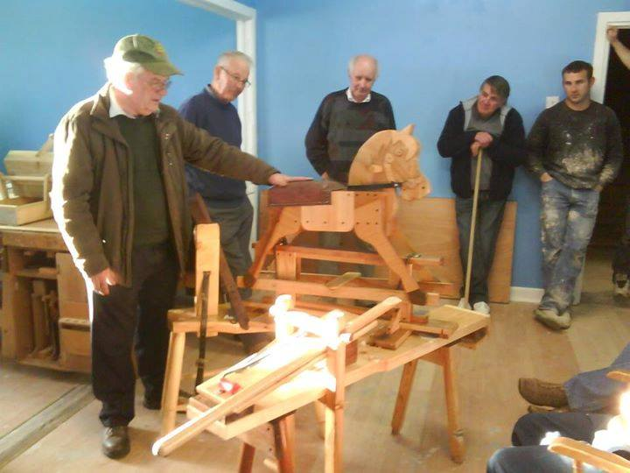
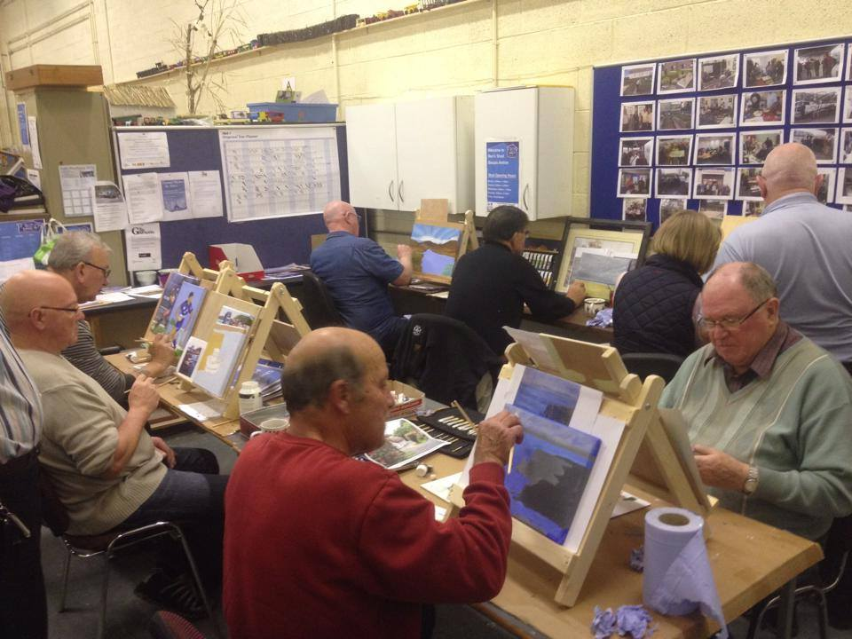
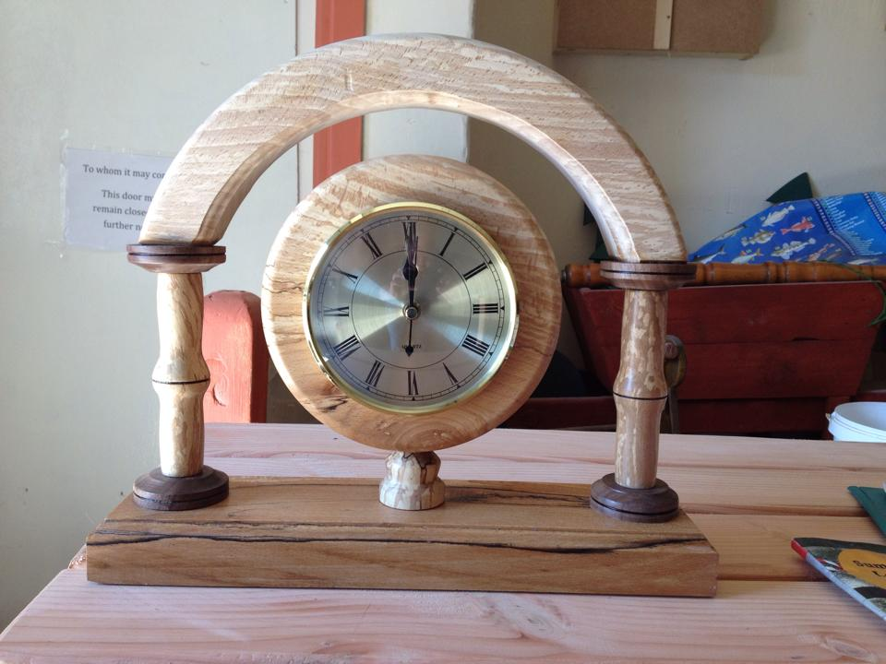
‘The most important part of creating a successful shed is the men, without the men all you have is a shed’

Slide 9
Impact of Sheds on Men and Communities
565 Sheds throughout the Island
565communities benefiting from having a Men’s Shed in their area
8,000 estimated per week use Men’s Sheds
Largest Men’s network in Ireland
The most Sheds per head of population in the world.
Shedder median age is around 60 years with around three out of ten are between 40-59 years.

Slide 10
11 Mens Sheds in Kerry
North Kerry
Ballybunion, Ballyduff, Ballyheigue, Listowel, Tralee
South Kerry
Killarney, Cahirciveen, Waterville, Dingle, Kenmare, Sneem

Slide 11
Impact of Sheds on Men and Communities
Research indicates the impact Men’s Sheds are having on men and communities:
89% of men reported that they felt better about themselves
97% were more confident as a result of attending
97% of respondents felt that as a result of participating in Men’s Sheds they can give back to the community,
86% said they felt more accepted in the community
Men’s Sheds in Ireland , Learning through community contexts
February 2013
Lucia Carragher (DR)

Slide 12
IMSA THE Challenges
Government recognition of role we play in Irish society
Funding - securing funding to deliver the supports needed to sustain and develop our sheds

Slide 13
5 Step Guide

Slide 14
SHED DOCUMENTS TO SUPPORT A REGISTERED SHED WITH IMSA
Governance for Sheds - Guidance and Sample Documents –
Sample Constitution
Guide to Management Committees
Sample Roles of Committee Officers
Guidance on Chairing a Meeting
Sample Data Protection Guide
Sample Financial Rules
Sample Ground Rules Document for sheds
Sample Conflict Resolution Rules
Sample Anti‐Bullying & Harassment Policy
Start up 5 step Guide for sheds
Mens shed Toolkit ( Ireland )
What is GDPR – What does it mean for a shed
Registered Charity Number letter available to sheds.
Local Agencies – ( ETB, Partnership, Encourage to register - PPN, etc., ) Names and contacts
Contacts and info on IMSA’s Preferred Providers.

Slide 15
Contact Details
Maurice O’Driscoll
085 137 5115
imsakerry@gmail.com

