Slide 1
Title Layout
Subtitle

Slide 2
Ash Wednesday – Palm Sunday of the Lord’s Passion The SEASON of LENT Year C - The Year of Luke
2nd March – 10th April 2022
As we enter the season of Lent, the dynamics of the Liturgy during Mass changes from Ordinary Time: the ‘Alleluia’ is not sung, and the Gloria is omitted. We have an opportunity to introduce a different Mass setting; perhaps one that is more considered and reflective, and in keeping with the aspects of Lent.
This need not mean having to learn a whole new setting. Many of the liturgical composers have now revised their original Mass settings to accommodate the new texts introduced in 2011. You may only need to learn a few adjustments to otherwise familiar settings:
Bernard Sexton – Mass of Renewal
Christopher Walker – A New Celtic Liturgy
Bernadette Farrell – Mass of Hope (Revised)

Slide 4
Grant to Us, O Lord
Text: Jer 31:31-34; Ez 36:26
Music composed by Lucien Deiss
Appears in the ‘Laudate’ hymnal compiled by Stephen Dean
Copyright: Formerly WLP, World Library Publications but now GIA Publications, Inc., 7404 South Mason Avenue, Chicago, IL 60638
https://www.giamusic.com/store/resource/grant-to-us-o-lord-print-002556

Slide 6
My Song Is Love Unknown
Tune: LOVE UNKNOWN composed by John Ireland
Text: Samuel Crossman
Copyright: Public Domain
Appears in ‘Hymns Old and New’ published by Kevin Mayhew
Alternative Word Setting by James Quinn SJ entitled ‘I am the Holy Vine’
Based on John 15: 1-5, "I Am the Holy Vine" versifies Jesus' teaching about leading fruitful lives. Using the common Old Testament symbol of a vineyard (Ps. 80; Isa. 5; Jer. 2:21), Jesus points out that love can be produced only by being rooted in the source of true love, Christ, in the Father's vineyard. Whereas the Old Testament vineyard is sometimes pictured as unfruitful, Jesus casts himself as "the true vine" that produces good fruit.
https://hymnary.org/text/my_song_is_love_unknown

Slide 7
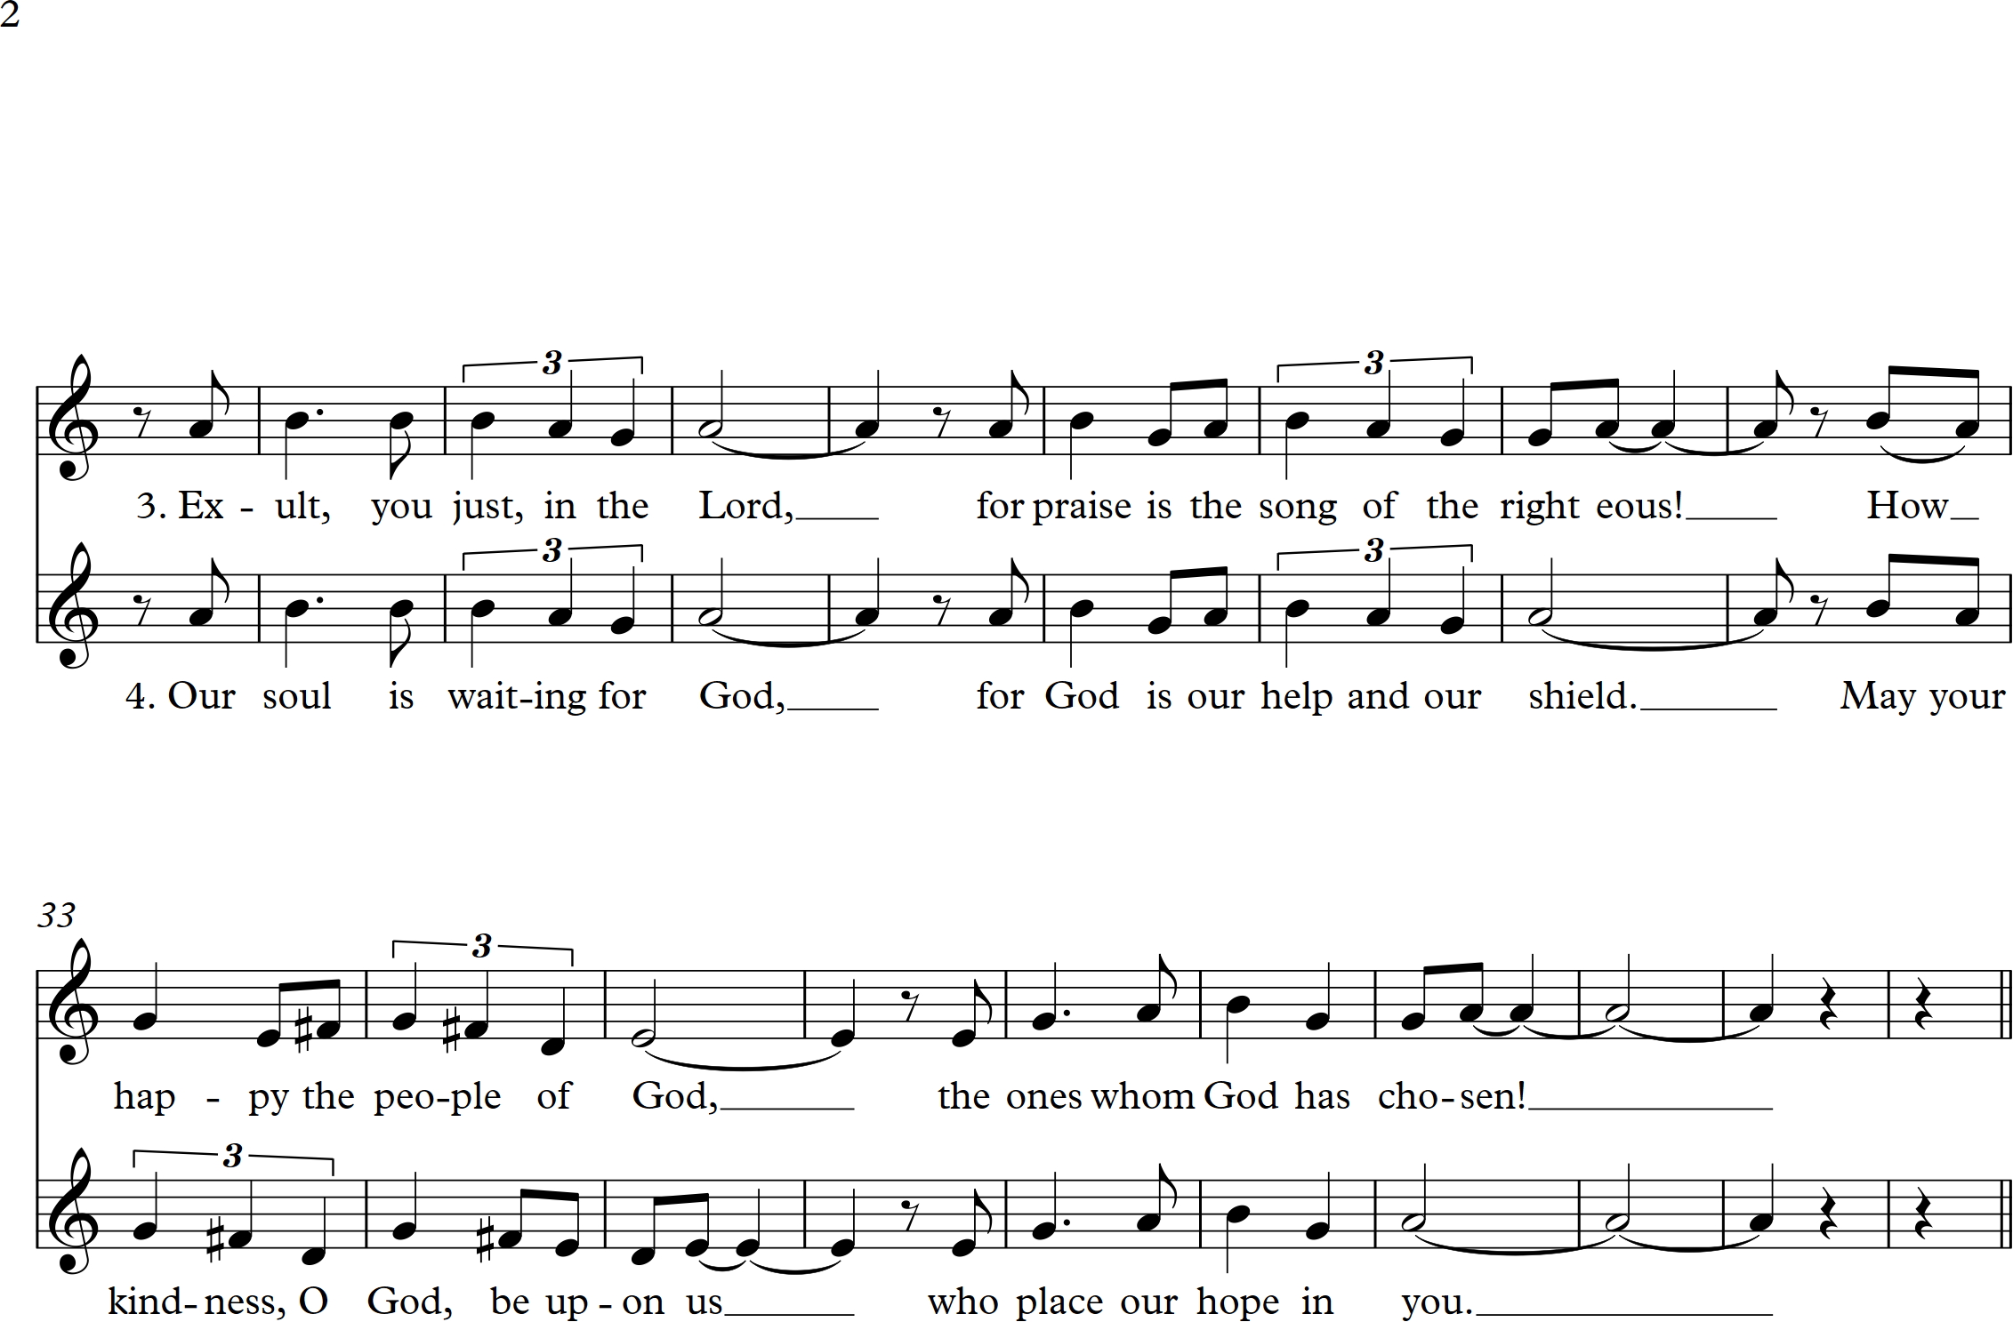

Slide 8
Let Your Mercy Be on Us
Text: Psalm 33 [2nd Sunday of Lent, Year A]
Music by Marty Haugen
Appears in Marty Haugen’s ‘Psalms for the Church Year: Volume II’
Copyright: GIA Publications, Inc., 7404 South Mason Avenue, Chicago, IL 60638
https://www.giamusic.com/store/resource/let-your-mercy-be-on-us-print-g3331

Slide 10
The Lord is My Light
Text: Based on Psalm 27 [2nd Sunday of Lent, Year C]
Music by Christopher Walker
Appears in
Christopher Walker’s Collection entitled ‘Celtic Mass’
In Caelo [published by Veritas & edited by Liam Lawton]
Copyright: OCP Publications, Oregon Catholic Press, 5536 NE Hassalo St., Portland, OR 97213
https://www.ocp.org/en-us/songs/16023/the-lord-is-my-light

Slide 12
Praise to You, O Christ Our Saviour
Text and Music by Bernadette Farrell
Appears in
Bernadette Farrell’s Collection entitled ‘Restless is the Heart’
‘Liturgical Hymns Old and New’ published by Kevin Mayhew
Copyright: OCP Publications, Oregon Catholic Press, 5536 NE Hassalo St., Portland, OR 97213
https://www.ocp.org/en-us/songs/1478/praise-to-you-o-christ-our-savior

Slide 14
My God, my God
Text: Psalm 21 [Palm Sunday]
Music by Liam Lawton; Arranged by John McCann
Appears in Liam Lawton’s Collection entitled ‘Ancient Ways, Future Days’
Copyright: GIA Publications, Inc., 7404 South Mason Avenue, Chicago, IL 60638
https://www.giamusic.com/store/resource/my-god-my-god-print-g5299

