Slide 1
Music and Song in Liturgy
Pastoral Ministry Course
Diocese of Kerry
Tuesday, January 29th 2019

Slide 2
Is music relevant to you in your life? Why?

Slide 3
How does music enhance your own faith?

Slide 4
What type of music would you say helps you to pray?

Slide 5
What do you think of music at our liturgies today?

Slide 6
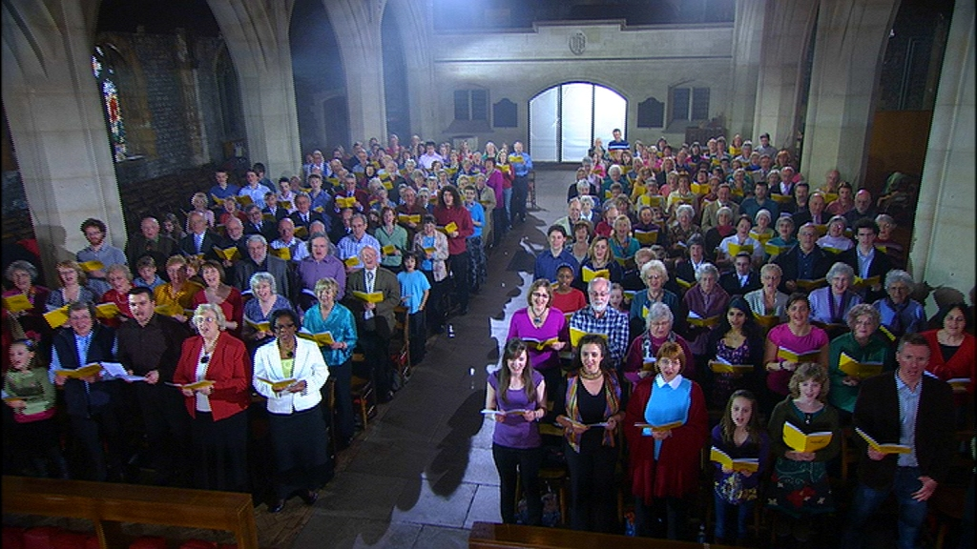
Is this a typical Irish Congregation?

Slide 7
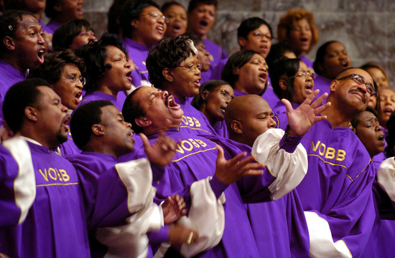
What about this?

Slide 8
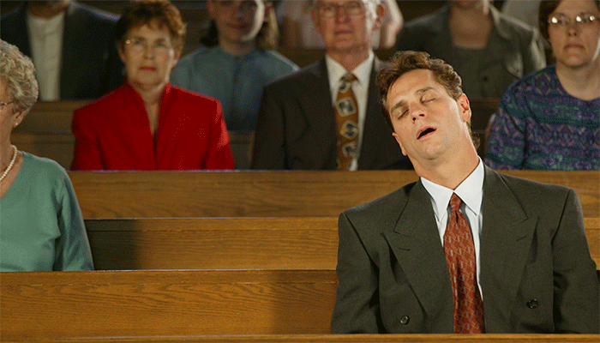
This?

Slide 9
Step 1: Understand why we have music at liturgy – The Function of Music
Music/Song creates a sense of joy and celebration
Music/Song unifies and involves the assembly/congregation
Music/Song highlights the liturgical season
Music/Song helps as we celebrate the different sacraments
Music/Song brings scripture and liturgical texts to life

Slide 10
Step 2: Understanding who does the music/singing?
Singing and Music is the responsibility of ALL the assembly – not just the choir/cantor/organist/musician/ presider.

Slide 11
When do we sing at Mass?

Slide 12
Step 3: When do we sing at Mass?
Entrance Hymn
Kyrie or Sprinkling Rite
Gloria
Responsorial Psalm
Gospel Acclamation

Slide 13
When do we sing at Mass?
Hymn for Preparation of Gifts
Eucharistic Acclamations:
Holy Holy
Memorial Acclamation
Great Amen
Lamb of God
Communion Hymn (s)
Recessional Hymn

Slide 14
Step 4: Be aware of how music can be used
Instrumental Music
Music for different instruments – not just organ
Singing soft Taizé chants before Mass begins
Music should be geared towards all age groups
Use different genres of music
Don’t be afraid to experiment
Be open to new ideas and new music

Slide 15
Why do we sing liturgical music and not secular music?
Secular music is music composed for the secular world
Sacred music or liturgical music is music composed for the purpose of prayer and worship – it should always direct us to God and help us experience God in our lives

Slide 16
Step 6: Where can we find appropriate music/songs?
Irish Church Music Association Summer School – First week in July every year – held in St. Patrick’s College, Maynooth – this year celebrating 50 years
Diocesan Workshops
Youth Music Ministry Workshops
Choir Workshops
Cantor Workshops
Parish Workshops – Listowel Parish
Primary School Resources – Grow in Love/Alive-O Programme

Slide 17
What can you do?
Arrange a meeting between your Parish Pastoral Council, liturgy committee and music ministers.
Discuss:
Possibilities for Congregational Singing in your parish
Prepare your own Congregational Hymn Cards
Invest in a parish hymnal
Prepare Copyright
Arrange for a diocesan representative to facilitate a workshop in your parish.
Arrange for your music ministers to attend workshops presented at diocesan level.
Outline a number of steps for yourself

