Slide 1

Celebration of Easter
Workshop for Parish Cantors and Music Directors
Diocese of Kerry - Wednesday, February 24th 2021, 8pm

Slide 2
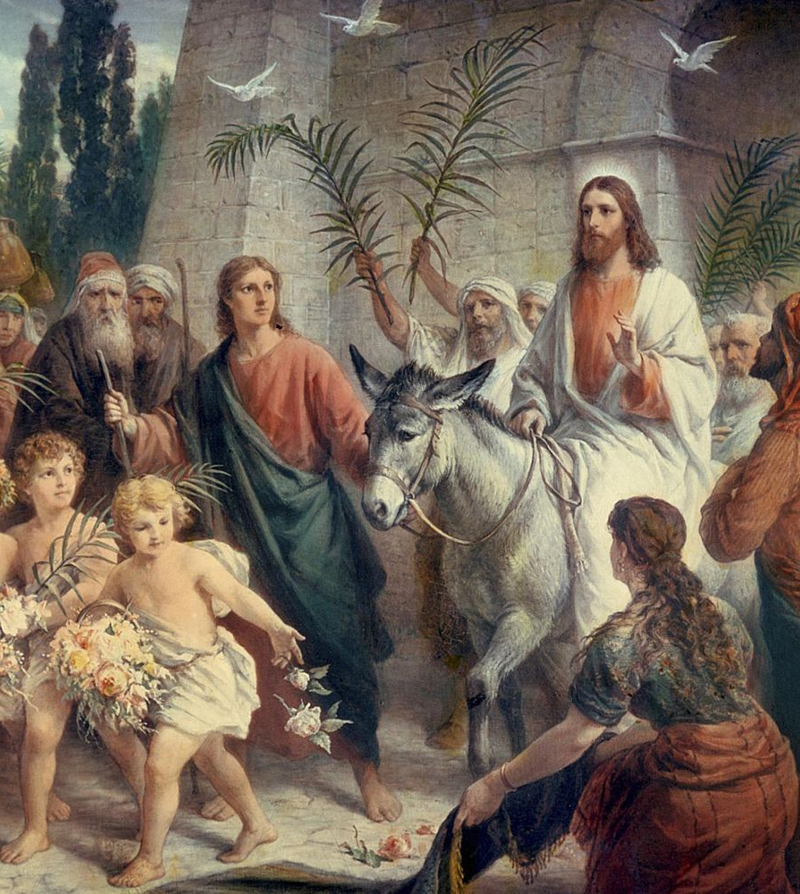
Palm Sunday
Palm Sunday marks the beginning of Holy Week.
It takes the form of a normal Sunday celebration but with the palm procession at the beginning.
After the blessing of palms and procession we go straight into the Liturgy of the Word – there is no Penitential Rite nor Gloria.
Music Suggestions
Hail Redeemer
The Children of Jerusalem – R. McDonagh
Faithful is the Lord and King
The Servant King
Love is his Word

Slide 3
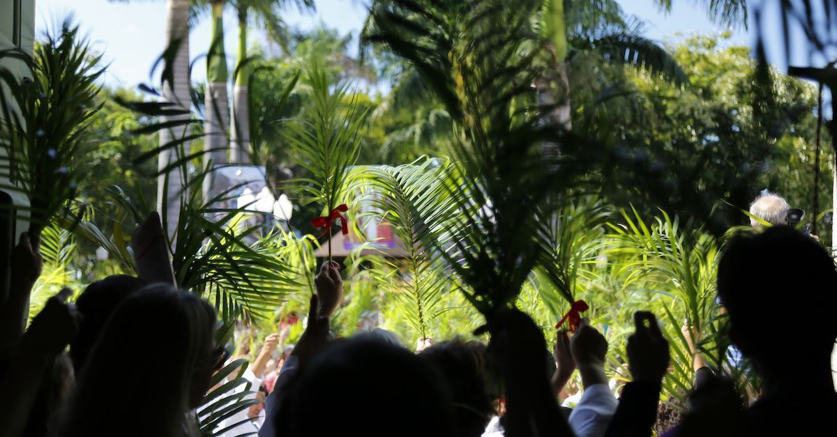
Palm Sunday
In Christ Alone
Lauda Zion (Joncas)
Lauda Jerusalem

Slide 4
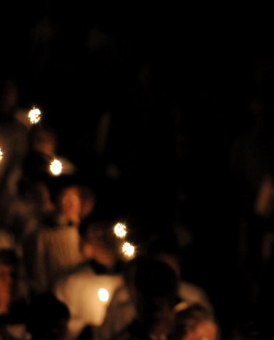
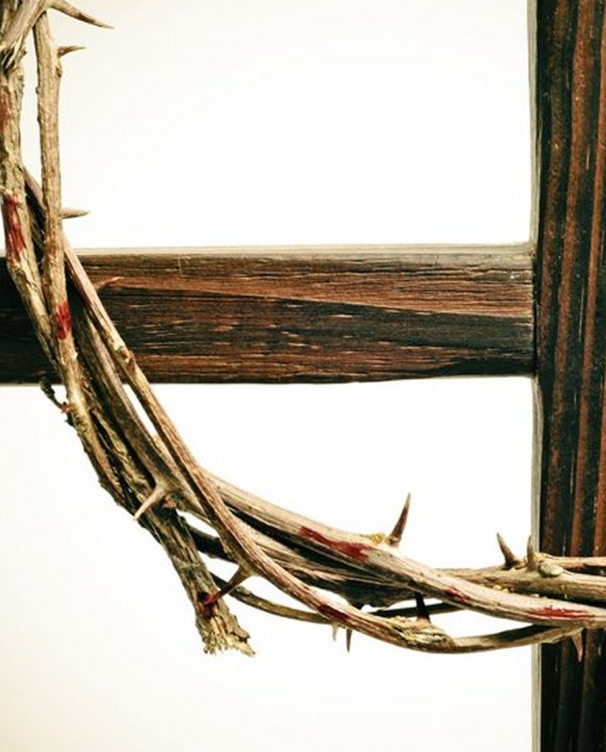
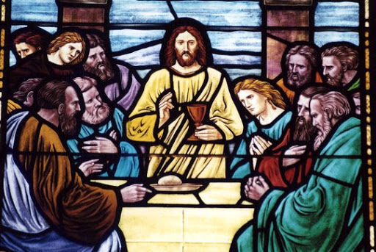
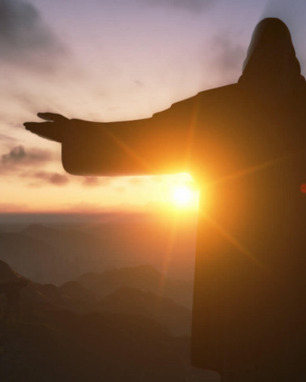
Easter Triduum
Since Vatican II in the 1960s the Easter Triduum is seen as the ‘summit of the liturgical year.’ It deserves the very best we can give.
The earliest Easter celebrations among Christians were celebrated in one day.
By the time of St. Augustine (700AD) it became a three-day celebration referring to the three separate moments within the Christian Passover – Christ dying, buried and resurrected.
The Triduum starts on Holy Thursday evening and ends on Easter Sunday evening.

Slide 5
The Easter Vigil is the high point of the Triduum
The season of Easter lasts for fifty days until Pentecost Sunday, May 23rd 2021.

Slide 6
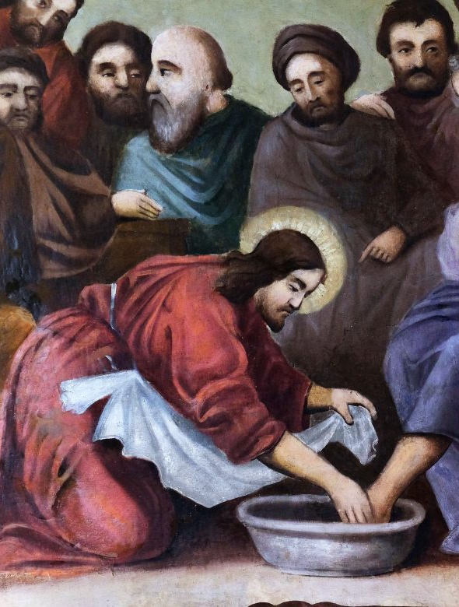
Holy Thursday
In a special way this night, we celebrate the evening of the Lord’s Supper, the first Eucharist.
The celebration should be special but keep some of the stops in for the Easter Vigil, which is the high point of the Triduum.
The entrance hymn should be processional and reflect the fact that we are opening the Easter Triduum.
Sing your Kyrie and Gloria.
Sing the Responsorial Psalm and Gospel Acclamation (no alleluia yet!!)
Music/song for the Washing of the Feet
Eucharistic Mass parts
Communion Hymns
Hymn/s for Procession to the Place of Repose

Slide 7
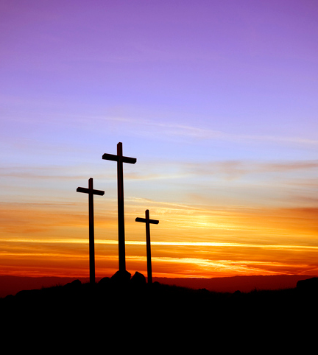
Good Friday
Good Friday is the most straight forward of the celebrations. There are five points of the liturgy where music is needed:
Responsorial Psalm
Gospel Acclamation
Intercessions
Veneration of the Cross
Communion

Slide 8
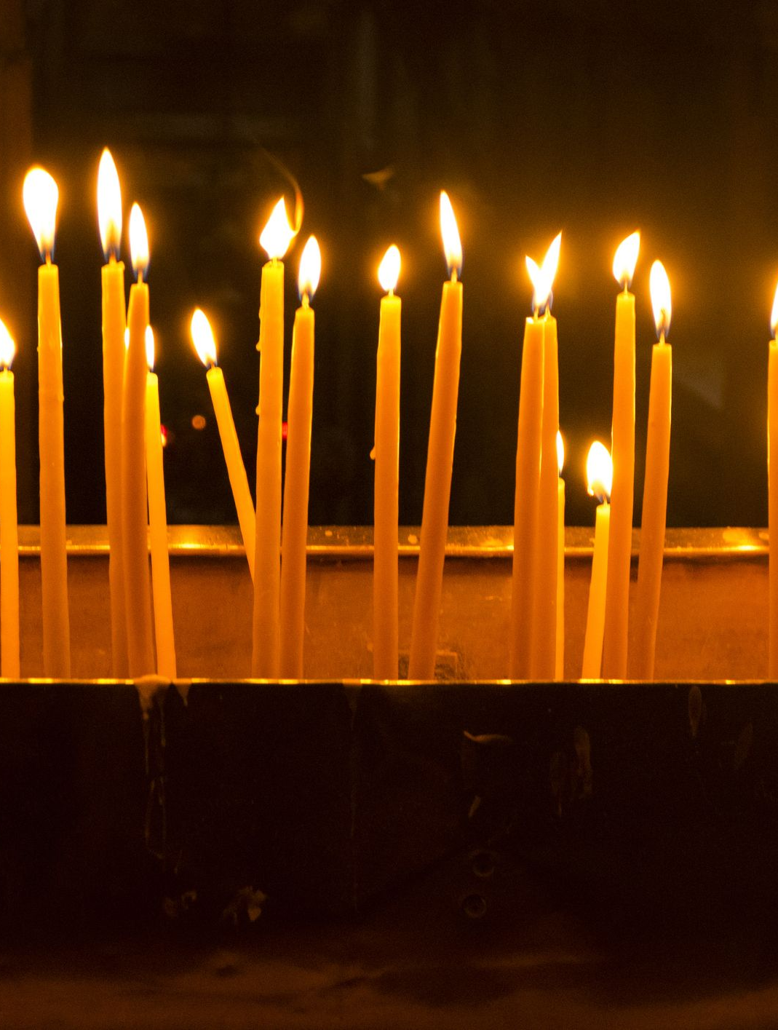
Easter Vigil
The night of nights – summit of the Triduum. There are four stages to the Easter Vigil
The Service of Light
Lumen Christi
Exsultet
The Liturgy of the Word
Psalms, Gloria and Gospel acclamation – Alleluia is back!
The Liturgy of Baptism
Sprinkling Rite after Baptismal vows are renewed
The Liturgy of the Eucharist
Offertory hymn, Mass parts, Communion hymn and Recessional hymn

Slide 9
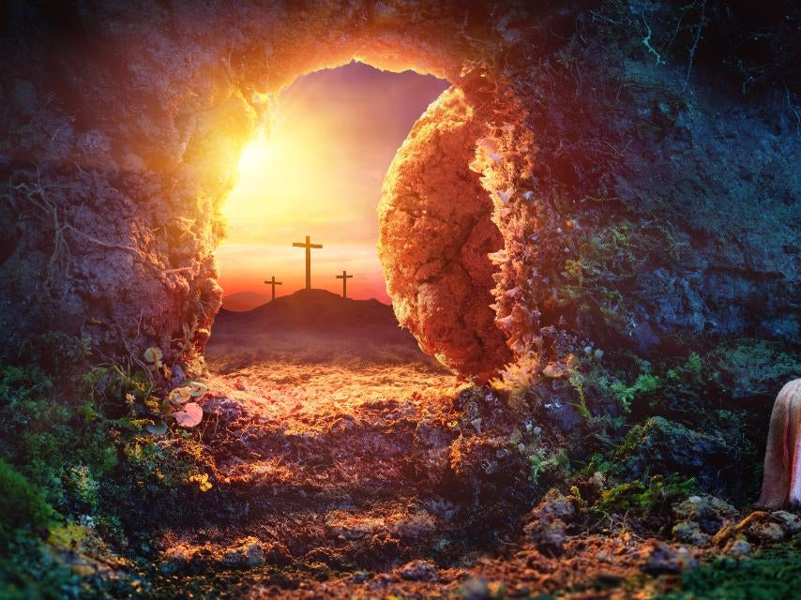
Easter Sunday
The celebration of Easter Sunday takes the shape of a normal Sunday Mass however, with all stops pulled out!

Slide 10
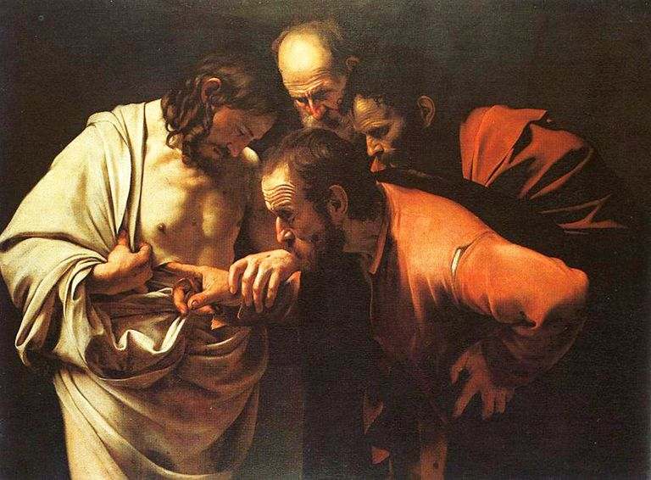
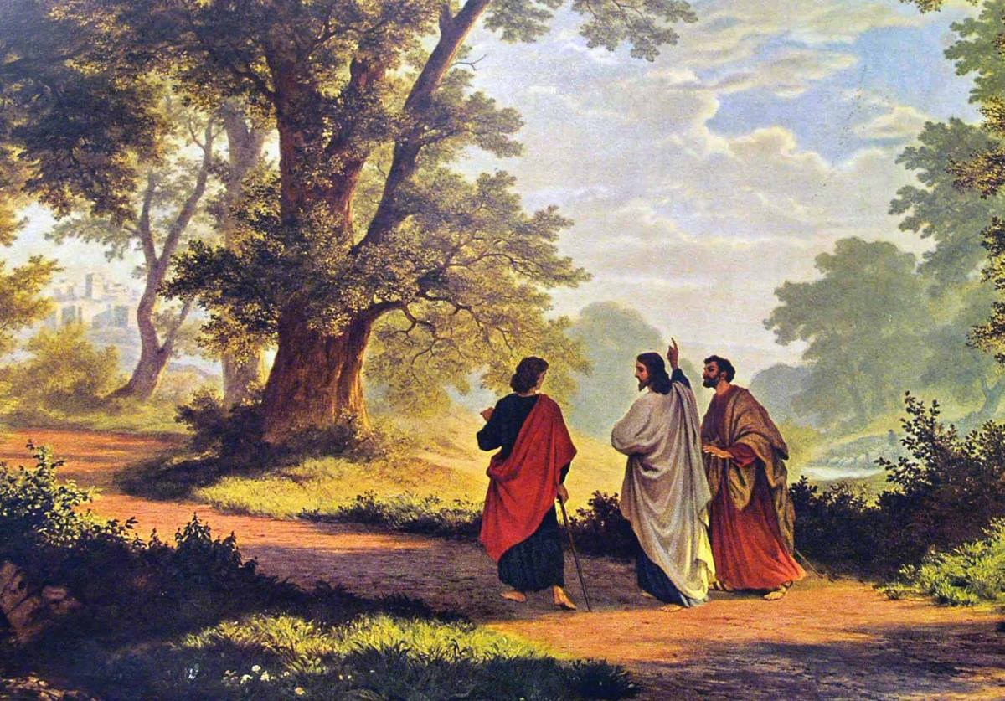
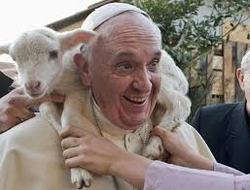
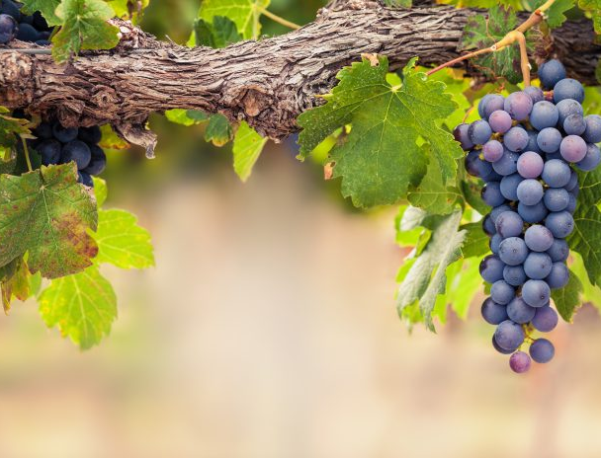
Easter Season
Second Sunday
Third Sunday
Fourth Sunday
Fifth Sunday
Divine Mercy Sunday
Doubting Thomas
Road to Emmaus
Good Shepherd Sunday – Vocation
I Will be the Vine

Slide 11
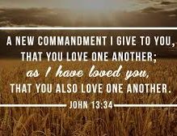
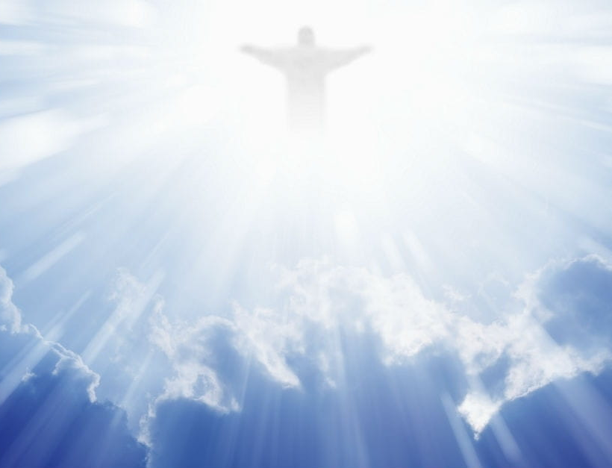
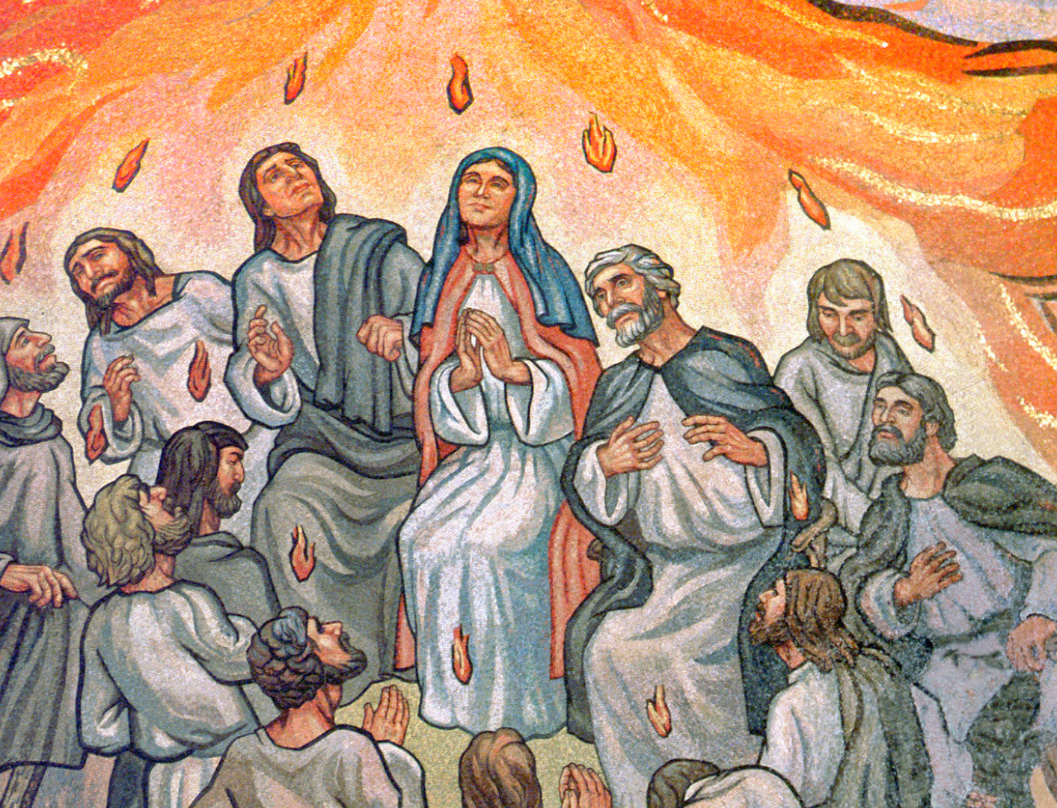
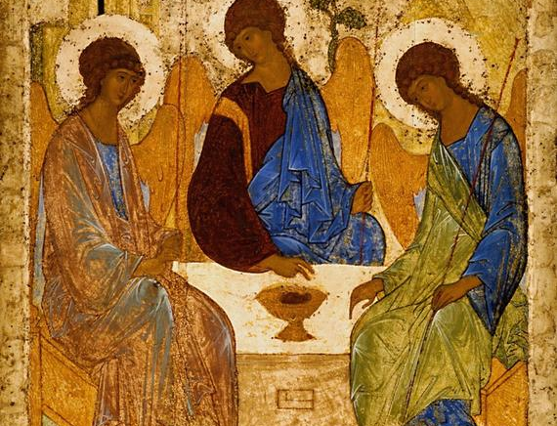
Easter Season
Sixth Sunday
Ascension
Pentecost
Trinity
I Give you a New Commandment

Slide 12

Resources
Feasts and Seasons 1 and 2 –
Compiled by John O’ Keeffe – Email president@spcm.ie
Those Three Days – By Fr. Patrick O’ Donoghue and Fr. Columba McCann
Catholic Hymns Old and New (Yellow Book)
Holy is the Temple – Collection by Bob Hurd
Here in Christ we Gather by Ephrem Feeley
Ancient Promise by Ronan McDonagh – New collection by McDonagh on the horizon!

