Slide 1
Holy Week 2021
From Palm Sunday to Easter Sunday

Slide 2
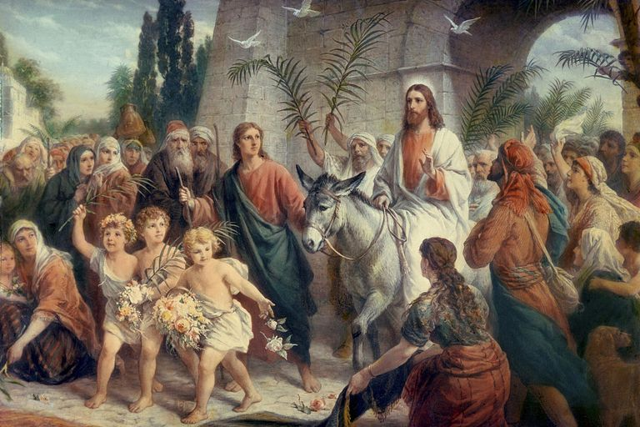
Sunday March 28th - Palm Sunday
Palm Sunday is a moveable feast that falls one week before Easter Sunday.
Christian worshipers celebrate the triumphal entry of Jesus Christ into Jerusalem, which took place the week before his death and resurrection
Palm Sunday, often referred to as Passion Sunday, marks the beginning of Holy Week, which concludes on Easter Sunday.
Something 'holy' is something set apart for God’s purposes. Holy Week, the most sacred and solemn week of the liturgical year, is a time we set apart, to focus on how we are spiritually renewed through the suffering, death, and resurrection of Jesus.

Slide 3
Palm Sunday remembers Jesus' Triumphant Entry to Jerusalem.
All four Gospels include the Triumphal Entry of Jesus Christ into Jerusalem:
The Gospel of John tells us:
‘The next day, the news that Jesus was on the way to Jerusalem swept through the city. A large crowd of Passover visitors took palm branches and went down the road to meet him. They shouted, 'Praise God! Blessings on the one who comes in the name of the Lord! Hail to the King of Israel! 'Jesus found a young donkey and rode on it, fulfilling the prophecy that said: 'Don’t be afraid, people of Jerusalem. Look, your King is coming, riding on a donkey’s colt.​' (John 12:12-15)
The Triumphal Entry is also found in Matthew 21:1-11, Mark 11:1-11, and Luke 19:28-44.

Slide 4
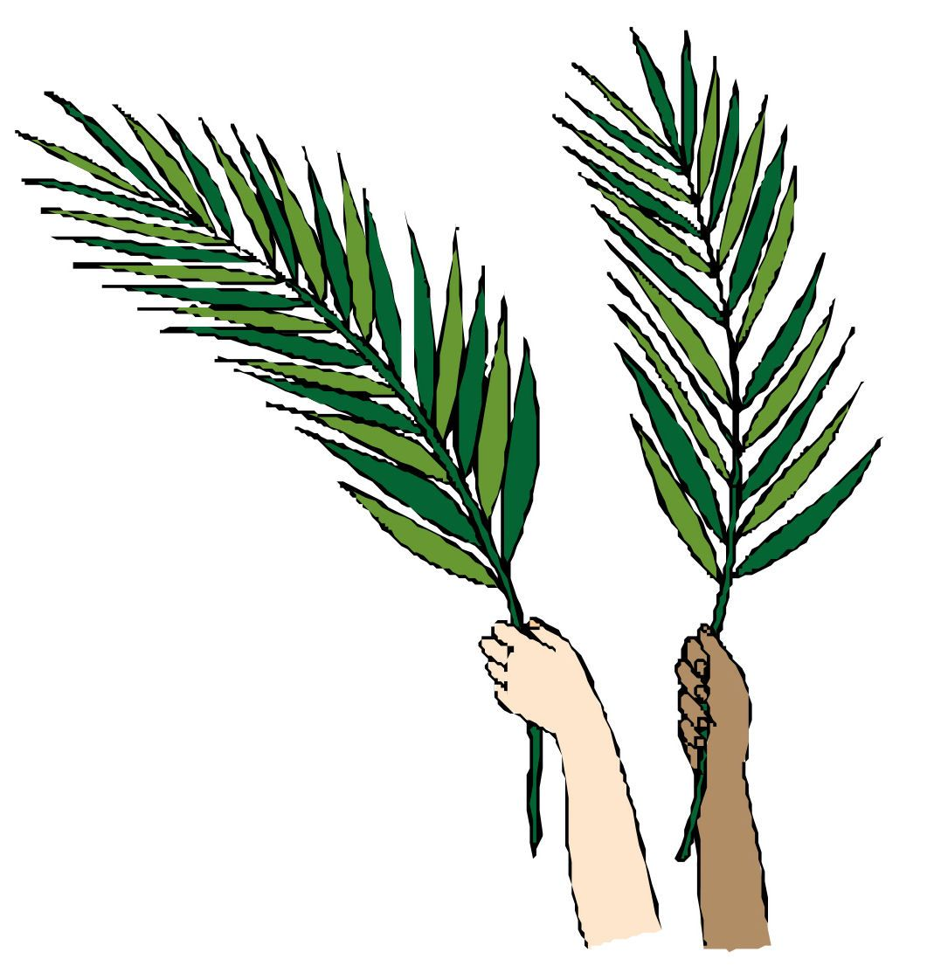
Palm Branches Today
Today, many Christian churches distribute palm branches to worshipers on Palm Sunday, which is the sixth Sunday of Lent and last Sunday before Easter. On Palm Sunday, people remember Christ's sacrificial death on the cross praise him for the gift of salvation, and look expectantly to his second coming.
Palm Sunday observances include the waving of palm branches in procession, the blessing of palms, and the making of small crosses with palm fronds.
Palm Sunday also marks the beginning of Holy Week a solemn week focusing on the final days of Jesus Christ's life. Holy Week culminates on Easter Sunday, the most important holiday in Christianity.

Slide 5
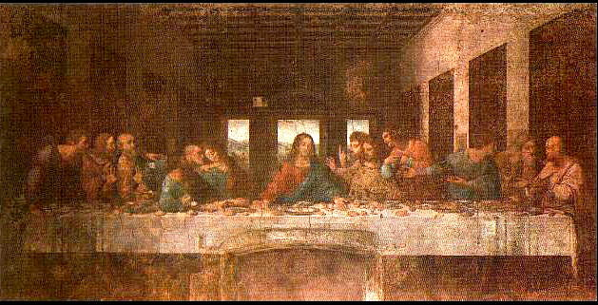
Easter Triduum
Holy Thursday - The Last Supper
The Triduum (three days) begins on the evening of Holy Thursday and continues through Good Friday and the Easter Vigil on holy Saturday and ends on Easter Sunday
Holy Thursday is the commemoration of the Last Supper of Jesus Christ, when he established the sacrament of Holy Communion prior to his arrest and crucifixion. It also commemorates His institution of the priesthood. The Last Supper was the final meal Jesus shared with his Disciples in Jerusalem. During the meal, Jesus predicts his betrayal.

Slide 6
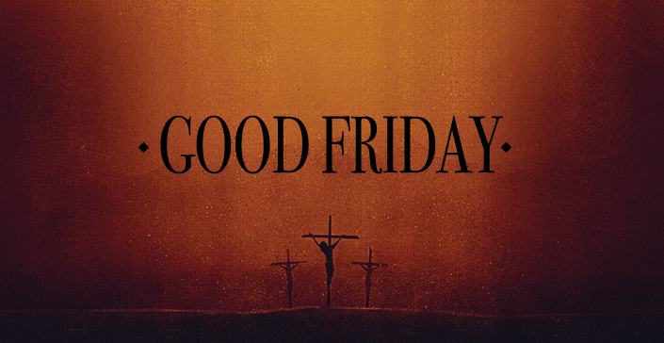
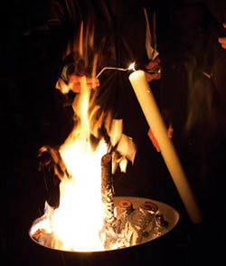
Good Friday and Holy Saturday
Good Friday is a day of mourning. During special Good Friday services Christians meditate on Jesus's suffering and death on the cross, and what this means for their faith.
Holy Saturday is the day in the Christian liturgical calendar that marks the time between Jesus’ death and burial on Good Friday and before his resurrection on Easter Sunday.
As on Good Friday, the church offers no Mass for Holy Saturday. The Easter Vigil Mass, which takes place after sundown on Holy Saturday, properly belongs to Easter Sunday, since liturgically, each day begins at sundown on the previous day.
Easter Vigil Mass often begins outside of the church near a charcoal brazier, representing the first vigil. The priest then leads the faithful into the church where the Paschal/Easter candle is lit and the mass is held. Traditionally new Christians are baptized during this Mass and all the people renew their Baptismal vows
The Alleluia is sung for the first time since the beginning of Lent

Slide 7
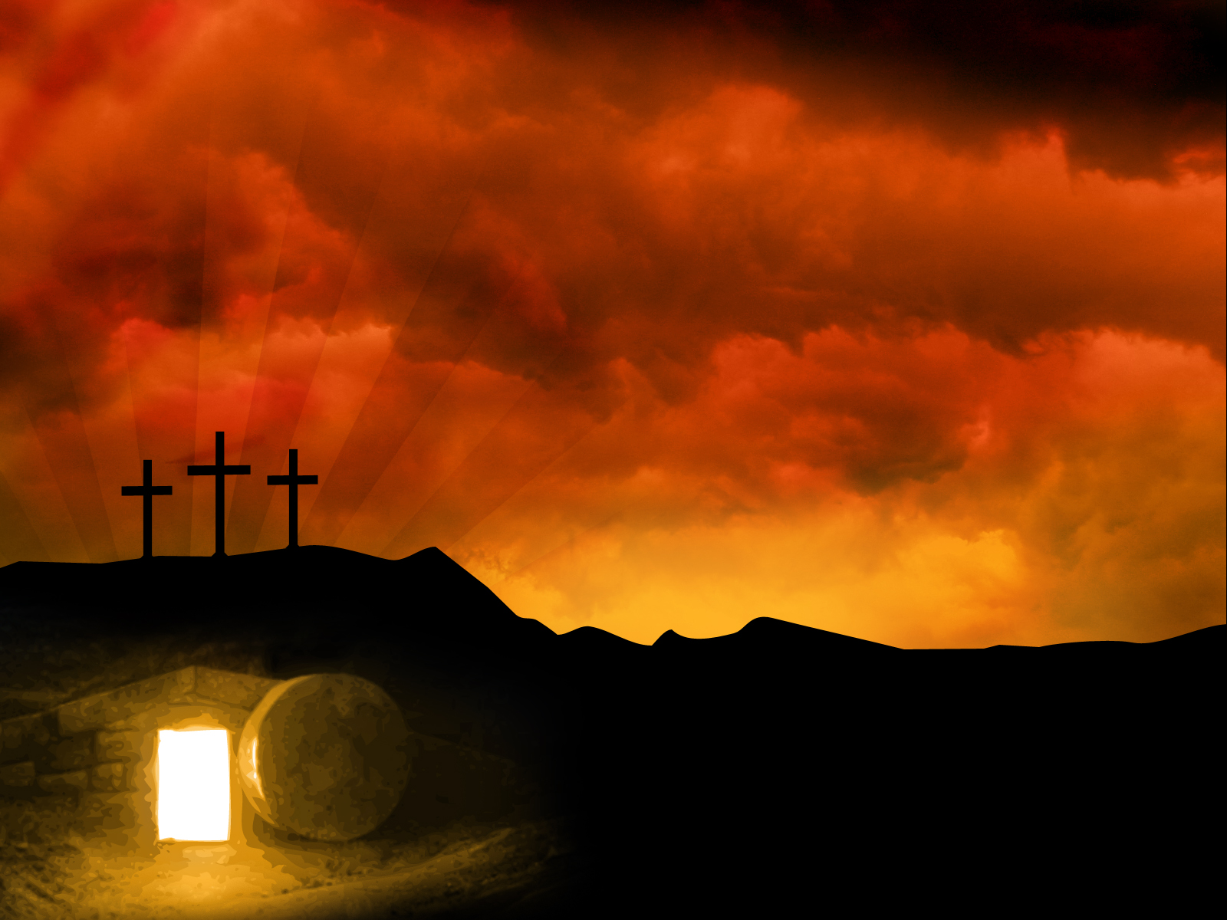
Easter Sunday – Christ has risen
Many Christians view Easter as the greatest feast of the Church year. It is a day of joy and celebration to commemorate that Jesus Christ is risen.
Many Christians worldwide celebrate Easter with special church services, music, candlelight, flowers and the ringing of church bells.
Easter processions are held in some countries such as the Philippines and Spain.
Easter Sunday comes at the end of 40 days of prayer, fasting, and almsgiving. Through spiritual struggle and self-denial, we have prepared ourselves to die spiritually with Christ on Good Friday, the day of His Crucifixion, so that we can rise again with Him in new life on Easter Sunday.

Slide 8
Prayer
Lord Jesus Christ, you were fastened with nails to the wood of the cross and raised on high for all to see. As the sun grew dark and the earth quaked, you surrendered your spirit to your Father, descended among the dead, broke open the gates of hell, and freed those bound in darkness. As angel choirs rejoiced, you were raised to life again on the third day, destroying death by your own death and canceling the power of sin. By these mighty deeds on our behalf, rescue us from our blindness and inspire us anew by your Holy Spirit, and lead us into a life of prayer and service worthy of your awesome sacrifice, O Savior of the world, we thank you and we ask you to guide and help us to follow you faithfully throughout our lives. ~AMEN.

