Slide 1
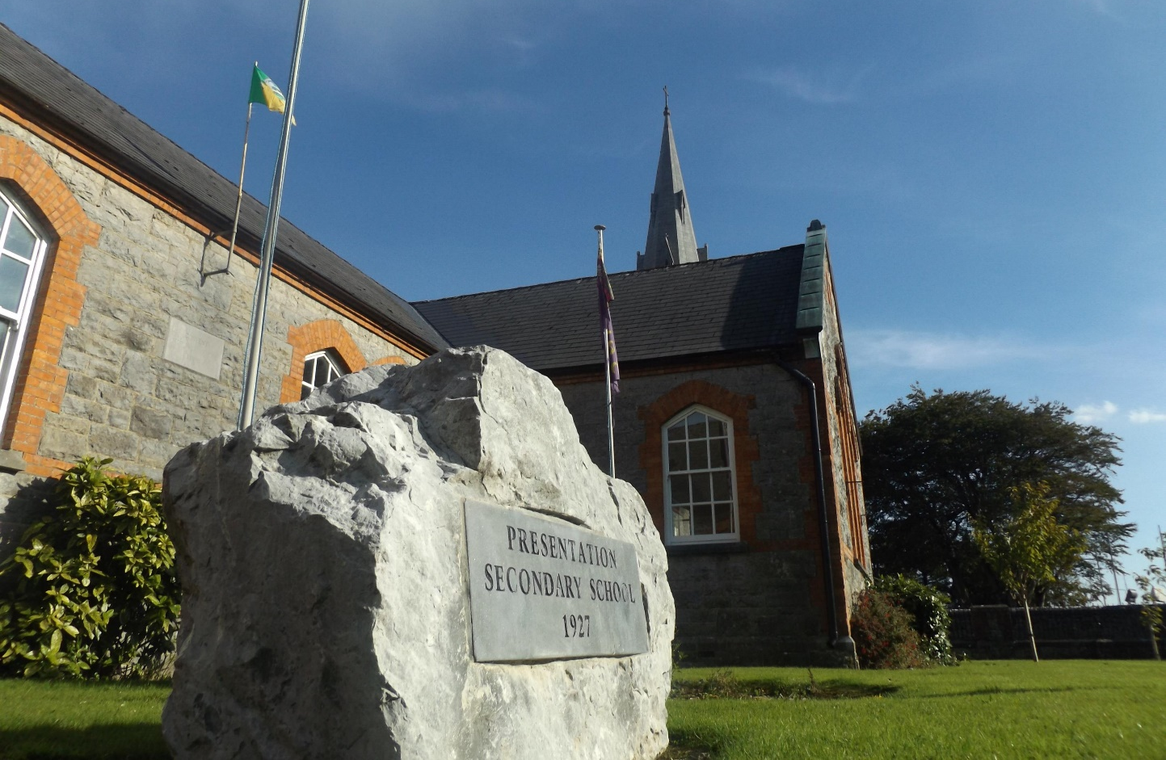
Religious Education Planning - Junior Cycle, Transition Year & Non-Exam Leaving Certificate

Slide 2
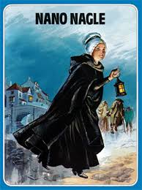
Ethos

Slide 3
Culture
Actions & Behaviours
Core Values
Root Beliefs

Slide 4
Education Act 1998 – Section 15 Paragraph 2 (B)
Ethos = Characteristic Spirit

Slide 5
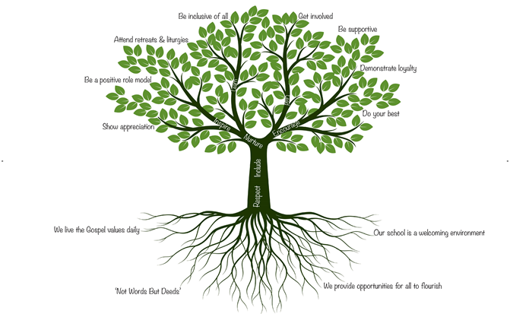
Vision Statement
Mission Statement
Culture
Ethos

Slide 6
Mission Statement
Guided by our Catholic ethos we provide a positive, respectful, inclusive, and welcoming learning environment for all, with a commitment to academic excellence.
Our students are afforded many opportunities to reach their full potential in all aspects of education.
We are dedicated and inspiring leaders of innovative and modern teaching practices, supported by a highly equipped technological learning environment.
Root Beliefs Core Values Actions & Behaviours
Vision Statement
Our vision is to prepare accomplished, confident and independent young adults to pursue their aspirations and develop a passion for equality, justice and life-long learning so that they will make a positive contribution to the society in which they live.

Slide 7
Junior Cycle RE
Linking School Culture and Ethos to Planning

Slide 8
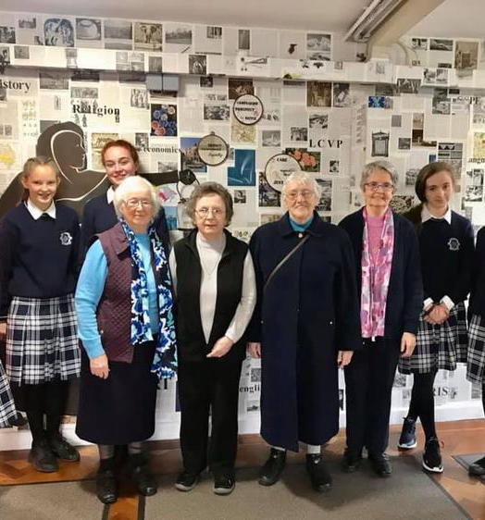
Whole School Approach
Religious Education is supported by all other areas of school life e.g. school functions, assemblies, Well Being week, Ethos Wall
The values and Gospel message of the Kingdom of God that we teach about is lived out in all other areas of school life.
We set the seeds of this ethos and culture in First Year and build upon it each year after. First Years are introduced to the life of Nano Nagle, the Presentation Sisters and our Welcome Ceremony invites them to participate in this community at an active level.

Slide 9
Approaches
There are three main elements to planning.
Liturgical Calendar Based Plan – School Ethos
Yearly Plan – 3 Year Cycle – Department Level Planning
Units of Learning Planning – Department Level and Individual Class Teacher planning.
This is a living document and constantly changing. We are constantly reviewing and changing our approach depending on our SIP, school context, cultural context, resources etc.
The syllabus allows you to incorporate your school ethos and culture because of the fluidity of the three strand and the SOLs.
The syllabus allows you to revisit topics year on year – Spiralling. This also facilitates relevance to your school ethos, cohort, locality etc.

Slide 10
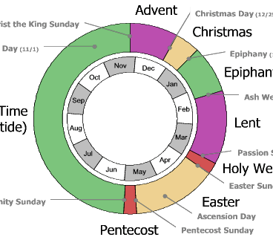
Liturgical Calendar
Incorporate the seasons of the Liturgical Year into the student's learning. Each season can be revisited each year – Spiralling in action. Introduce a topic in first year and build upon it each consecutive year.
Example - Season of Lent – Lenten Prayer Services, Lenten Promise Jars, Visual displays. Focus can be placed on an element of Lent in each year e.g. season, rituals, expressing religious belief.

Slide 11
Links to Wellbeing
Responsible – for their own work, for the consequences of their actions
Connected – links to the community e.g. visits with the Presentation Sisters, Vincent De Paul, the local church, Trocaire
Resilient – encourage perseverance – Nano Nagle is a role model
Respected – different cultures encountered in the syllabus, respect shown in school
Aware – links to the morality element of the course. Trocaire, Stewardship. Homelessness and other social issues

Slide 12
Links to the Three Strands
Expressing
Expressing beliefs – links to the Liturgical Calendar
Exploring
Exploring Questions – seeking answers to questions, looking at different perspectives
Living
Living Our Values – Trocaire, Presentation Week, Well Being Week, Catholic Schools Week, everyday actions where we can show love in school. Nano Nagle motto – Not Words, But Deeds

Slide 13
Department Planning
This can be done on a yearly basis or a Unit of Learning basis. We try to have a departmental approach here – using the same active methodologies, assessments, class structure etc
Again you need to remember it's a living document and will change due to circumstance and class groups – whether it is exam or non-exam
Here you are incorporating the SOLs or Learning Outcomes, your Units of Learning and topics, assessment, learning experiences, differentiation.
The Learning Outcomes are the building blocks and the starting point – they will create your units of learning which then in turn will create your overall plan.

Slide 14
Creating a Unit of Learning.
What to include:
Aim of the Unit
Learning Outcomes
L1LP/L2LP
Assessment
Learning Experiences.
CBAs
Key Skills

Slide 15
Individual Class Planning
Individual teacher style
Class Group
Differentiation
School Ethos and Culture
Liturgical Calendar
Wellbeing
SIP

Slide 16
Transition Year RE
Looking Up Course

Slide 17
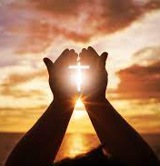
Transition Year Prayer
Dear Jesus,
Listen to our prayer and promise at hard times You’ll be there,​
We hope You treat us with love and care and we know we can turn to You anywhere,​
We hope this year is full of fun and happiness and we are very grateful for every moment we spend together. ​
We pray for the people affected by Covid 19 that they will get well soon and recover.​
Grant us each day the desire to do our best, to grow mentally, morally and physically. ​
Fill our minds with knowledge and give us the strength to always try our best at school and at home.​
And that we may reach our full potential.​
Amen

Slide 18
The aim of the Catholic Post-Primary Religious Education Curriculum is:
‘To help children mature in relation to their spiritual, moral and religious lives, through their encounter with, exploration and celebration of the Catholic faith’.

Slide 19
Looking Up!
This is a pilot programme that Presentation Secondary School Castleisland were invited to take part in. It aims to build on the work completed by students in Junior Cert and honour the tradition of Jesus. It has been interesting and engaging for the students guiding them in looking at how Jesus is explicitly and implicitly found in contemporary culture.​
Each teacher was provided with detailed lesson plans which are suitable for all planning needs and a teacher manual. Students are provided with PowerPoint presentations instead of a textbook and a student journal.​
Each lesson also contains time for reflection and a closing prayer or guided meditation.​
It is very suitable for a school which has a strong Catholic ethos and whose students have sat the Junior Cert Religion Exam.​
It gives time for students to focus on their own personal faith development journey before continuing into Senior Cycle.

Slide 20
Course Contents
A New Beginning | Jesus teaches about the Kingdom of God | Ritual and Prayer | Eucharist and Reconciliation
1. A New Beginning | 11. The Parables of Jesus | 15. The Role of Symbols in our life | 19. The Origins of the Mass
2. Who do I say Jesus is? | 12. The Beatitudes | 16. The role of ritual in our lives | 20. The Celebration of the Mass
3. Who do Christians say Jesus is? | 13. Jesus Valued and Respected Women | 17. Ritual and Symbol in religious worship and celebrations | 21. Forgiveness and Reconciliation
4. Who do Muslims say Jesus is? | 14. Jesus valued the gift of creation | 18. Prayer
5. Who do Jews say Jesus is?
6. Comparing Christian and Secular Worldviews
7. Christian Values reflected in film
8. Religious themes reflected in Secular Music
9. Communicating with God through Sacred Music
10. Religious Themes in Poetry

Slide 21
Sample Lesson – Lesson 8 ‘Religious Themes Reflected in Secular Music’

Slide 22
Main Topics Covered
Definition of Sacred and Secular – Revision of Junior Cycle
Comparing songs and deciding if they are Sacred or Secular
Discussing the concept of Religious Themes in songs ; forgiveness, love, sacrificing oneself for the sake of others, etc
Class discussion – ‘The search for meaning’ - What questions do you have about the meaning of life?
Study 3 songs: Listen to some secular music to assess whether themes like religious belief and the search for meaning can be found in such non-religious sources.
‘Make you feel my love’ by Adele
‘This is Me’ from The Greatest Showman
‘Blinded by your Grace’ Pt 2 by Stormzy

Slide 23
“But I won't let them break me down to dust I know that there's a place for us”
“I am brave, I am bruised I am who I'm meant to be, this is me”
“We are bursting through the barricades And reaching for the sun (we are warriors) Yeah, that's what we've become”
“And I know that I deserve your love There's nothing I'm not worthy of”

Slide 24
Reflective Journal Exercise
One thing I found interesting in this lesson was …
One new thing I learned from this lesson was …
One question I still have following this lesson is …
“That even though I didn’t consider music I normally listen to religious most of the songs I listen to have religious themes in them”
“If normal music has religious themes why don’t we hear more of the music we listen to in mass?”
“If we listened to pop music in mass and school prayer services would we lose all the Religious music that we normally hear in church or school prayer services?”

Slide 25
Non-Exam RE - Leaving Certificate

Slide 26
Layered 5th & 6th Year Planning Non-Exam
World Events & Projects
LC RE Syllabus
Feast Days
Liturgical
Calendar

Slide 27
5th Year Scheme of Work
Term 1 - Sept – Dec : 16 Weeks
Ice Breaker Activity – Desert Survival Challenge –
Community, Skills & Values
Liturgical Calendar - Overview
The Search for Meaning
September 11th – 9/11 (Link to Islam)
The Search for Meaning – Music
The Search for Meaning – Film
The Search for Meaning – Literature
The Search for Meaning – Art
Origins of Philosophy
Plato
Plato & Allegory of the Cave – (Link to the Matrix Film)
Presentation Week - Project
Advent & Christmas
Christianity – Jesus birth and the Messiah
Term 2 - Jan – Mar : 10 Weeks
Christianity – Origins, Palestine at the Time of Jesus
Catholic Schools Week - Project
St. Brigid's Day – Cross Making
St. Blaise
St. Valentine
Christianity – Jesus’ Public Ministry (The Story of God Series – Netflix – Miracles)
Ceiliúradh na nÓg Project – 6 Weeks
Ash Wednesday
Lent
Trócaire – Lenten Appeal
St. Patricks Days
Holy Week
Christianity – Death & Resurrection of Jesus

Slide 29
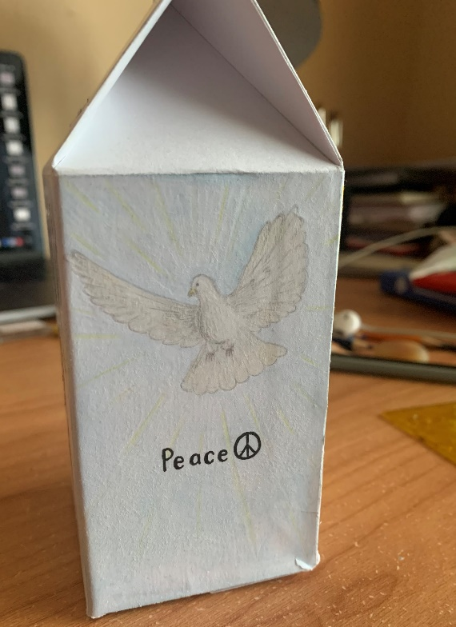
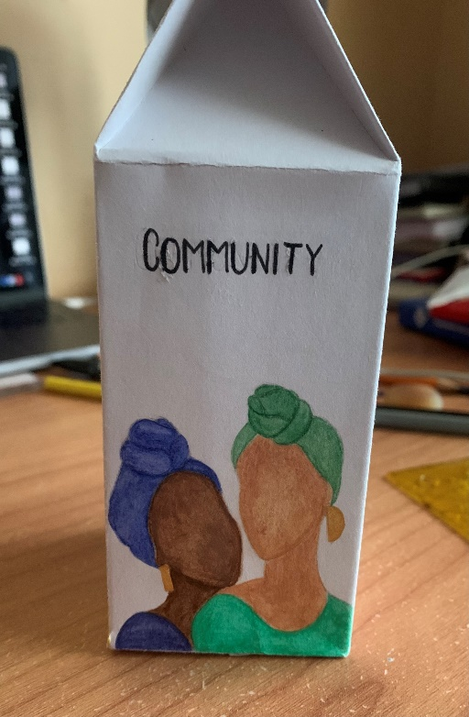
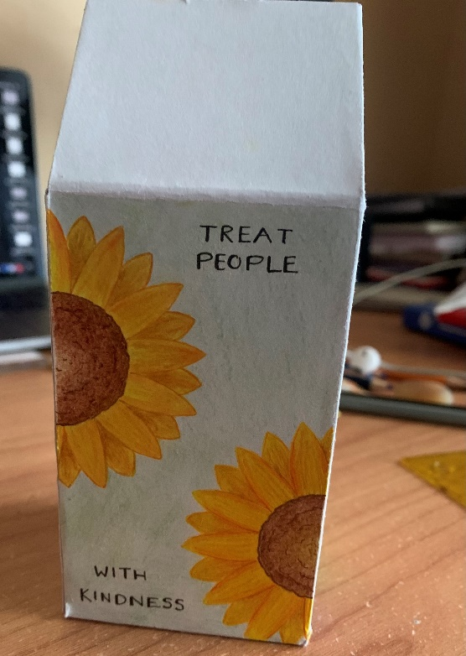
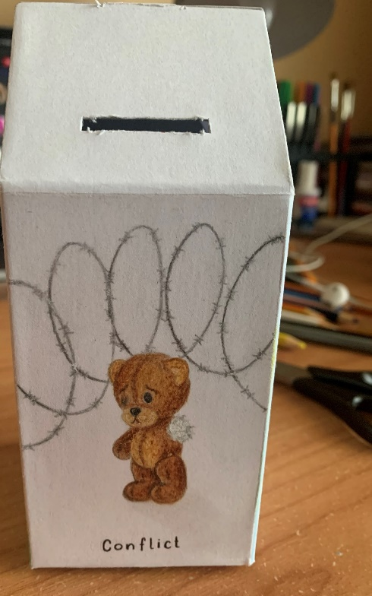
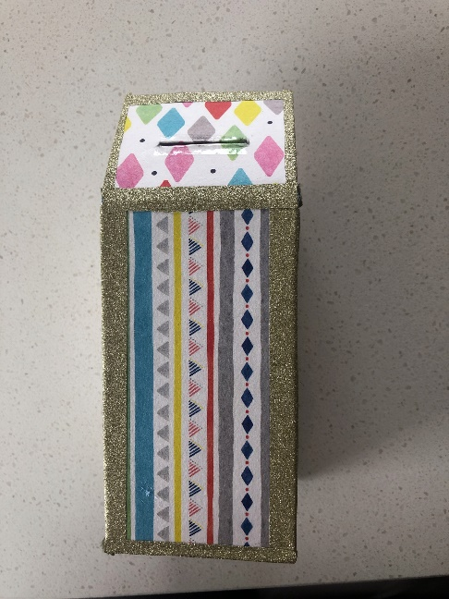
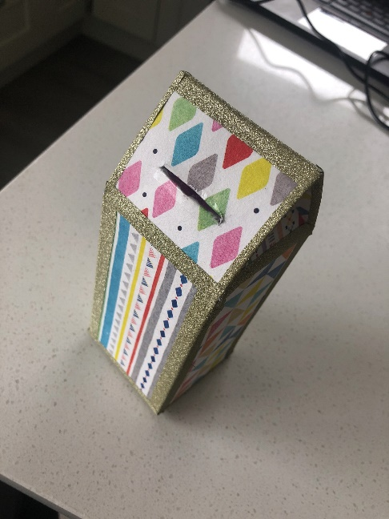
Sample of Students Work – Ceiliúradh na nÓg

Slide 30
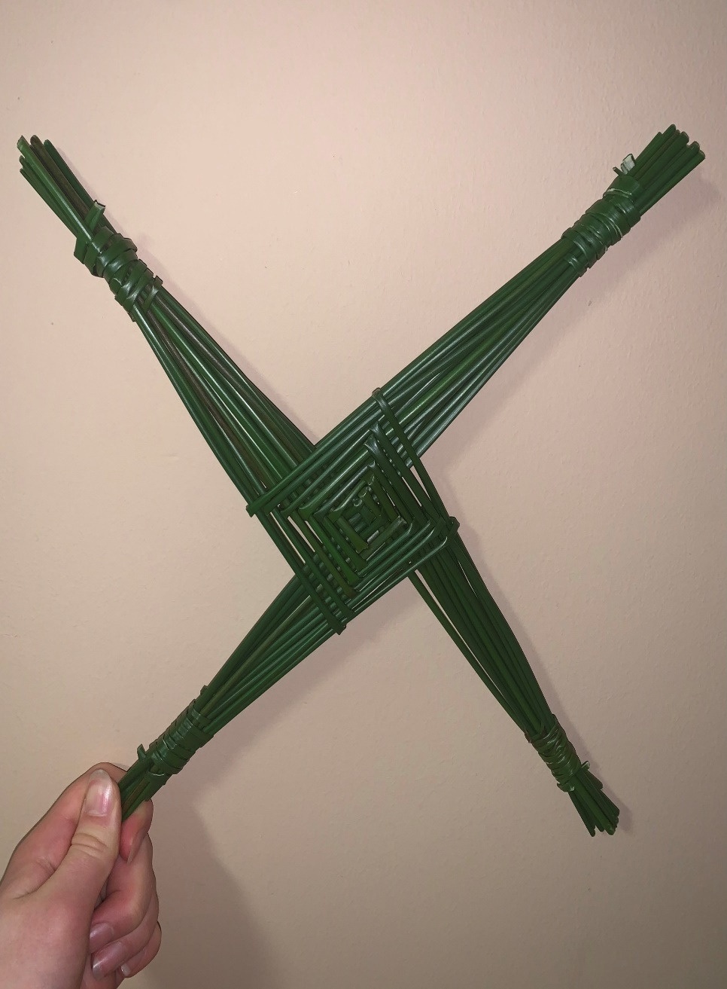
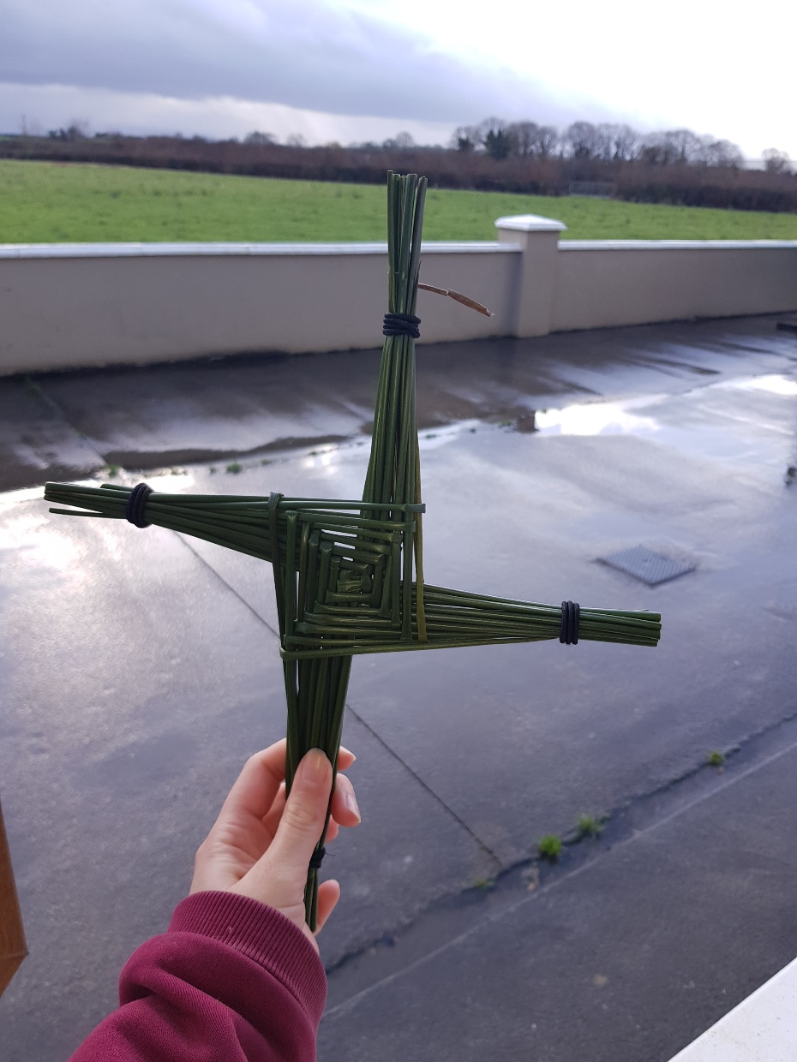
St. Brigid’s Day

Slide 31
Leaving Certificate Exam Religion

