Slide 1
The Sacrament of Confirmation. “Chosen, Gifted and Invited to Respond”. Session 3.
How can I make a difference?

Slide 2
Prayer for help
TO BE WITNESSES!
Let us begin with a Prayer:
Holy Spirit, you are the giver of many gifts which God wants to give me personally.
Open my heart and my mind as I prepare for Confirmation. Increase my desire to know and follow Jesus as His disciple with a grateful and courageous heart. Amen.

Slide 3
Let’s review what we did last week!
https://www.youtube.com/watch?v=yY554Jj_KNg&feature=youtu.be

Slide 4
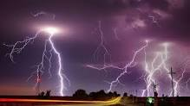
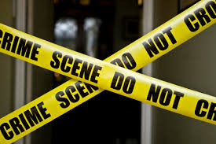
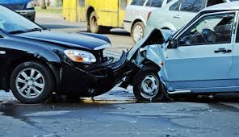
A WITNESS
Have you ever witnessed a natural phenomenon, like a storm or a tornado?
Have you witnessed a car- accident or to a crime?
Witnesses sometimes go to Court to tell the truth of exactly what they saw.
They help represent the truth of what occurred.

Slide 5
The Holy Spirit can help us to:
give WITNESS, but in a different way:
To our Faith, to what we believe.
be honest, to speak courageously and defend our FAITH.
We might feel afraid but we are not alone. The Holy Spirit gives us the words that we need.

Slide 6
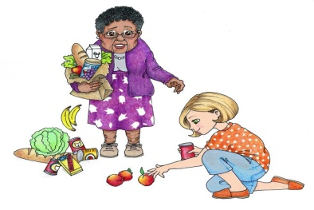
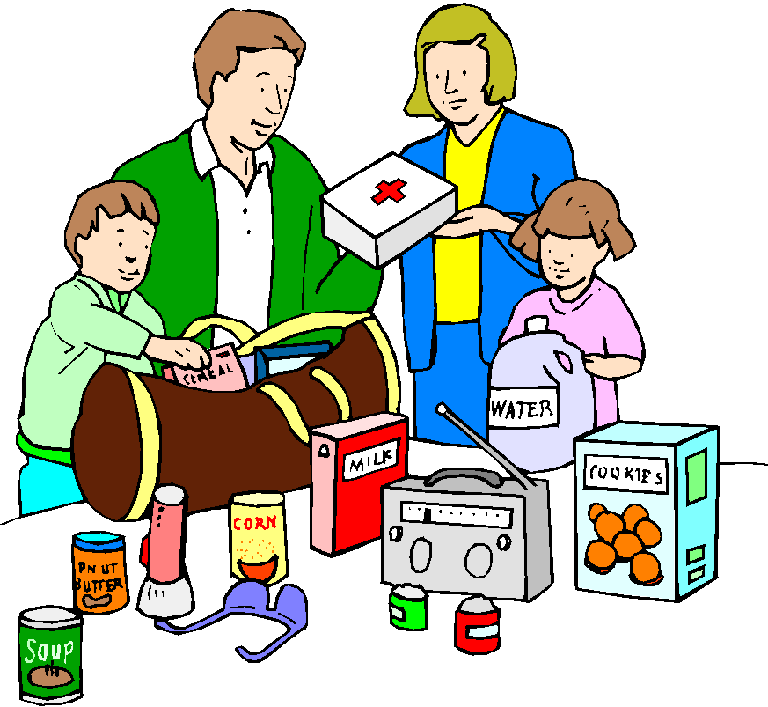
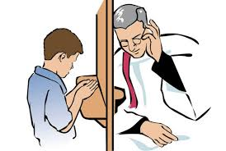
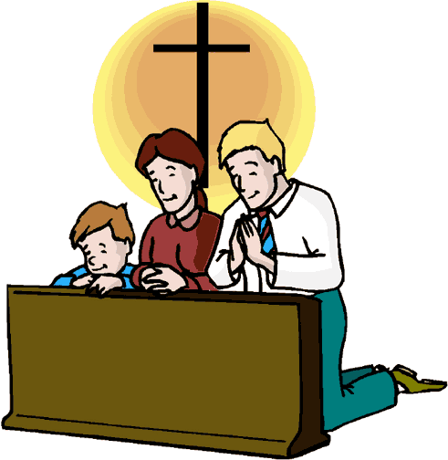
So how can I be a witness?
The Holy Spirit, is always trying to work in us. Sometimes he makes himself felt, and other times he doesn’t – but you can be sure that he is always present in you! He often places good desires in your heart.
to spend a little more time praying
He can inspire you to think of others and not just yourself,
to attend Mass on Sundays with your family,
to go to confession when you can
to share your free time to help others.

Slide 7
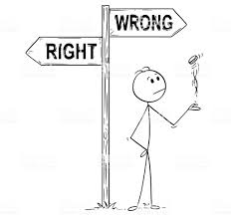
To be a witness, WHAT DO I NEED??
Honesty
Courage
Commitment... to do
what is right

Slide 8
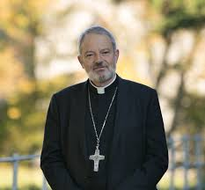
Bishop Kevin has a message for us.
https://www.elphindiocese.ie/confirmation/bishop-kevins-confirmation-page-2019-2020/

Slide 9
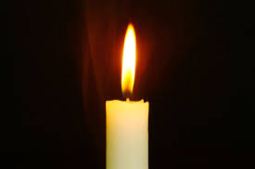
I can be a light in the world in my own home.
The Gospel of Matthew.
You are a light for the whole world. A city built on a hill
cannot be hidden. No-one lights a lamp and puts it under
a bowl; instead he puts it on the lamp stand where it gives
light for everyone in the house. In the same way your light
must shine before people so that they will see the good
things you do and praise your father in heaven.
Matthew 5:14-16

Slide 10
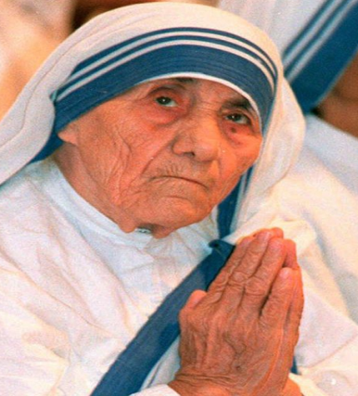
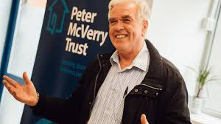
People Who Give Witness To Their Faith…
Celebrating Confirmation 2020
Can you be a witness too?
Saint Teresa of Calcutta felt a calling from God to help the poor. She devoted her whole life to caring for the sick and dying in Calcutta.
Fr. Peter Mc Verry works in the inner city in Dublin.
He set up a charity which helps vulnerable youths and drug addicts.

Slide 11
Do you know who else witnesses their faith and can help you?
The saints who have gone before us!
During the Covid Crisis there is so much good to be seen in action.
Doctors, Nurses, Hospital staff, volunteers.
How can you help as a good person and as a Christian?
So many Christians are filled with the Holy Spirit to act bravely & to speak the truth.
They gave witness through their actions and how they live their everyday lives

Slide 12
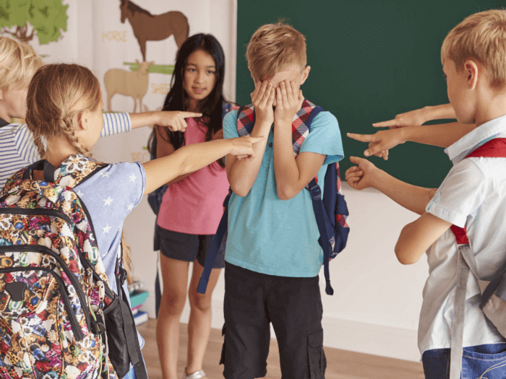
How can I be a witness to my faith?
Set up a prayer Space in my home.
Light a candle and say a prayer.
Talk about your faith or with your Family.
Go to Mass or watch Mass via stream during this time at home.
Have you ever been embarrassed to practice your faith in public?
The Holy Spirit will help you to do what is right.
The Holy Spirit can help!

Slide 13
We can be Witnesses by Showing People the Way to Live
We can show people how to live by giving good example,
by showing through our words and actions that we try to
love God and others.
By sharing toys, books etc. with others during this time.
By helping out with jobs at home.
By keeping in touch with our grandparents, by phone or by writing to them at this time.
By making sure nobody is left out.
By being thoughtful and helpful at home

Slide 14
We can be witnesses by Overcoming the Darkness and Evil Around Us
We don’t have to follow the crowd when people are doing wrong. We can do the right thing, show love and so encourage people to turn away from sins and selfishness.
Examples:
We don’t have to jeer at somebody even though others are doing it.
We don’t have to take part in something that is wrong and dangerous.

Slide 15
We can be witnesses by being Bright and Cheerful
Nobody likes a gloomy face! People who are bright and cheerful bring a lot of love into other people’s lives. We can be lights by our cheerfulness and joy. When we are cheerful and joyous the light of God’s love shines through us.
Come Holy Spirit . Enkindle in us the fire of your love.

Slide 16
Post Confirmation Commitments click below or view on Grow in Love 6th class resources.

Slide 17
Reflection
“All the earth watches with interest To see what I shall become. The future hangs in the balance, For what I am The world of tomorrow will be”.
Holy Spirit Guide me so that I may respond generously.
Click on the following link to
“We are the World” !
https://www.youtube.com/watch?v=8jKnuc6XqgQ

Slide 18
Thank you for your participation.
Please complete the questionnaire by clicking on the following:

