Slide 1

Connect with Confirmation 2020

Slide 2
St. Augustine's prayer to the Holy Spirit
Breathe in me, O Holy Spirit, that my thoughts may all be holy.
Act in me, O Holy Spirit, that my work, too, may be holy.
Draw my heart, O Holy Spirit, that I love but what is holy.
Strengthen me,
O Holy Spirit, to defend all that is holy.
Guard me, then, O Holy Spirit,
that I always may be holy.
Amen

Slide 3




Connect with Confirmation 2020
Remember the Gifts and the Fruits?
Click on the icon below to go to an interactive webpage:
Looking forward to Celebrating the Sacrament of Confirmation?
The big day will arrive sooner than you think!
Make sure you are online!

Slide 4
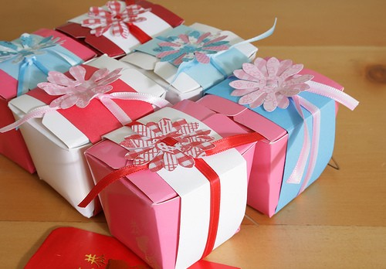
Connect with Confirmation 2020
THE SEVEN GIFTS OF THE SPIRIT:
Wisdom
Understanding
Right judgement
Courage
Knowledge
Reverence
Wonder & Awe

Slide 5

the Fruits of The Holy Spirit
Connect with Confirmation 2020
Love
Joy
Peace
Patience
Kindness
Goodness
Gentleness
Trustfulness
Self - control

Slide 6




We use signs and symbols every day
Connect with Confirmation 2020
Traffic Lights
Road Sign
Barber Shop
What other symbols can you think of?
We also use symbols for the Holy Spirit.
Which symbols do you know about?

Slide 7
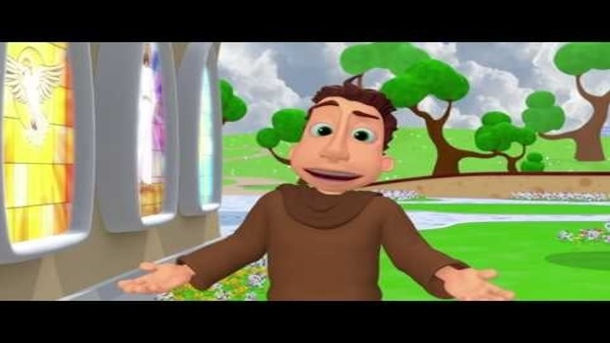
Symbols of the Spirit
Connect with Confirmation 2020
Watch this video and explore symbols :
NEW!!
Make sure you are online!

Slide 8

Symbols of the Spirit
Connect with Confirmation 2020
Fire, Breath, Wind, The Dove
Fire gives us light. The Holy Spirit lights up our lives. He shows us the way and helps us to grow.
Fire gives us warmth. The Holy Spirit warms our heart so that we are filled with God’s love for those around us. The Holy Spirit helps us to be warm-hearted.
Fire melts and moulds.
The Holy Spirit melts our sins and our hardness of heart. He moulds us into the new people that God wants us to be - followers of Jesus.

Slide 9
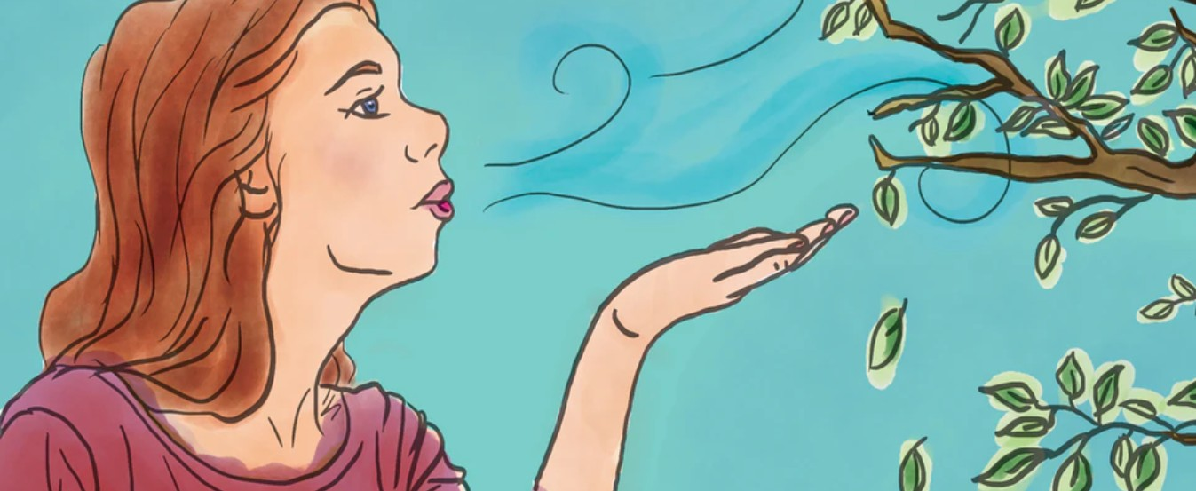
Connect with Confirmation 2020
Symbols of the Spirit
Fire, Breath, Wind, The Dove
Breath is a sign of life. All living things breathe. The Holy Spirit breathes life into us as children of God. The Holy Spirit came to you first in Baptism.
Your physical life began when you are born.
Your spiritual life began when you are baptised.
The Holy Spirit breathes new life into us at Confirmation.

Slide 10

Connect with Confirmation 2020
Symbols of the Spirit
Fire, Breath, Wind, The Dove
Wind can be strong and powerful - it can guide ships out at sea. The Holy Spirit can guide us closer to God.
Wind can destroy. The Holy Spirit can destroy sin and selfishness.
Wind can be gentle like a summer breeze. The Holy Spirit can be gentle and kind and helps us to be conscious of the needs of others .
`
Wind is refreshing. We feel refreshed when a cool wind blows on a hot summer’s day. The Holy Spirit can refresh us. If we sin the Holy Spirit can help us to make amends.
Holy Spirit, guide me, mould me, fill me with your love.

Slide 11

Connect with Confirmation 2020
Symbols of the Holy Spirit
Fire, Breath, Wind, The Dove
The dove is a symbol of peace.
The Holy Spirit brings peace into our lives.

Slide 12

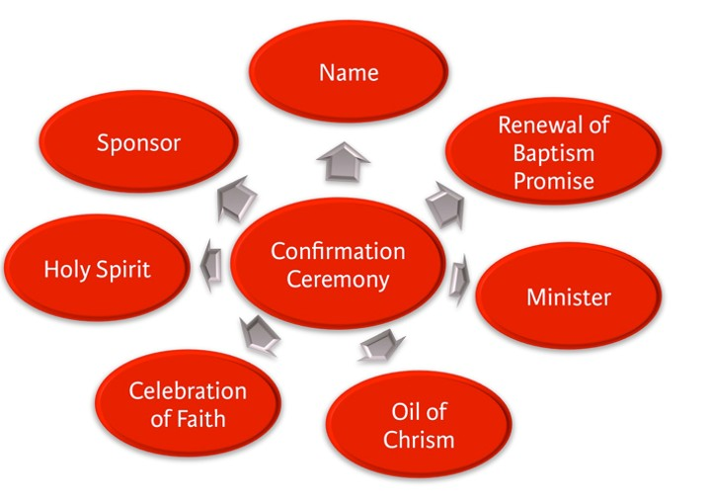
Connect with Confirmation 2020
Brainstorming!
What do I need to focus on, in preparation for the Sacrament ?

Slide 13
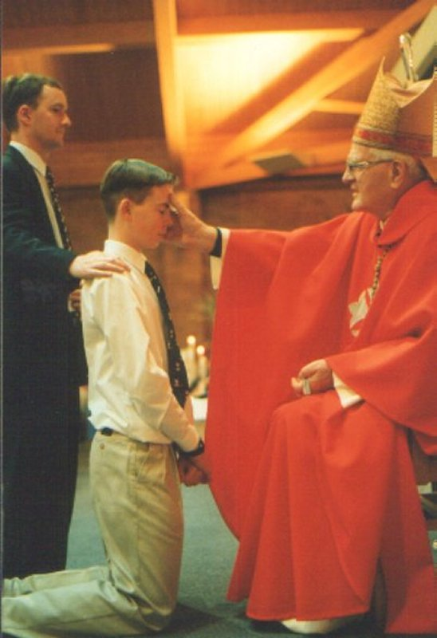
The most solemn moment of Confirmation
Connect with Confirmation 2020
“Be sealed with gift of the Holy Spirit”
I become the anointed witness of Christ

Slide 14
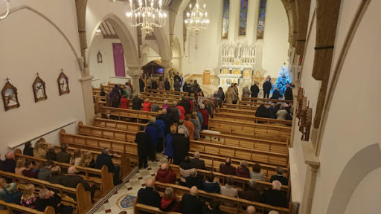
The Rite of Confirmation
Connect with Confirmation 2020
What does it involve?
The Rite of Confirmation is celebrated during the Mass.
Mass begins in the usual way and continues as normal until the Gospel.
After the Gospel everybody sits and the Confirmation ceremony itself begins.
The Confirmation ceremony is made up of four parts:
1. The Calling of Names.
2. The Renewal of Baptismal Promises.
3. The Laying on of Hands.
4. The Anointing with Chrism.

Slide 15
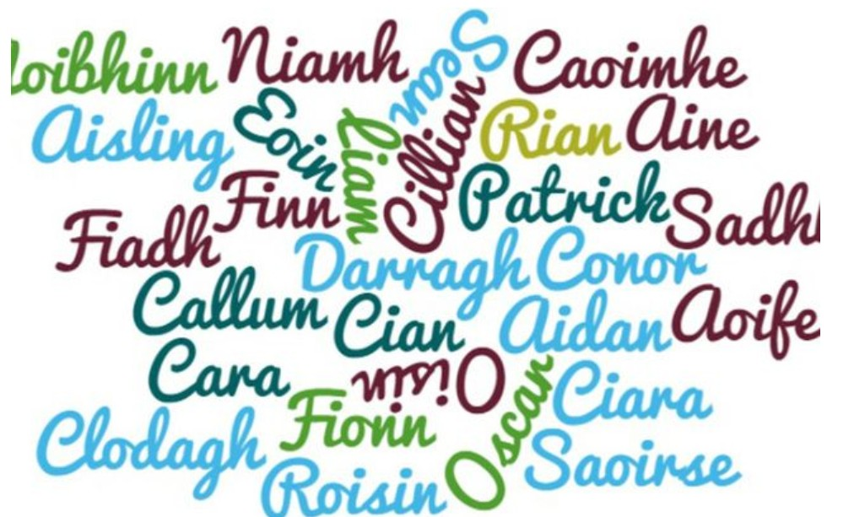
Called by Name
Connect with Confirmation 2020
A member of the community calls out the names of those to be confirmed. Each candidate stands on hearing his or her name called and remains standing until all the names have been called.
The Bishop then invites all the candidates to sit and he addresses a short homily to them on the meaning of Confirmation.

Slide 16
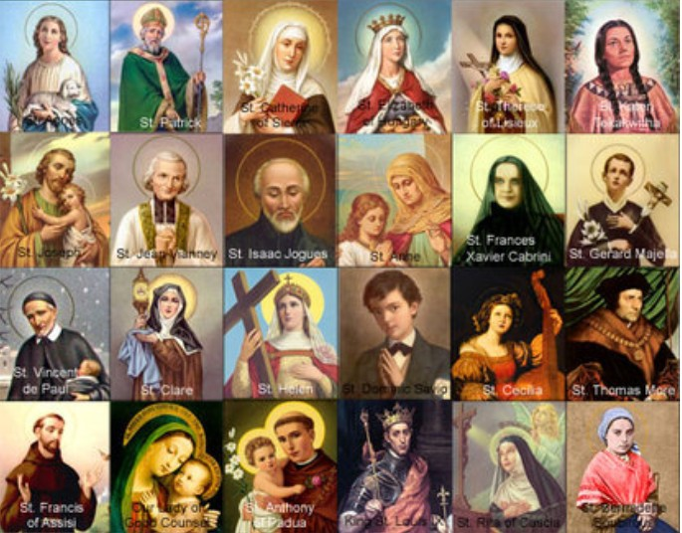
CHOOSING A CONFIRMATION NAME
Connect with Confirmation 2020
Taking a Confirmation name is a sign of starting a new life. In the Old Testament God gave new names to some of the people he called to serve him, e.g. Abram became Abraham.
Jesus also gave new names to some of the apostles whom he called to serve him, e.g. Simon became Peter and Levi became Matthew.
What saint’s name will I choose?
Click on the image for more information

Slide 17
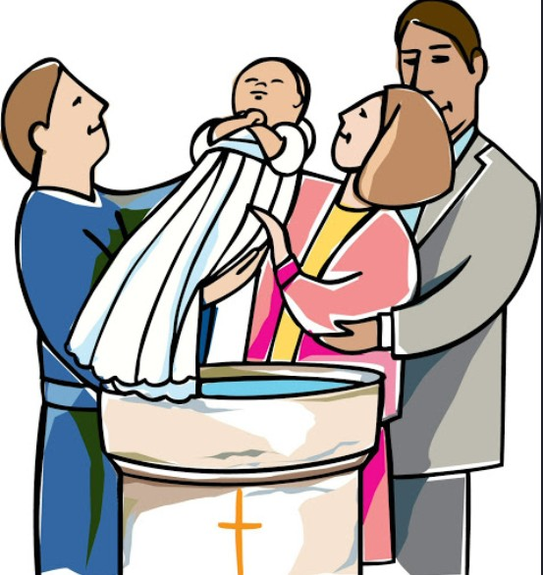

Renewal of Baptismal Promises
Connect with Confirmation 2020
The Confirmation candidate renews the promises made by their sponsors at Baptism
- to resist evil and
- to work for the spread of God’s
Kingdom in the world.
This time you make the promises yourself.

Slide 18
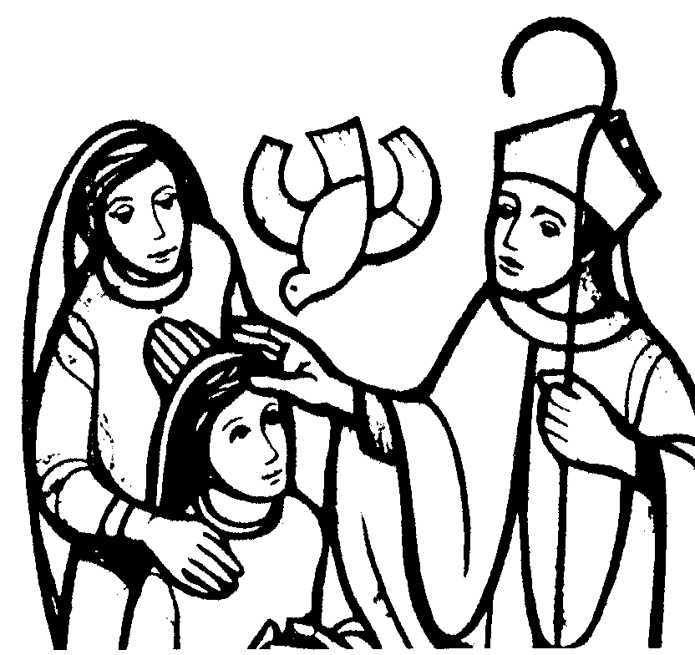
Laying on of Hands
Connect with Confirmation 2020
In Old Testament times the laying on of hands was a sign that the love of God was being given to the person being blessed.
In Confirmation, the Bishop lays his hands over you when you are being confirmed.
This is a sign that God is blessing you with the gift of the Holy Spirit. It is a sign that God is choosing you for a special mission.

Slide 19

Connect with Confirmation 2020
Laying on of Hands - Key words
“Send your Holy Spirit upon them to be their
helper and guide.
Give them the Spirit of Wisdom and
Understanding,
the Spirit of Right Judgment and Courage,
the Spirit of Knowledge and Reverence.
Fill them with the Spirit of Wonder and Awe in
your presence.
We ask this through Christ our Lord. Amen.”

Slide 20

Connect with Confirmation 2020
Anointing with chrism
Each person to be confirmed is anointed with Chrism. This anointing symbolises receiving the Holy Spirit who is strengthening you to work for Jesus Christ.
Being confirmed means being strengthened. The Bishop dips his thumb into the Chrism and then traces the sign of the cross on your forehead while he says the words:

Slide 21
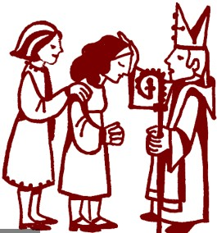
“BE SEALED WITH THE GIFT OF THE HOLY SPIRIT.”
Connect with Confirmation 2020
We say that in Confirmation we are sealed and given a special lifelong mark when we are given the gift of the Holy Spirit.
The sponsor, who presents you for your Confirmation has a special role to play to encourage you by their example to work for Jesus Christ.

Slide 22

What can I do to prepare for my Confirmation?
Connect with Confirmation 2020
Compose a prayer to the Holy Spirit seeking his help and guidance especially in your growing up years.
Taking a Confirmation name is a sign of starting a new life. In the Old Testament God gave new names to some of the people he called to serve him, eg. Abram became Abraham. Jesus also gave new names to some of the apostles whom he called to serve him, eg. Simon became Peter and Levi became Matthew.
Research and compile the life story of the saint’s name you have chosen for Confirmation and indicate your reasons for choosing this name.

Slide 23
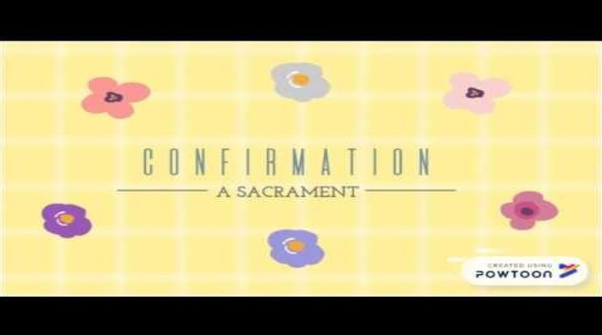
Click below to review what’s done!:
Connect with Confirmation 2020
Make sure you are online!

Slide 24
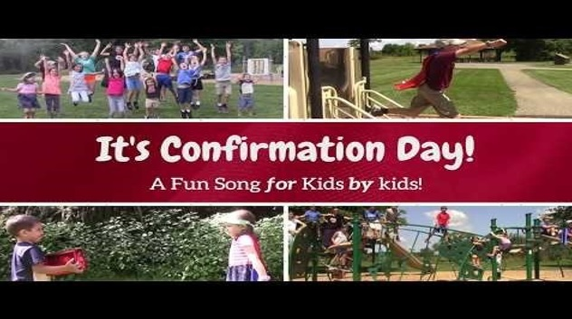
Looking Forward to Celebrating My Special Day! Click the image:
Connect with Confirmation 2020
Make sure you are online!

Slide 25

Thank you for your participation
Please click on the following link to complete a questionnaire.
https://docs.google.com/forms/d/e/1FAIpQLSe5ZBozGpVgxflQBAOi6BFIjtXBKHzf2AOqMzySn-v1_ys_gA/viewform?usp=sf_link

