Slide 1
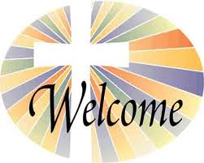
Celebrating Confirmation 2020
Come Holy Spirit, fill the hearts of your faithful.
Enkindle in us the fire of your love.
Send forth your Spirit, and we shall be created,
And you shall renew the face of the earth.
Amen.
Notes:
Together in prayer, we invite the Holy Spirit into our lives.

Slide 2
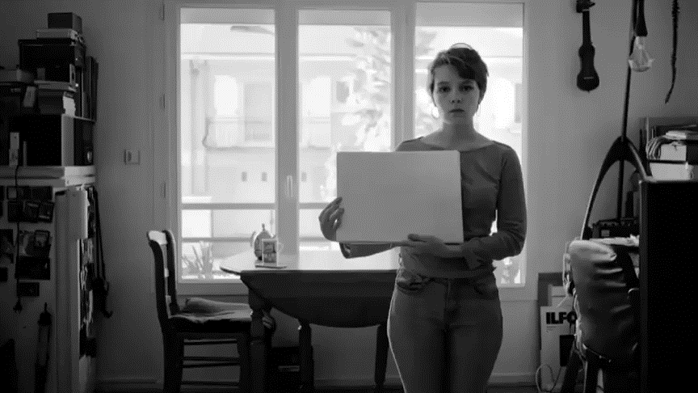
.........we must work together and trust in God.
Listen carefully to the lyrics of the following song: https://www.youtube.com/watch?v=bUZIp_PKeZ0
Celebrating Confirmation 2020
During Tough Times
Notes:
This song reminds us some of the challenges which the Corona Virus has brought into our lives. What does it remind us is important?
The lyrics go “don’t give up on your faith, together we will get through the dark. How might your faith help you?
Now we will learn more about our faith and when we were firt welcomed into the family of god through Baptism.

Slide 3
Why Confirmation ?
Celebrating Confirmation 2020
The sacrament of Confirmation confirms to each of us that we can make a difference in our world today.
Notes:
Confirmation is a sacrament of choice. Invite participants to suggest why they might wish to receive this sacrament.

Slide 4
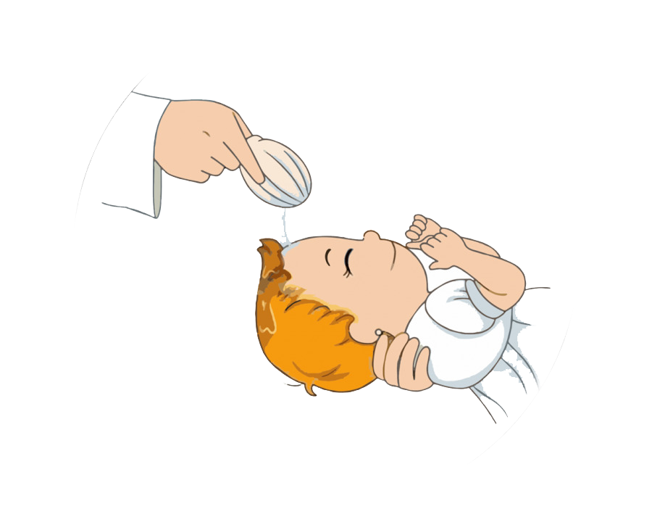

Celebrating Confirmation 2020
This great Sacrament is when the Holy Spirit, comes to you in a new way to CONFIRM what you have already received at Baptism.
Despite all the upset we are experiencing now, you will soon be making your Confirmation!

Slide 5



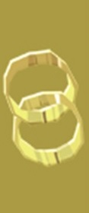


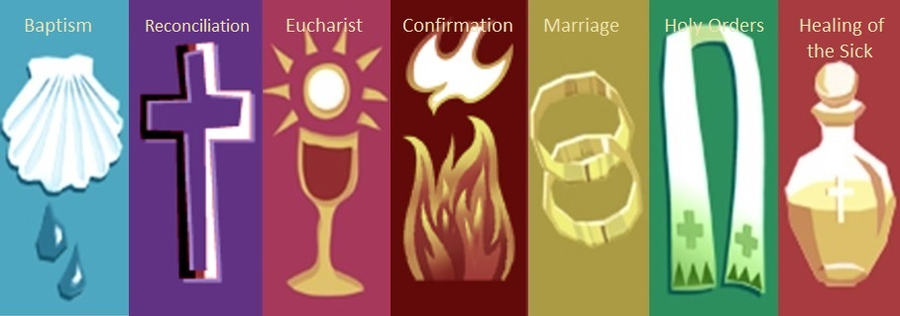
There are seven Sacraments altogether.
They mark important highlights in our lives.
Check to see do you know them……..
Celebrating Confirmation 2020
The Seven Sacraments
Recheck! Baptism, Reconciliation, Eucharist, Confirmation, Marriage, Holy Orders, Anointing & Healing of the Sick.

Slide 6
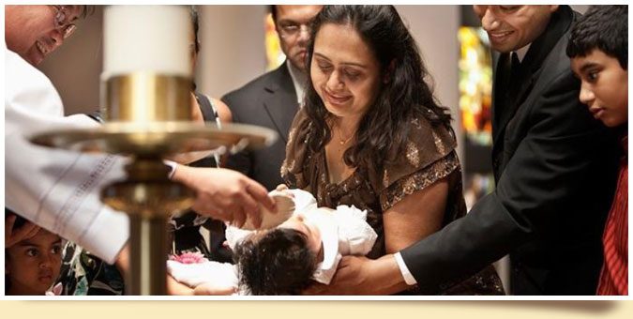
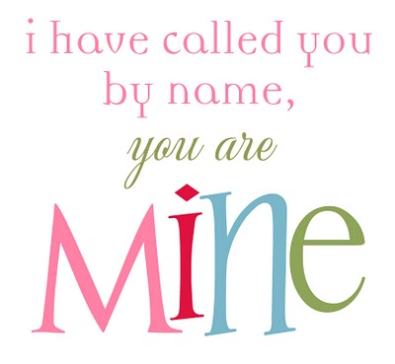
Celebrating Confirmation 2020
You were first called into the family of God
through your Baptism.
Jesus Himself was baptised by John the Baptist in the River Jordan.
Notes:
God has given them a gift of choice as a sign of His love. This is called ‘free will’. You may well have experienced them ‘playing with free will’.! This is a natural part of growing up.
Through preparation for the Sacrament of Reconciliation, your child will gradually realise that when we are kind, merciful, and compassionate we become more like Jesus.
We Pray to God to help us to make good choices.
Jesus and others forgive and your child is called to be forgiving – even when this is difficult.
How can you help your child to be forgiving with friends and family, and in their school relationships?

Slide 7
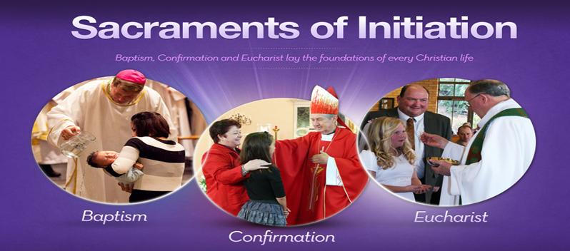
Celebrating Confirmation 2020
Sacraments of Initiation
make us full members of the Church family.
Notes:
God has given them a gift of choice as a sign of His love. This is called ‘free will’. You may well have experienced them ‘playing with free will’.! This is a natural part of growing up.
Through preparation for the Sacrament of Reconciliation, your child will gradually realise that when we are kind, merciful, and compassionate we become more like Jesus.
We Pray to God to help us to make good choices.
Jesus and others forgive and your child is called to be forgiving – even when this is difficult.
How can you help your child to be forgiving with friends and family, and in their school relationships?

Slide 8

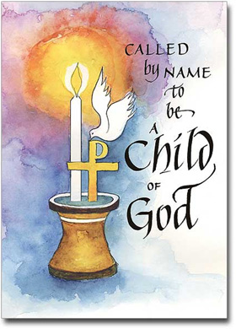
Celebrating Confirmation 2020
My Faith Journey
It began with my Baptism when
I received the Holy Spirit for the First Time
I am forgiven in Reconciliation and try to be better.
I am nourished by the Eucharist at Mass.
I will be strengthened by the Holy Spirit at my Confirmation.
Notes:
God has given them a gift of choice as a sign of His love. This is called ‘free will’. You may well have experienced them ‘playing with free will’.! This is a natural part of growing up.
Through preparation for the Sacrament of Reconciliation, your child will gradually realise that when we are kind, merciful, and compassionate we become more like Jesus.
We Pray to God to help us to make good choices.
Jesus and others forgive and your child is called to be forgiving – even when this is difficult.
How can you help your child to be forgiving with friends and family, and in their school relationships?

Slide 9
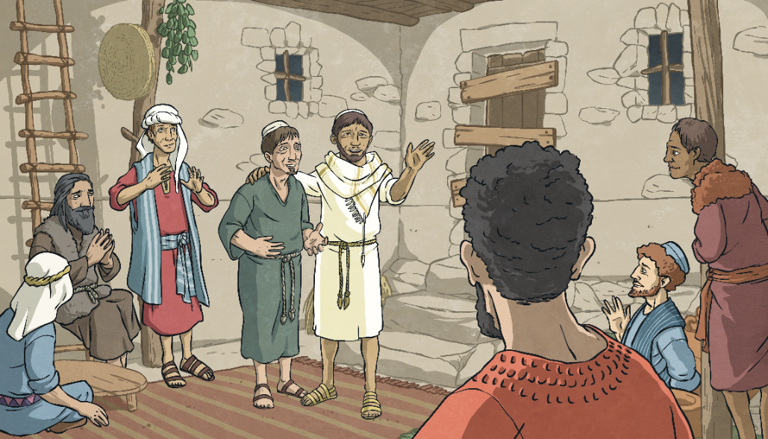

God’s Gift
Celebrating Confirmation 2020
After Jesus’ resurrection from death, after the crucifixion, he remained among his friends and family for forty days.
Click the flame for more information
Think About It
Why might the disciples need help spreading the message of God’s love?

Slide 10
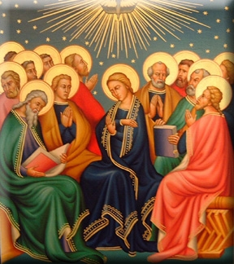
Celebrating Confirmation 2020
After Jesus died, God promised to send the Holy Spirit to his friends, the Disciples.
At Pentecost, the Church’s birthday, the Holy Spirit was given to the Disciples.
They became the new Church Family, helped by the Holy Spirit.

Slide 11
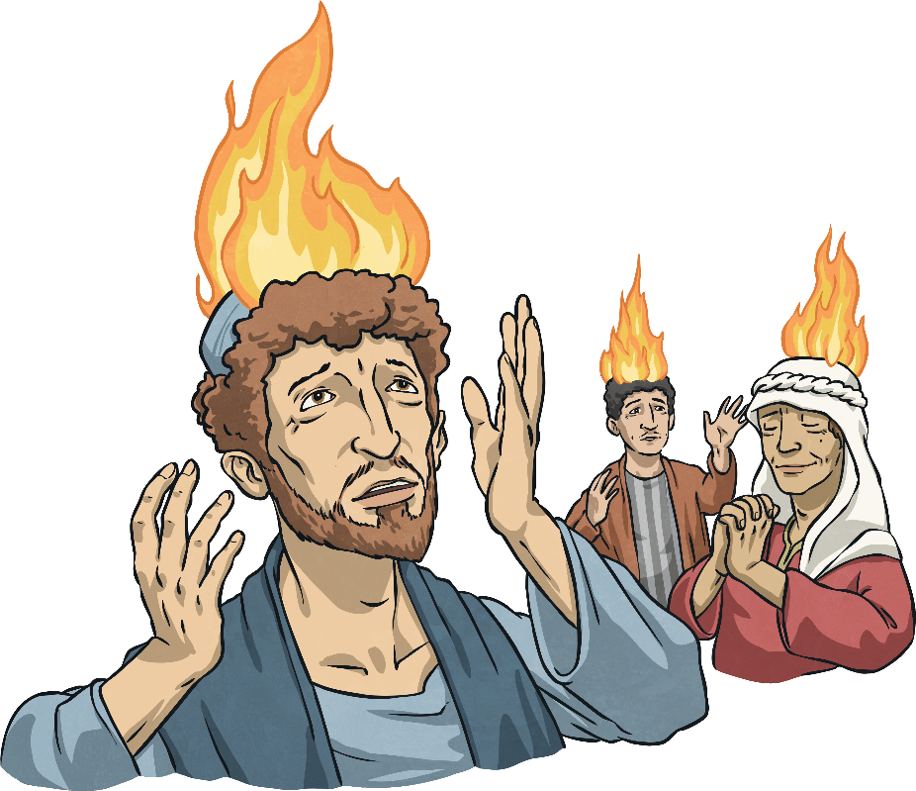
the Gift Arrives
Celebrating Confirmation 2020
Click the flame for more information
Suddenly, the room was filled with the sound of a violent wind! Tongues of fire appeared and came to rest above each person’s head, but no one was burned!
Each of the disciples was filled with the Holy Spirit.

Slide 12
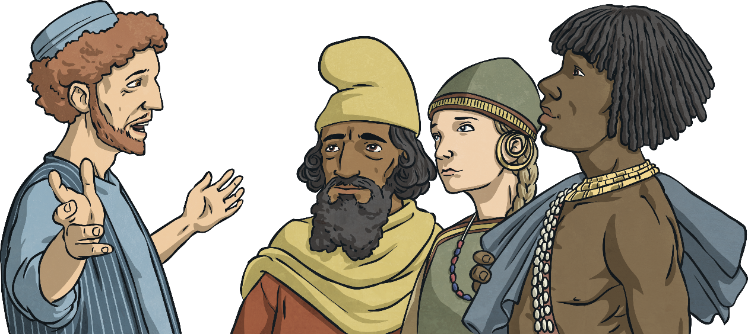

The Gift of the Holy Spirit
Celebrating Confirmation 2020
The disciples were talking away and their voices carried out into the streets. Jerusalem was full of people from many different countries at that time and they were amazed to realise that they could understand what the disciples were saying in their own language.
Fellow Jews and all who are in Jerusalem. Jesus was crucified and rose from the dead. You must all repent and be baptised for the forgiveness of your sins, then you too will receive the gift of the Holy Spirit!
Peter appeared and spoke to the people:
(Click on Peter)
Click the flame for more information
Discuss It
How might the disciples be feeling at this time? Why?

Slide 13
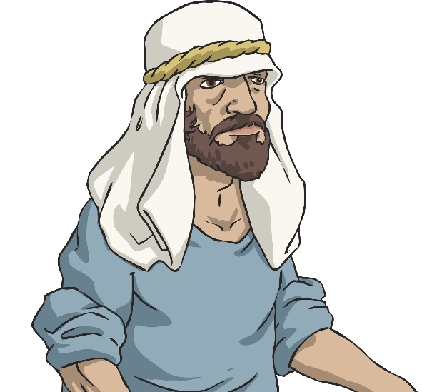
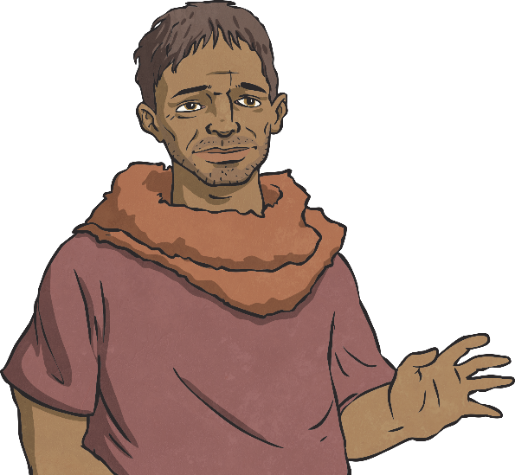
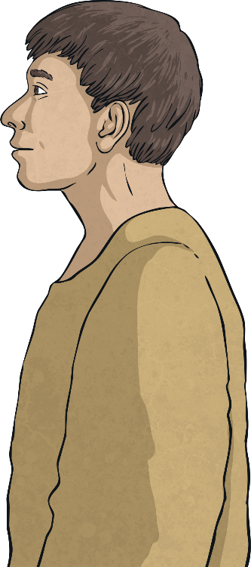
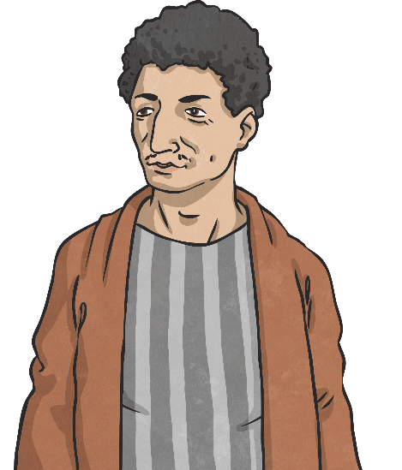
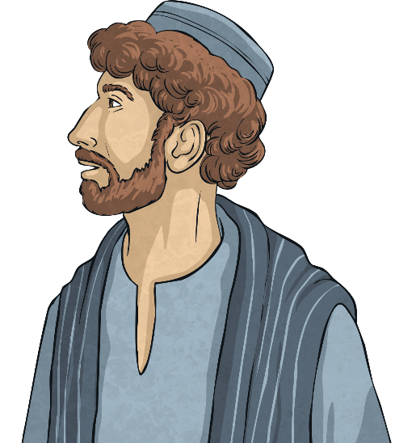
Spreading God’s Message
Celebrating Confirmation 2020
Suddenly, the disciples realised they could speak different languages! The Holy Spirit enabled them to speak different languages and they were amazed!
Hej!
Hola!
Γεια σου!
Bonjour!
Merhaba!
Click the flame for more information
Discuss It
Why was it necessary for the disciples to be able to speak different languages to spread God’s message?

Slide 14
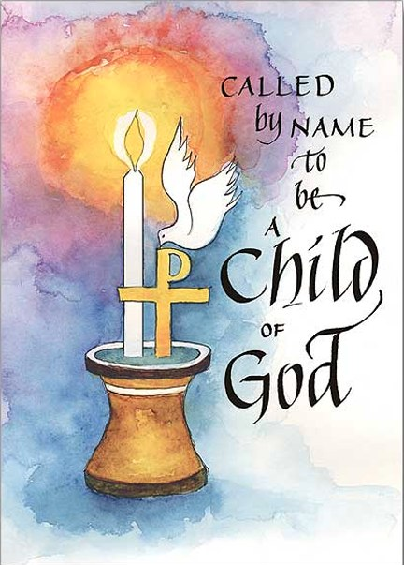
Celebrating Confirmation 2020
The Holy Spirit is sent to us too, as friends of Jesus, through the sacraments of Confirmation and
………………. ?
……….. Baptism!
The gift of the Holy Spirit lasts forever.

Slide 15
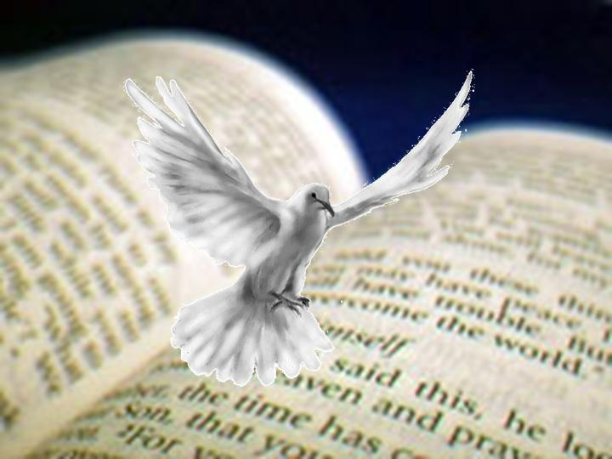
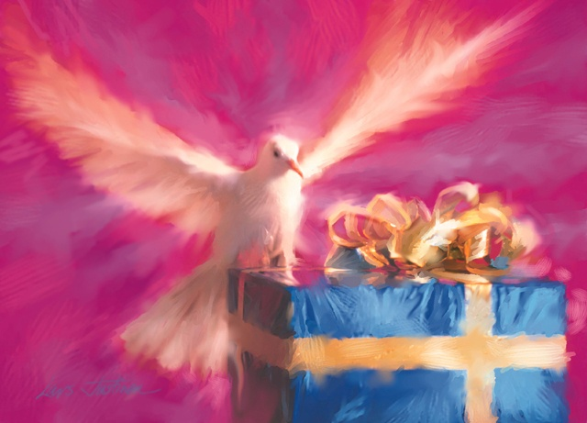
Celebrating Confirmation 2020
The Holy Spirit teaches us how to live well.
The Holy Spirit speaks to us through scripture - The Word of God.
The Gifts of the Holy Spirit can help us in our lives right now and can also help us to live as followers of Jesus in the future

Slide 16
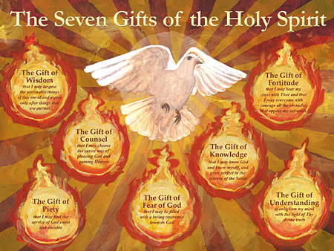
Gifts of the Holy Spirit
Celebrating Confirmation 2020
Wisdom
Let us judge things in the way that God does
Right Judgement
This gift helps us to know what to do especially when faced with really difficult situations
Understanding
The gift that helps us to understand all that God has told us
Courage
This gives us the strength to do what is right no matter how hard
Reverence
This gift gives us the power to love God and our neighbour as we should
Knowledge
This lets us see the world as it really is
Wonder and Awe in God’s Presence
This gives us the power to remember the greatness of God and consequently gives us a horror of offending God who has loved us so much

Slide 17
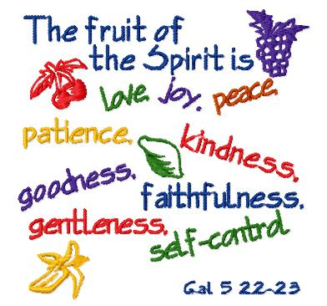
Celebrating Confirmation 2020
The 9 fruits of the Holy Spirit
The seven gifts of the Holy Spirit
can bear
9 fruits
in my life if I use them wisely.

Slide 18
Celebrating Confirmation 2020
Remember:
CONFIRMATION is about:
Choice
Commitment
Initiation
growth
maturity
courage,
preparation for life
the fullness of the Holy Spirit
spiritual gifts which can bear fruit in our daily lives
“Be sealed with the gift of the Holy Spirit”.

Slide 19
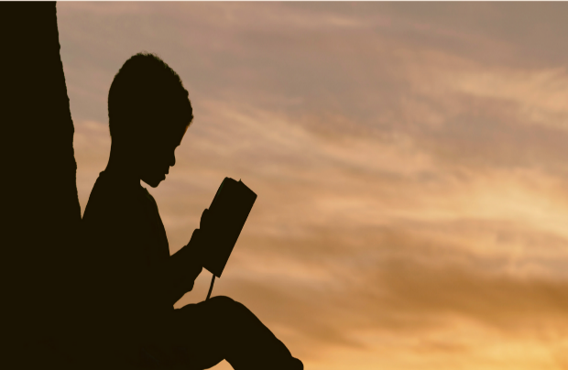
Celebrating Confirmation 2020
The Holy Spirit can help us to
give WITNESS, in our everyday lives:
* to our Faith, in what we believe.
* to speak courageously
Remember: We might feel afraid
right now, but we are not
alone. The Holy Spirit
gives us the gifts
that we
need.
* to be honest

Slide 20
Come Holy Spirit,
Bring me today,
Love joy and peace, in all that I say.
Come Holy Spirit,
Help me to be like you,
Showing Goodness and Kindness In all that I do
Come Holy Spirit

Slide 21

Celebrating Confirmation 2020
Watch Bishop Kevin’s video message to you
https://youtu.be/v4fwjKjYdjc
Make sure you’re on line !

Slide 22
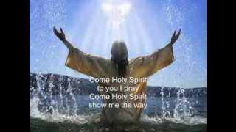
https://youtu.be/K_WOFqap0oM
Click on the above link
Celebrating Confirmation 2020
Reflection
RRl

Slide 23
Today’s Challenge
Celebrating Confirmation 2020
Design a poster for the sacrament of Confirmation, which displays all the 7 gifts or Write and decorate a simple prayer “Come Holy Spirit” to display in your home.
Take a snapshot of it and email it to mhprojectconfirmation@gmail.com
We can display your work during our next session.
Remember this work is for display, so make it pleasing to the eye as well as informative!
Please complete the questionnaire on this link:
https://docs.google.com/forms/d/e/1FAIpQLScEpB2kvpPrjTcHANVwXc_YKhKQY6gXxEH9j1EeB2ZjTKskTg/viewform?usp=sf_link
Thank You.

Slide 24
How do you think you did today?
Celebrating Confirmation 2020
Draw a ‘green’ traffic light if you think you really understood
today’s lesson.
Draw a ‘red’ traffic light if you really don’t understand and would like some extra help.
Ask your parents to go over the power point with you again,
Draw a ‘yellow’ traffic light if you think you are beginning to understand, or need a little more help.

