Slide 1
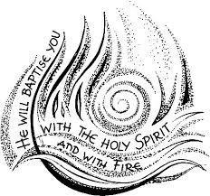
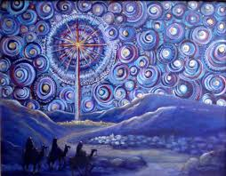
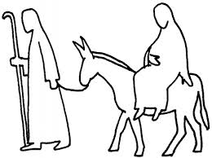
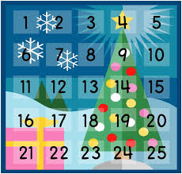
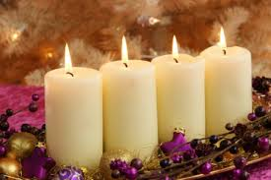
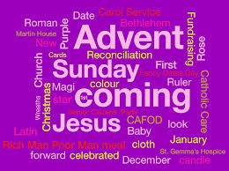
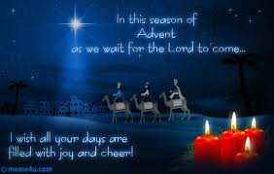
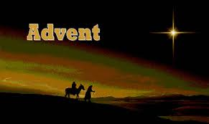
Advent

Slide 2
What is Advent?
Advent is a time of preparation.
What does that mean?
Who are we as Christians preparing for?
What are we preparing for?
Why is preparation needed?
How do we prepare for Christmas?
How should we be preparing for the coming of Christ?
Should this preparation only be taking place in Advent?
Notes:
Key Questions. Note class responses in big book. Why is the liturgical colour of advent purple? Is this suitable? Why?

Slide 3
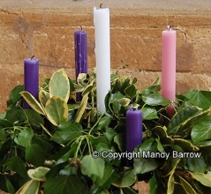
Advent Wreath
The Candle of Peace-
The Old Testament Prophets
Peace is like a light shining in a dark place. As we look at the candle we celebrate the peace we find in Jesus Christ.
2. The Candle of Love- John the Baptist
Love is like a light shining in a dark place. As we look at this candle we celebrate the love we have in Jesus Christ.
Notes:
Create an advent wreath. Sketch wreaths and label ensuring symbolism is made clear.

Slide 4
3. The Candle of Joy- Mary the Mother of Jesus
Joy is like a light shining in a dark place. As we look at this candle we celebrate the joy we find in Jesus Christ.
4.The Candle of Hope- God’s People
This candle his a light shining in a dark
place. As we look at the candle we celebrate the hope we have in Jesus Christ.
5. The final candle represents the birth of Jesus Christ. The flame of this candle reminds us that He is the light of the world and that if we follow Him, we will never walk in darkness, but will have the true light of life.

Slide 5
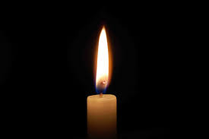
Imagine that the Church is full. It is midnight, it is dark and the only light is coming from the Advent candles. The central candle is lit. How does this moment remind people of the true meaning of Christmas?
How do the people feel?
Is it silent or do they say something to each other?
What might they sing?
Notes:
Description of the scene.

Slide 6
First: The Prophets
Who were they?
What did they do?
Read the chapters/verses given. How do these prophecies relate to Christmas and Jesus?
How did Jesus fulfil these prophecies?
Notes:
Look at prophecies from Isaiah and Mica. What do these show/say/mean?

Slide 7
Second: John the Baptist
What is his story? Luke Chapters 2 and 3, Mark Chapter 1
Who was John?
What did he look like?
What did he do?
Notes:
Read stories about John the Baptist as well as passages from Luke and Mark.

Slide 8
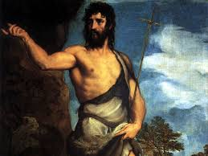
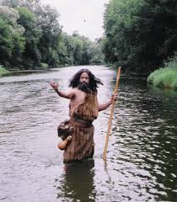
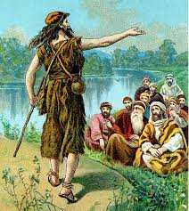
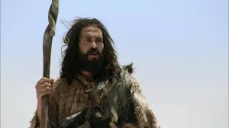
John the Baptist

Slide 9
How do we prepare for the arrival of someone special?
Who heralds the way of someone special today?
Notes:
Discussion-note responses in Big Book.

Slide 10
The Holy Land
Sea of Galilee
River Jordan
Jerusalem
Dead Sea

Slide 11
If John was here today from what would he be calling people to repent?
Notes:
Write an internal monologue of John

Slide 12
Can you imagine people queuing up to be baptised in the local river? Why? Why not?
Do you know anyone who has been baptised in a river, lake or the sea?
Notes:
Record responses in Big Book.

Slide 13
Jesus’ Baptism

Slide 14
Third: Mary Mother of Jesus
What do you know about Mary?
When is she mentioned in the Bible?
What did she do after Jesus was crucified?
Mary was at the Ascension, what did she do next?
What sort of person was she? What did she look like?
Why is Mary important?
What was the conversation between Mary and Gabriel?
Notes:
Record Responses in Big Book. Ask a Catholic in to discuss how and why Mary is so important to them.

Slide 15
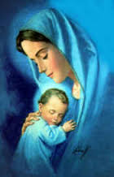
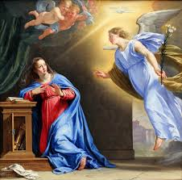
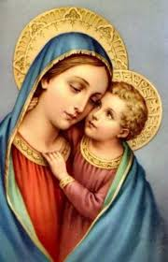
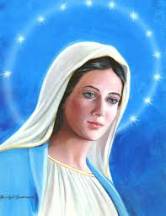
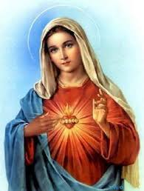

Slide 16
Imagine being Mary watching Jesus grow up. What do you think she would remember most?
Imagine being Mary hearing about Jesus’ teaching and miracles, how would she feel?
Notes:
Create a photo album/diary of Mary as Jesus grows up.

Slide 17
Fourth: The People of God
Who are the people of God?
What do they pray for in Advent?
Notes:
Record responses in Big Book.

Slide 18
Advent Collect
Almighty God, give us grace to cast away the works of darkness and to put on the armour of light, now in the time of this mortal life, in which your Son Jesus Christ came to us in great humility; that on the last day, when he shall come again in his glorious majesty to judge the living and the dead, we may rise to the life immortal; through him who is alive and reigns with you, in the unity of the Holy Spirit, one God, now and for ever
Notes:
Discussion- what do these collects all remind us of? Why?

Slide 19
Advent Collect
Almighty God, as your kingdom dawns, turn us from the darkness of sin to the light of holiness, that we may be ready to meet you in our Lord and Saviour, Jesus Christ

Slide 20
Advent Collect
God our redeemer, who prepared the Blessed Virgin Mary to be the mother of your Son: grant that, as she looked for his coming as our saviour, so we may be ready to greet him when he comes again as our judge; who is alive and reigns with you, in the unity of the Holy Spirit, one God, now and for ever.

Slide 21
Hopes for the future – what is hope?
What does it mean to hope for something?
What do the people of God hope for?
What do the children hope for?
What are their dreams for the future? Why?
What are appropriate hopes and dreams?
Notes:
Record in Big Book.

Slide 22
What about the hopes and wishes God has for his people?
What might they be?

Slide 23
Advent is a time to reflect on who we are and what God has planned for our lives.

Slide 24
Design an advent calendar that reflects the true meaning of Christmas and the themes of the season of Advent.

